Slide 1
Lesson 1 Photo Cards
Photos are credited where appropriate; otherwise from the Creative Commons.

Slide 2
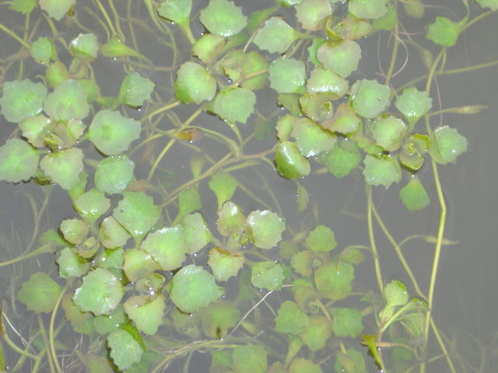
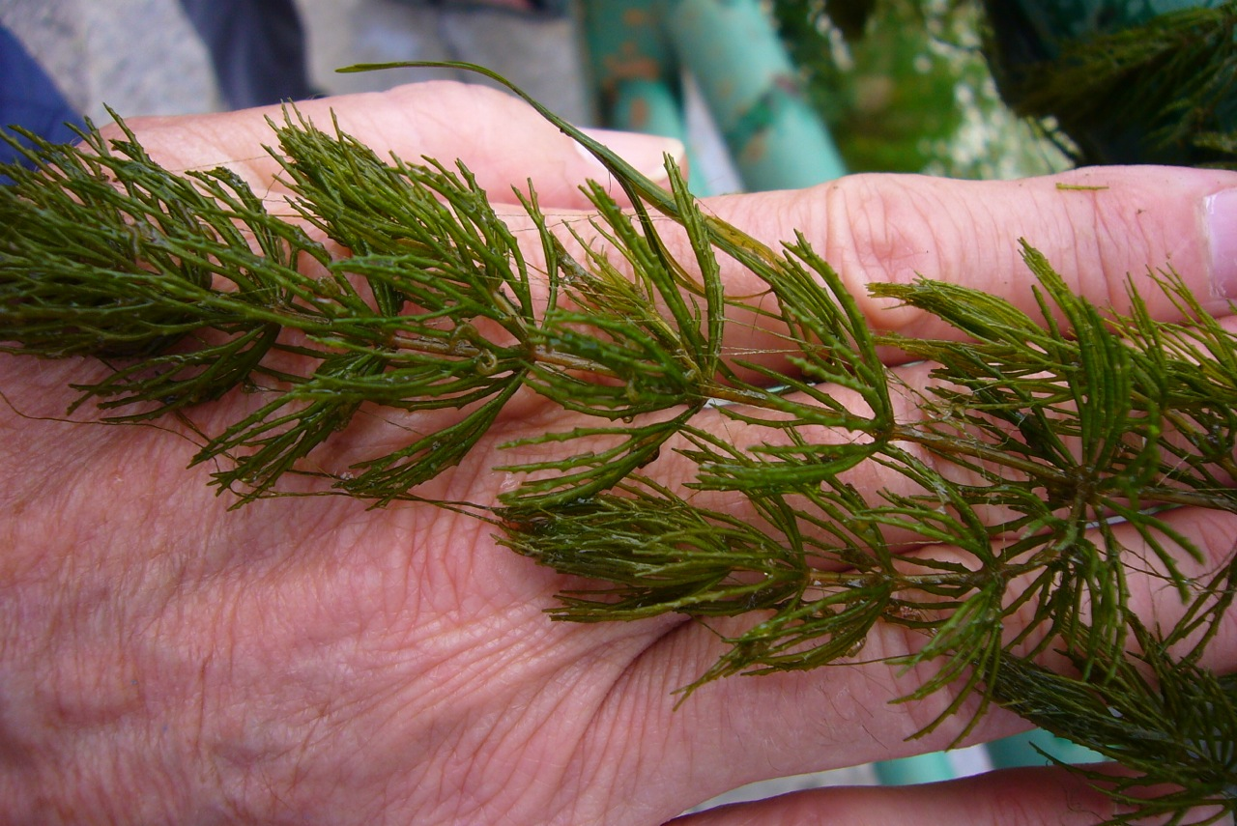
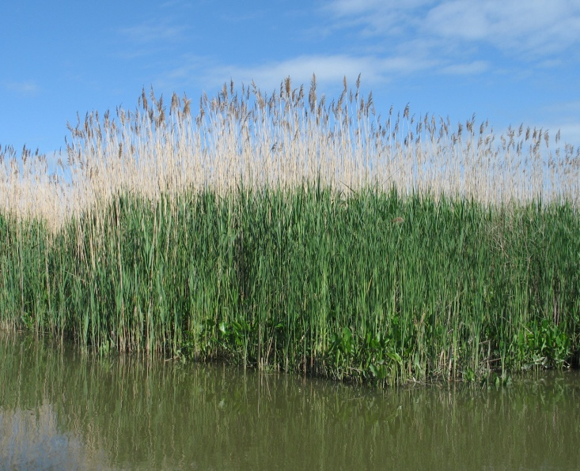
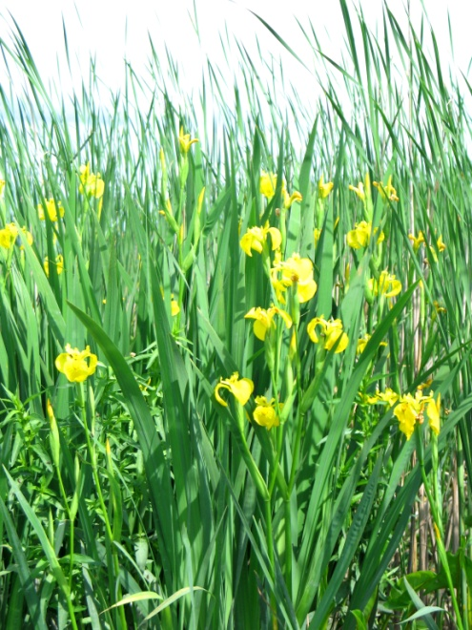
*Photo courtesy of Steve Stanne.
*Photo courtesy of Steve Stanne.
*Photo courtesy of Steve Stanne.

Slide 3
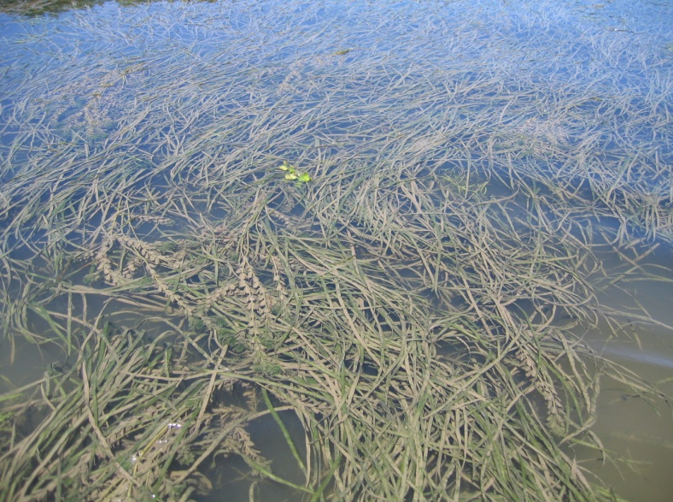
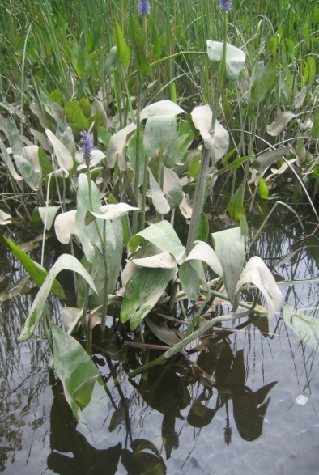
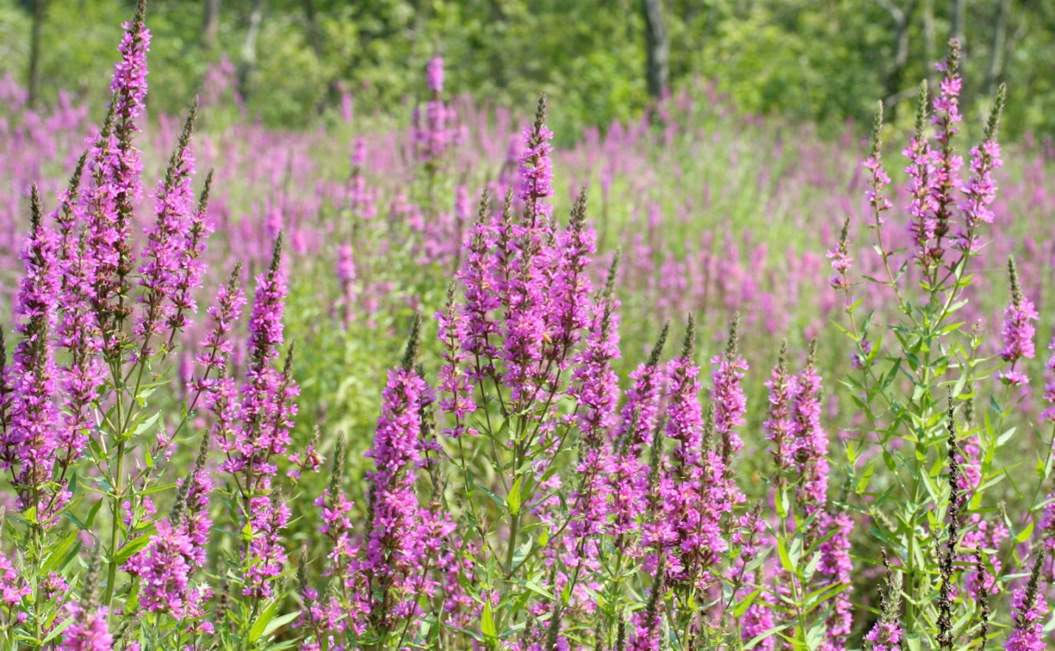
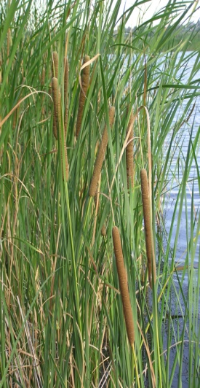
*Photo courtesy of Steve Stanne.
*Photo courtesy of Steve Stanne.

Slide 4
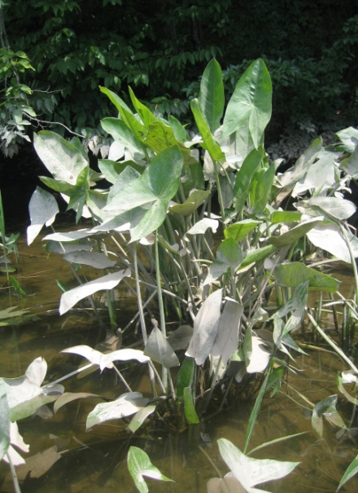

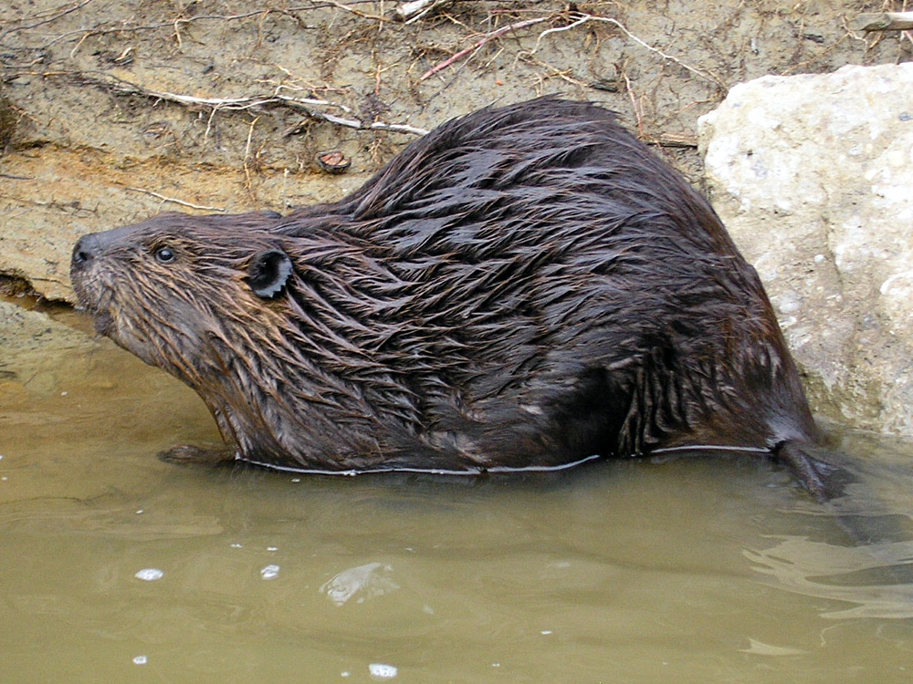
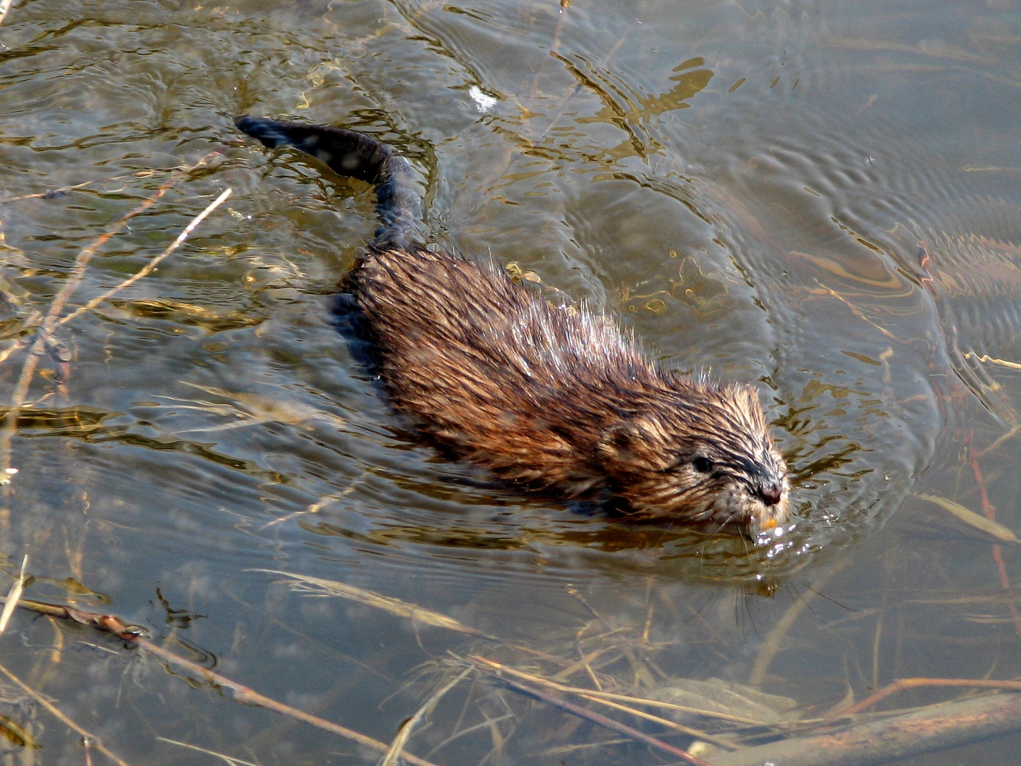
*Photo courtesy of Steve Stanne.
*Photo courtesy of Steve Stanne.

Slide 5
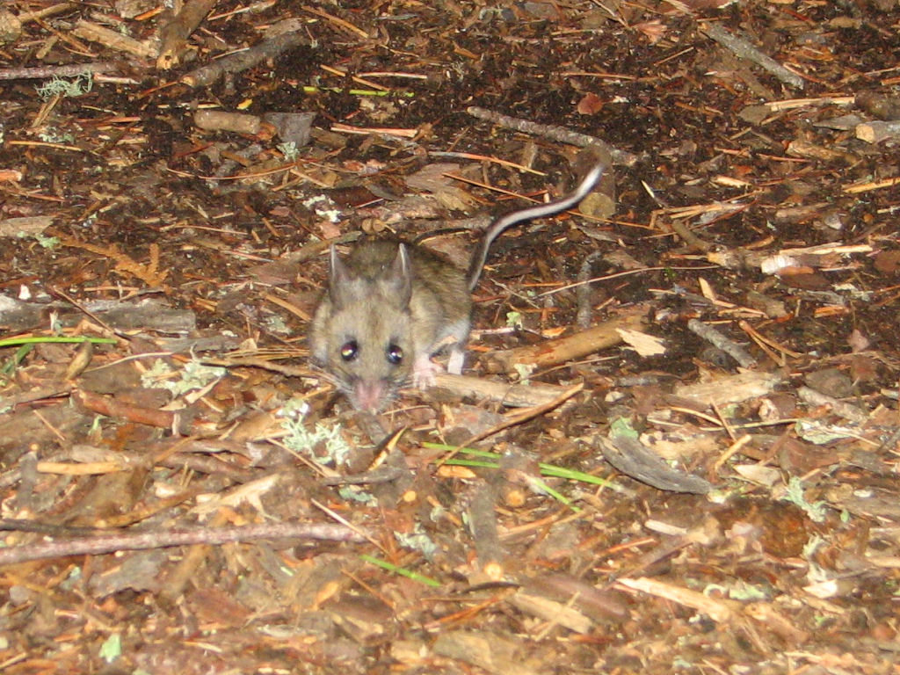
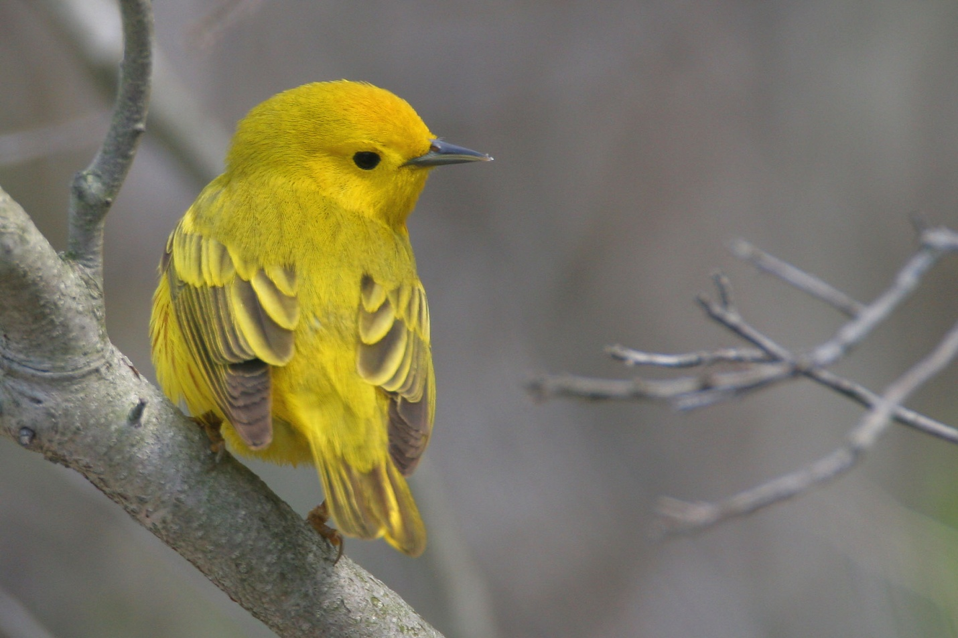
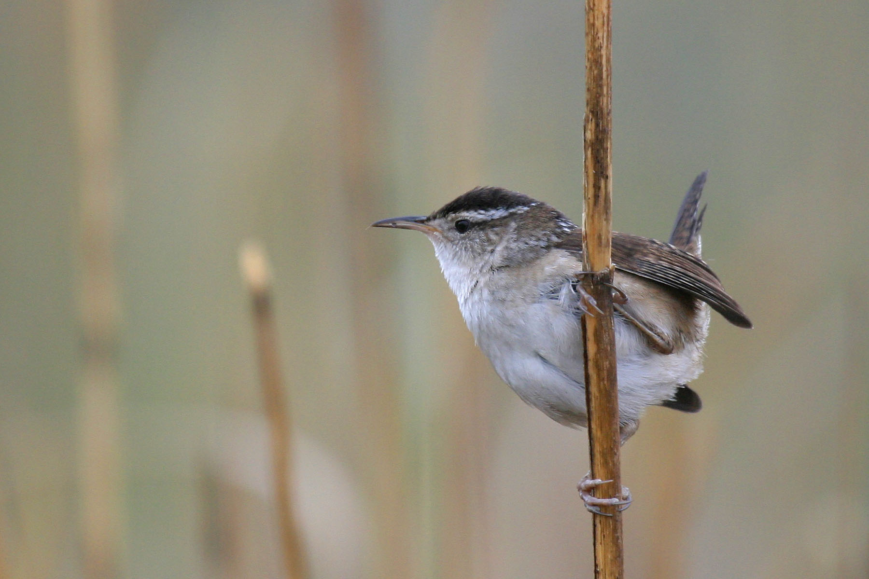
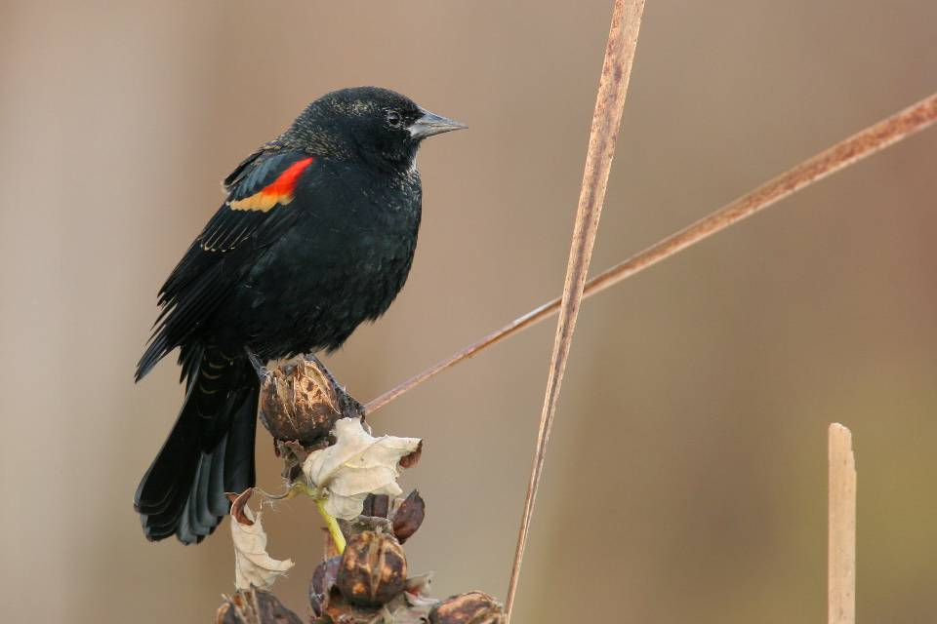
*Photo courtesy of Alan Wells.
*Photo courtesy of Alan Wells.
*Photo courtesy of Alan Wells.

Slide 6
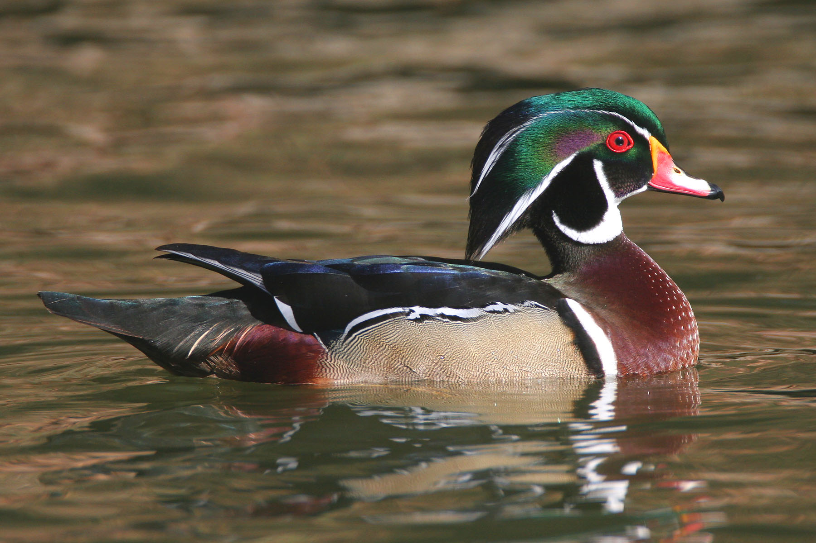
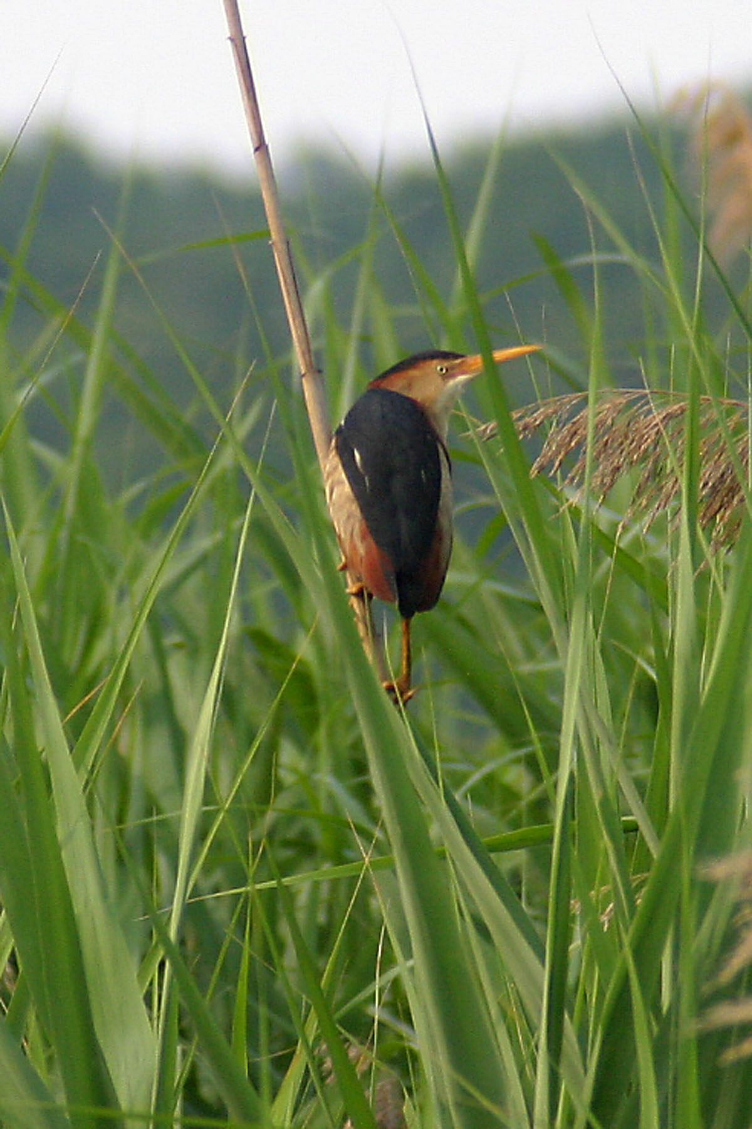
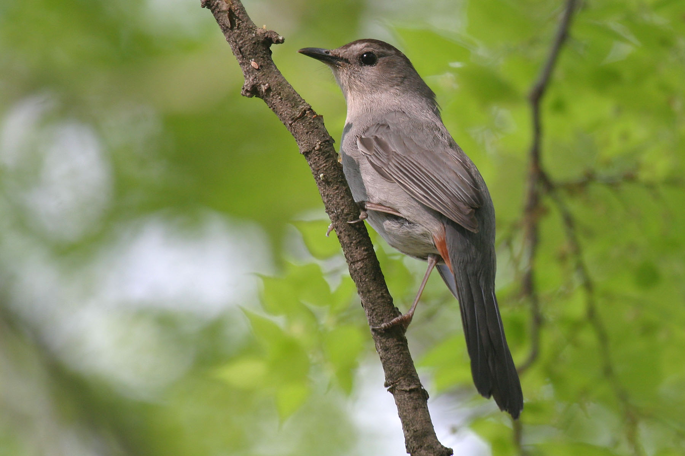
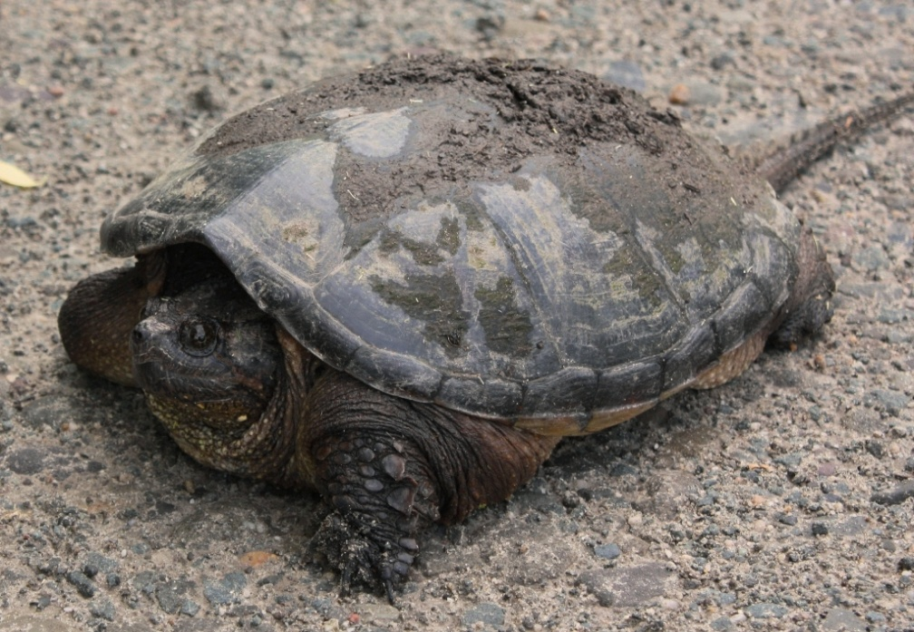
*Photo courtesy of Alan Wells.
*Photo courtesy of Alan Wells.
*Photo courtesy of Alan Wells.
*Photo courtesy of Steve Stanne.

Slide 7
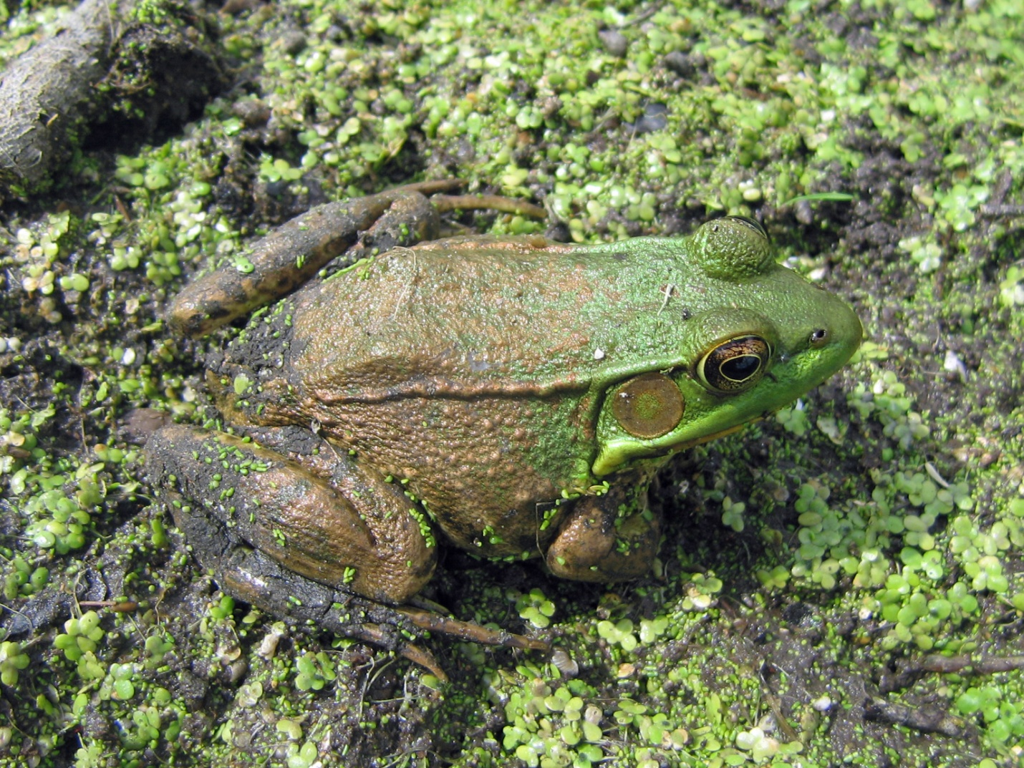
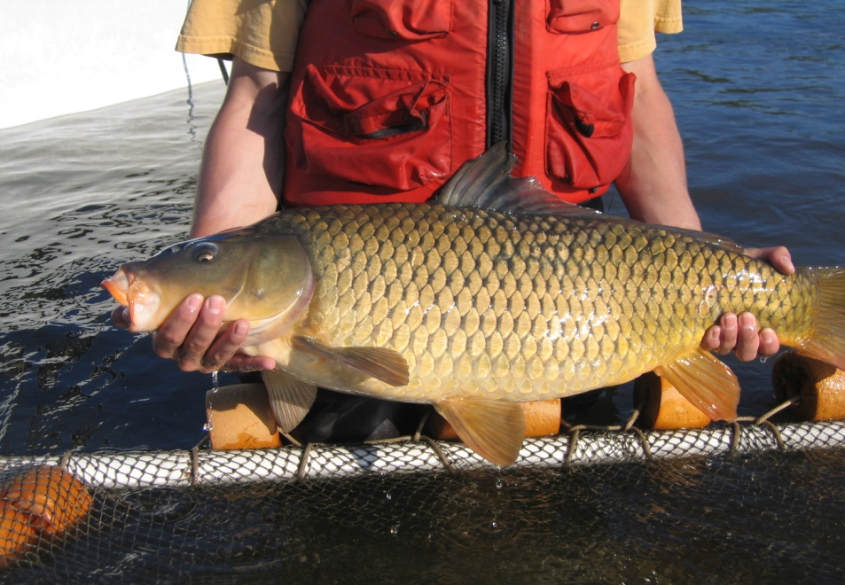
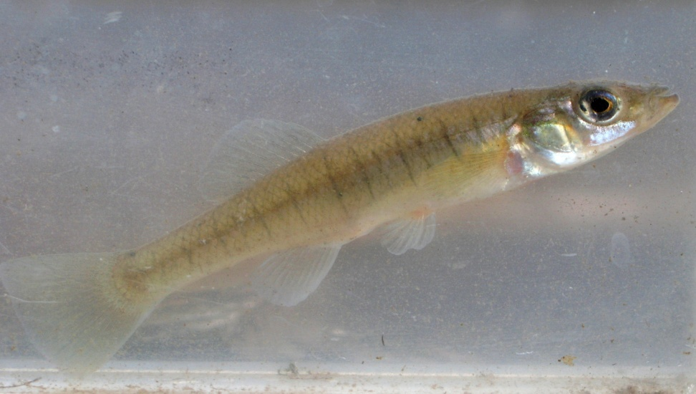
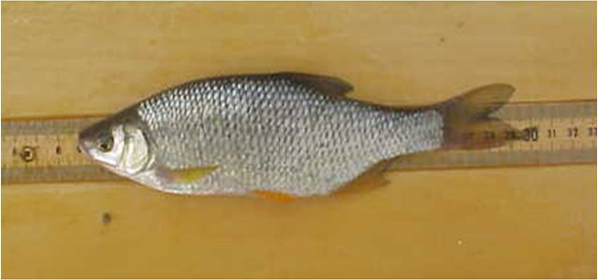
*Photo courtesy of Steve Stanne.
*Photo courtesy of Steve Stanne.
*Photo courtesy of Steve Stanne.

Slide 8
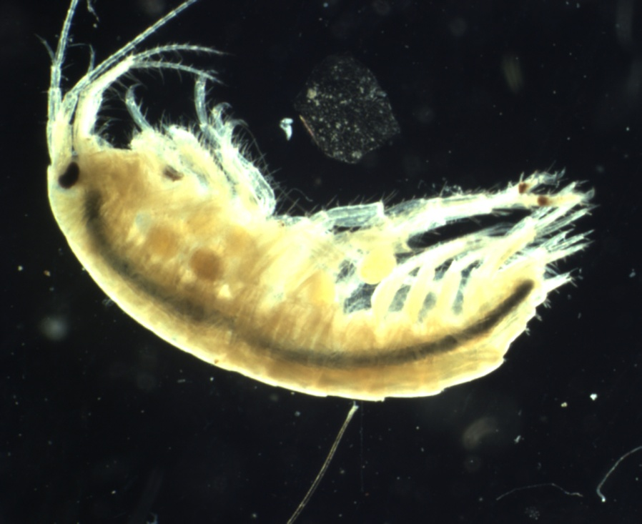
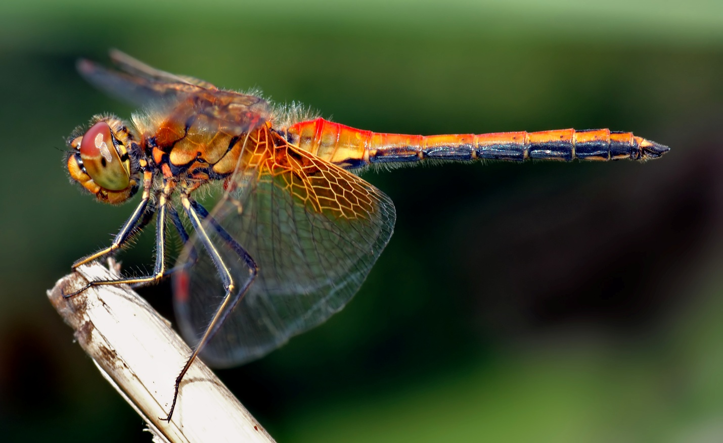
*Photo courtesy of Steve Stanne.

