Slide 1
Changes in a Marsh: Iona Island
1991-2005
Photos by Alan W. Wells
Virgina Rail photo by Matthew White

Slide 2
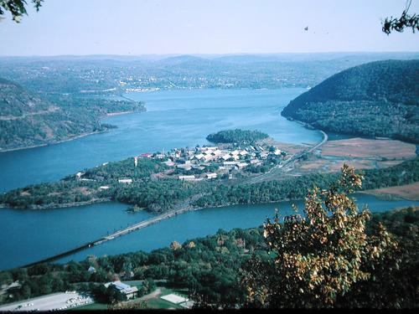
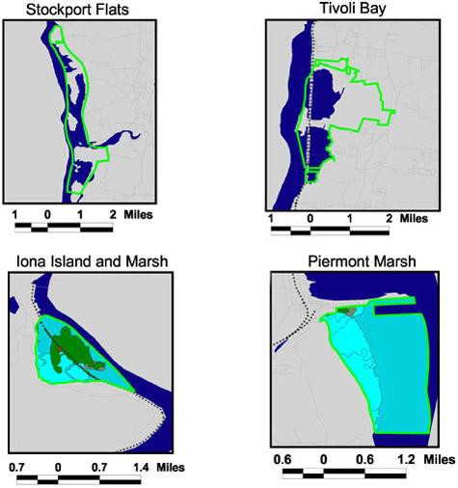
Iona Island
Source: www.panoramio.com
The Island has been designated a National Natural Landmark and is one of four sites which are part of the Hudson River National Estuarine Research Reserve.

Slide 3
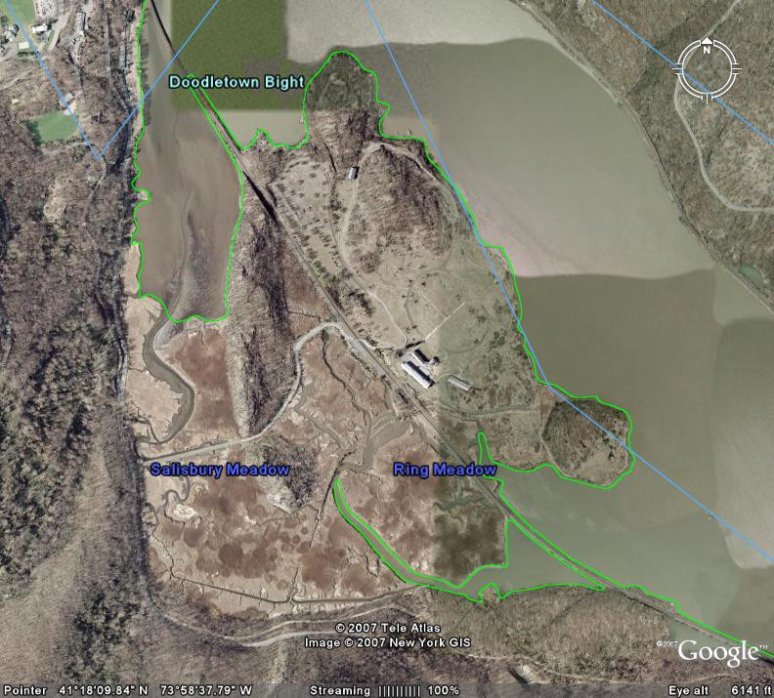

Slide 4
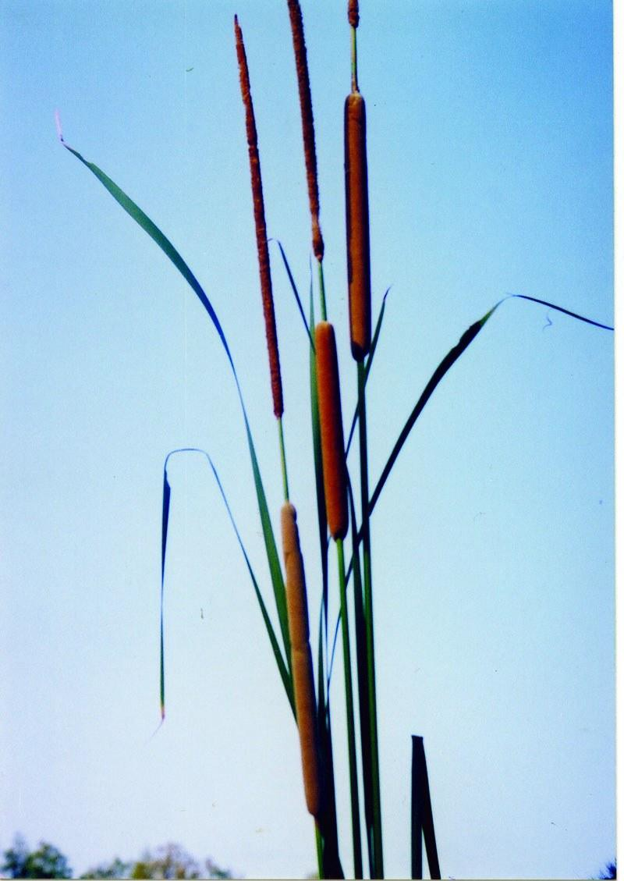
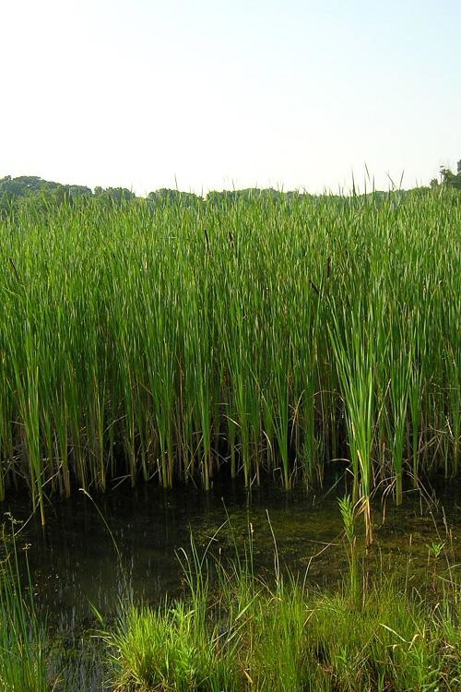
Common native marsh plant, cattail (Typha angustifolia)
Source: http://flora.huh.harvard.edu
Source: www.tncweeds.ucdavis.edu

Slide 5
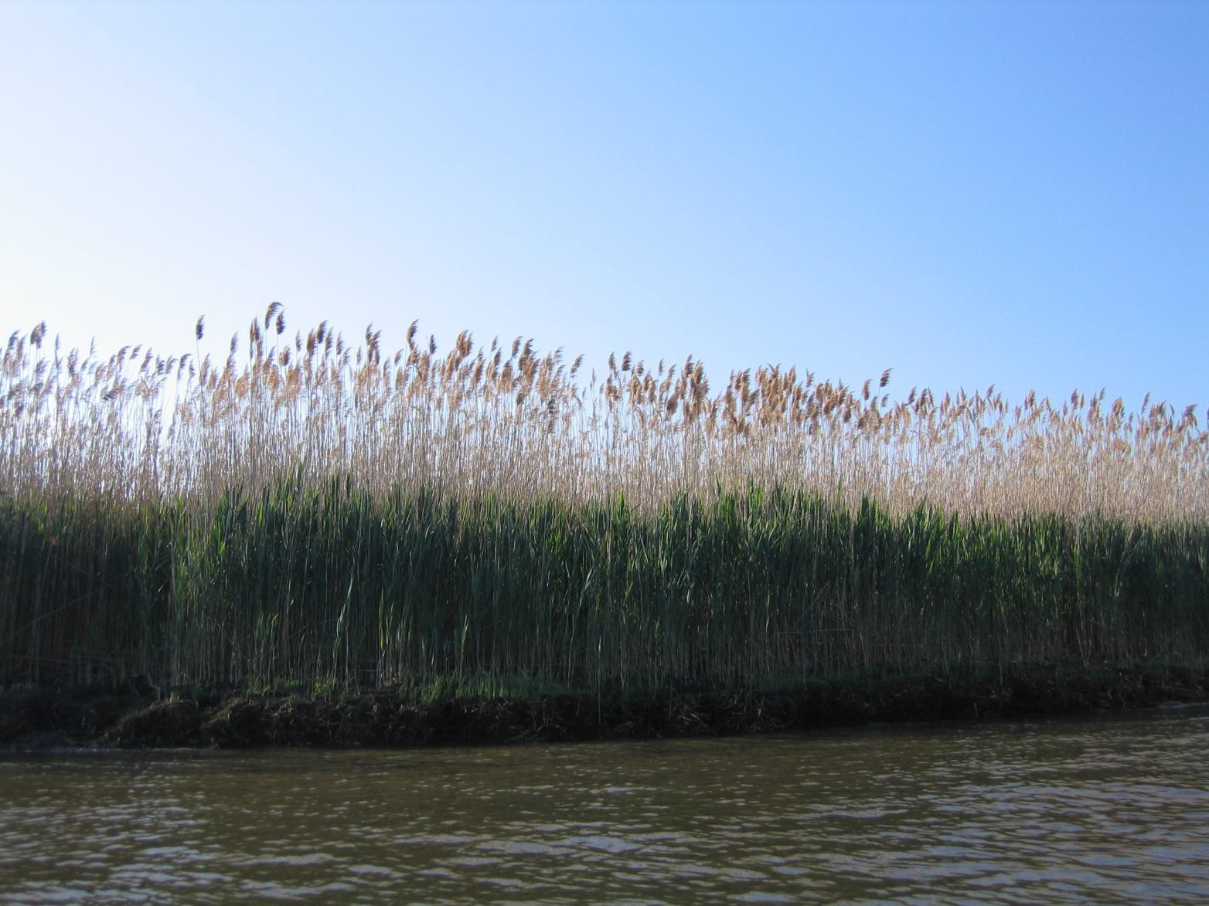
Source: Cornelia Harris
Invasive marsh plant: Common reed (Phragmites australis)

Slide 6
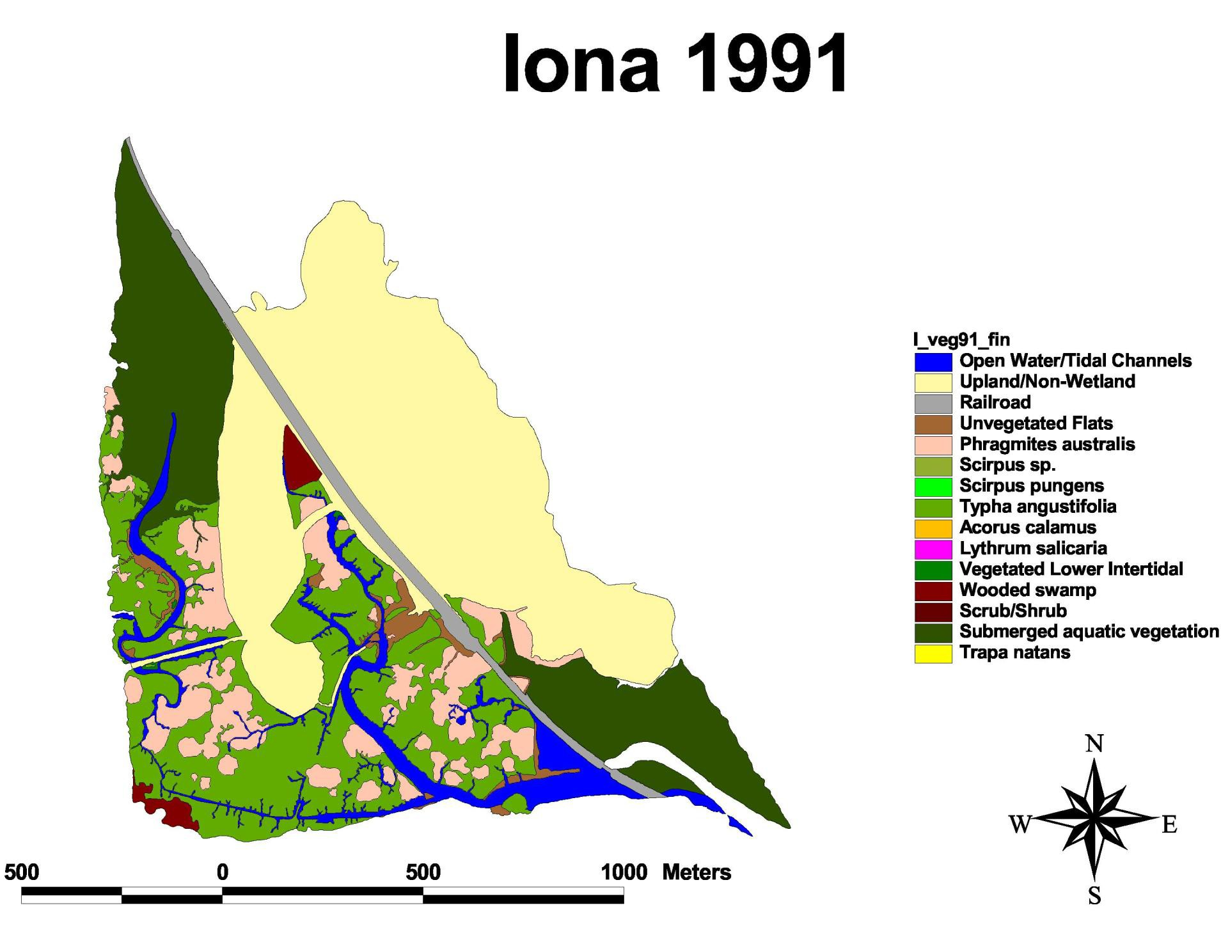

Slide 7
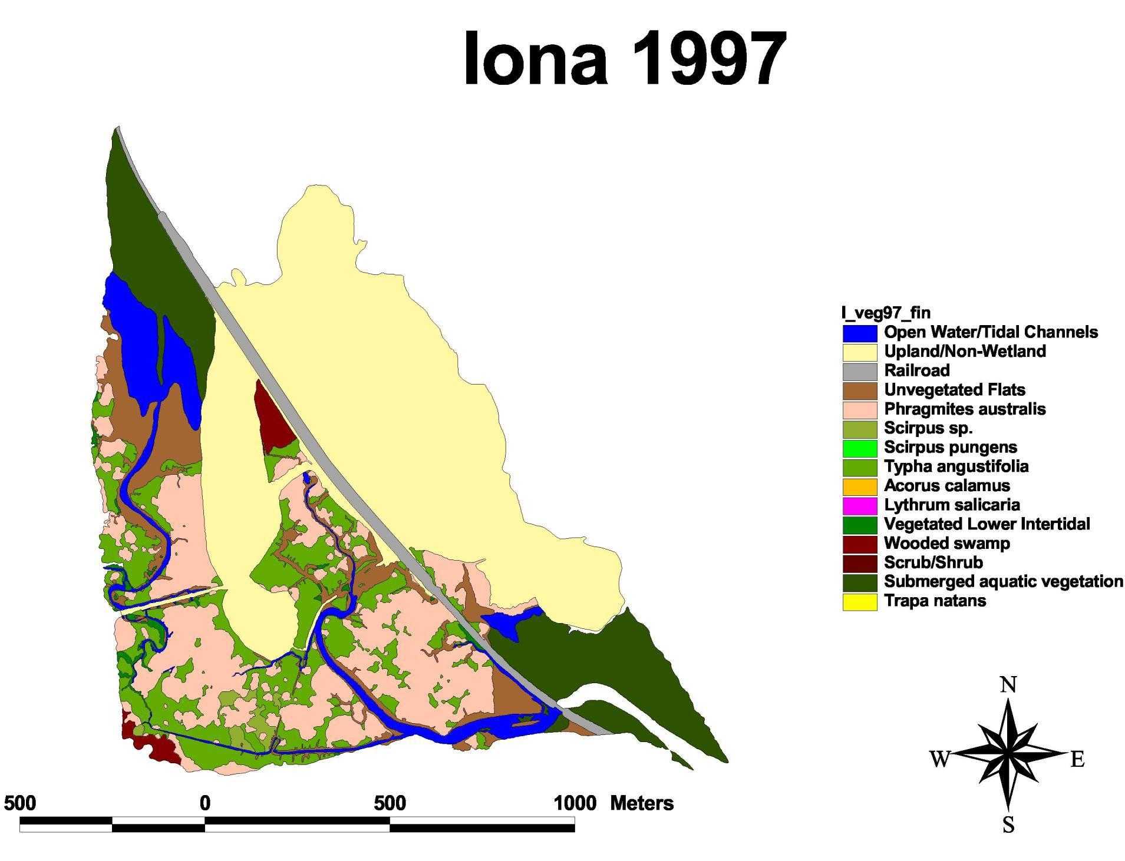

Slide 8
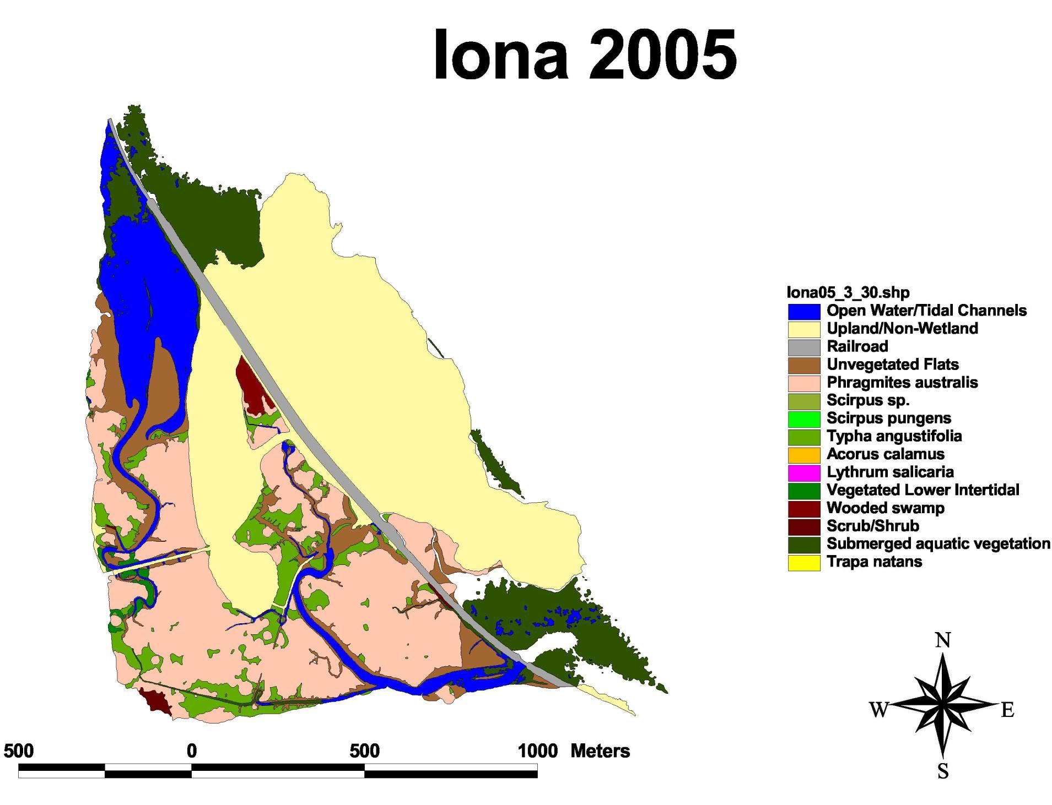

Slide 9
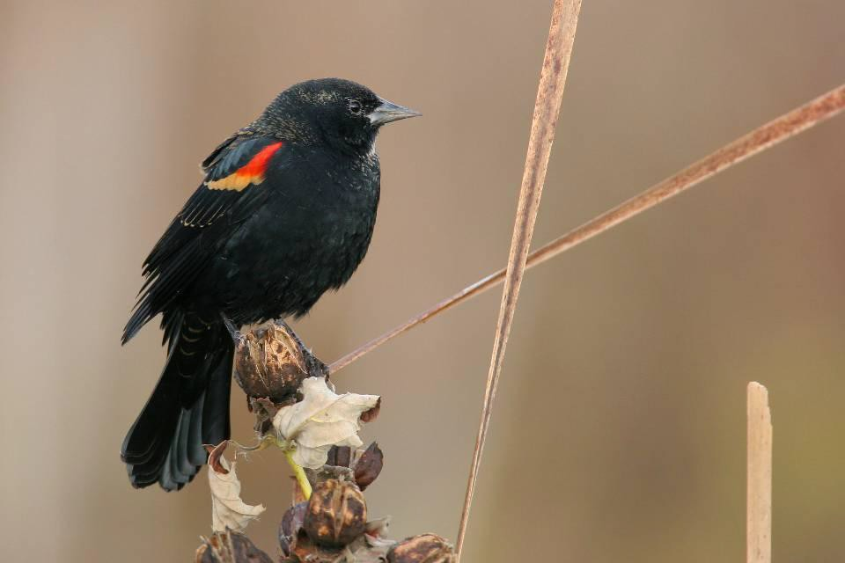
Red-winged Blackbird
Photo Credit: Alan W. Wells

Slide 10
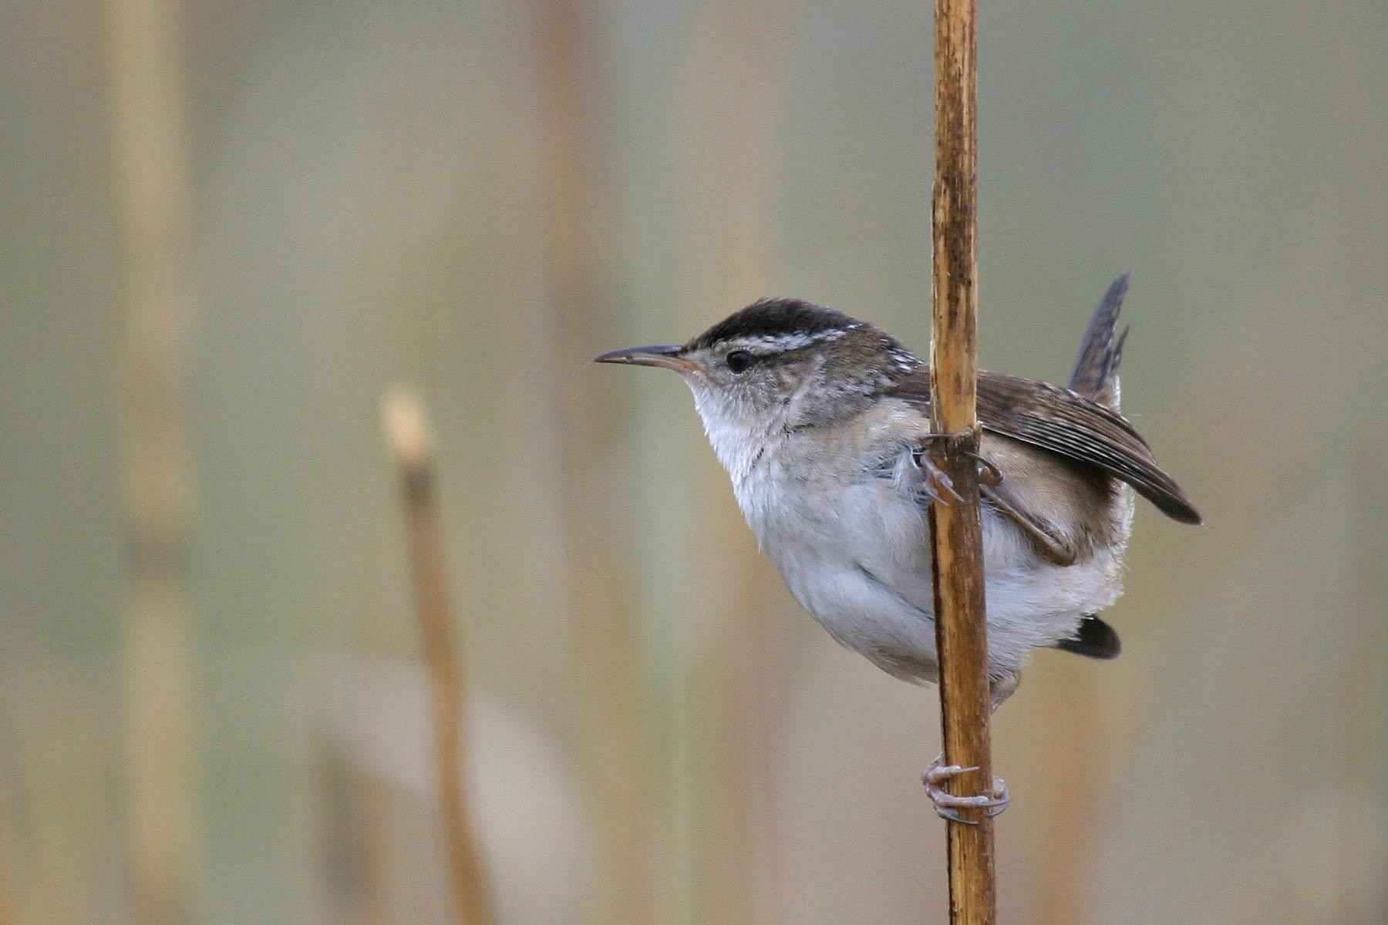
Marsh Wren
Photo Credit: Alan W. Wells

Slide 11
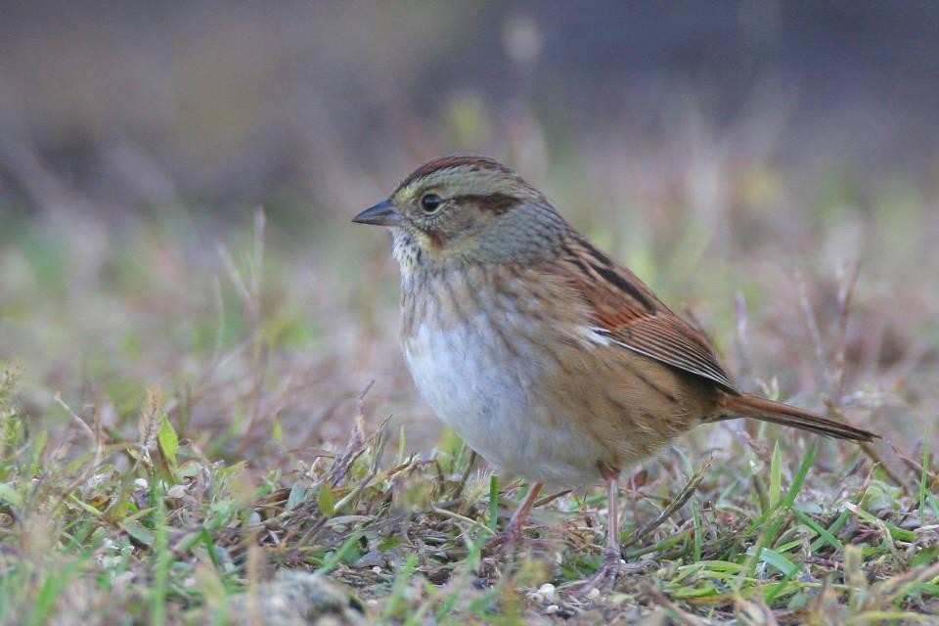
Swamp Sparrow
Photo Credit: Alan W. Wells

Slide 12
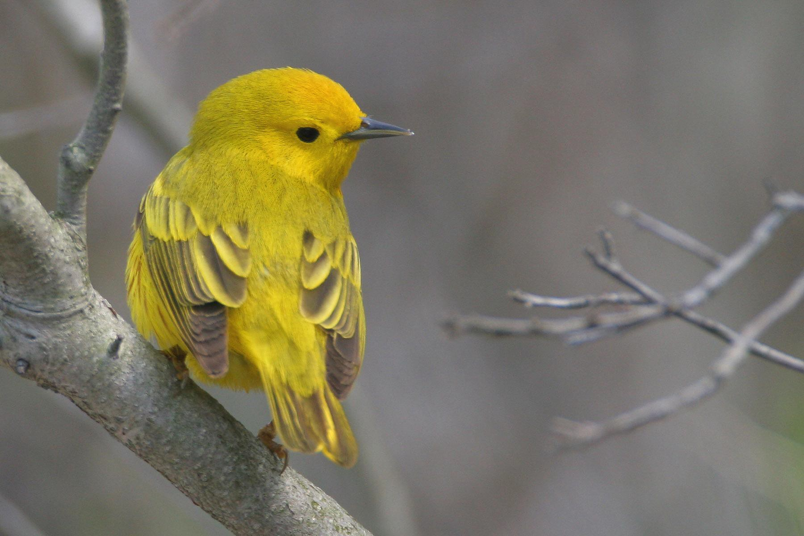
Yellow Warbler
Photo Credit: Alan W. Wells

Slide 13
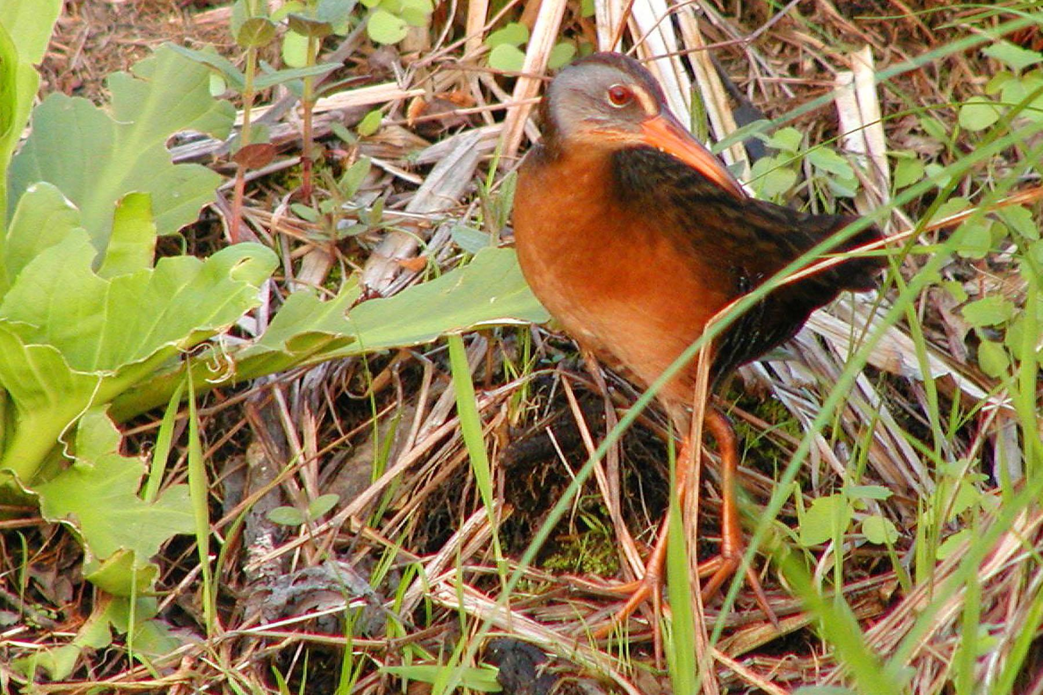
Virginia Rail
Photo Credit: Matthew King

Slide 14
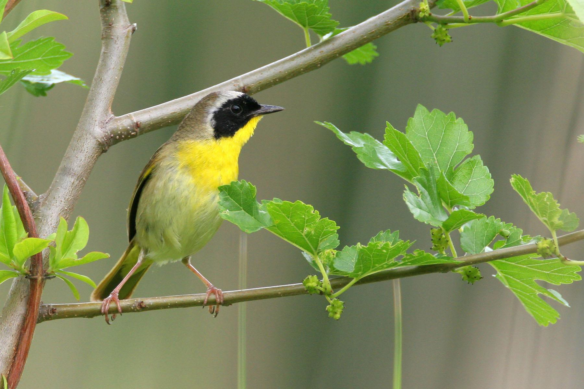
Common Yellowthroat
Photo Credit: Alan W. Wells

Slide 15
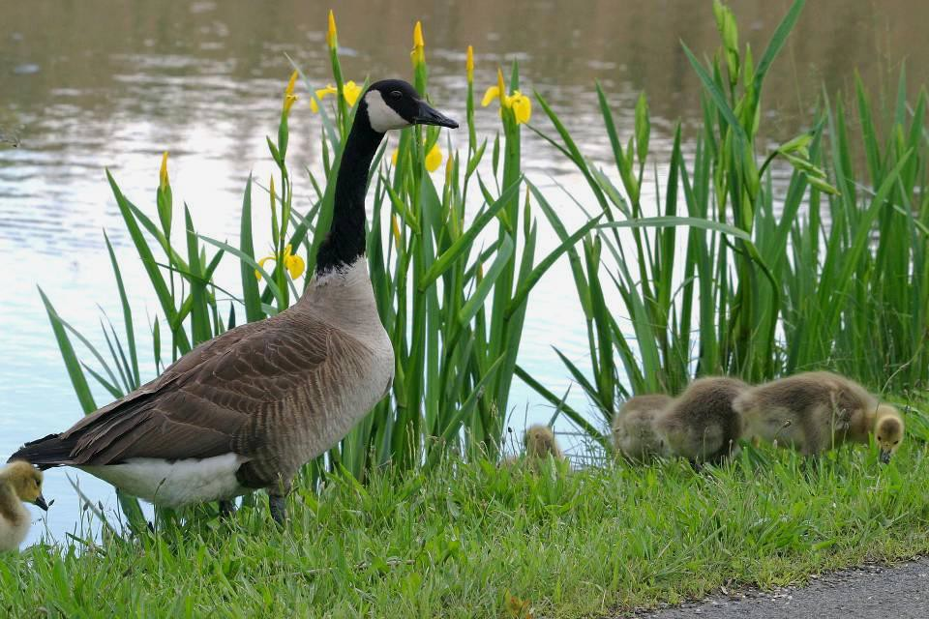
Canada Goose
Photo Credit: Alan W. Wells

Slide 16
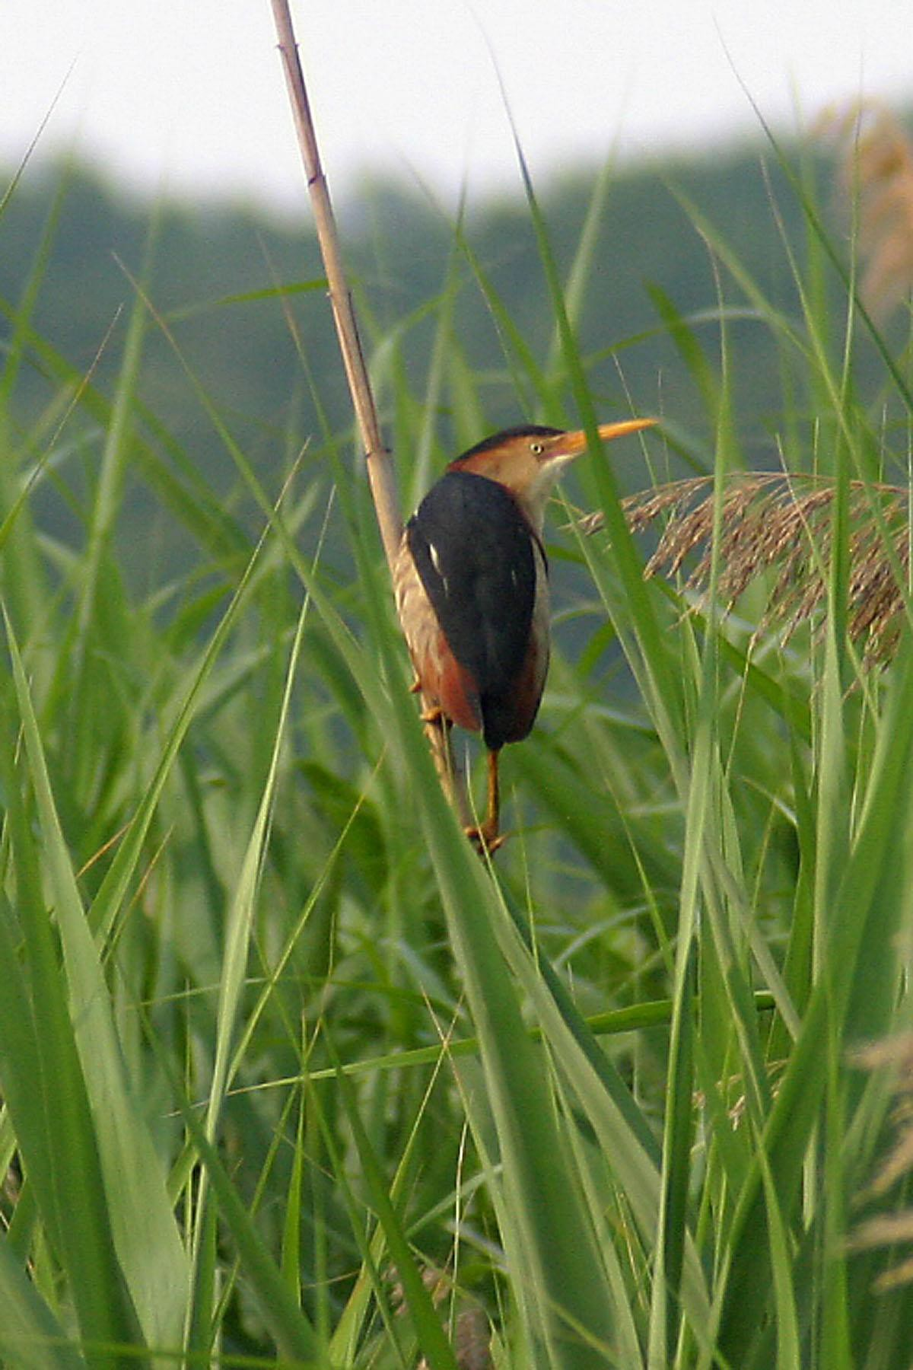
Least Bittern
Photo Credit: Alan W. Wells

Slide 17
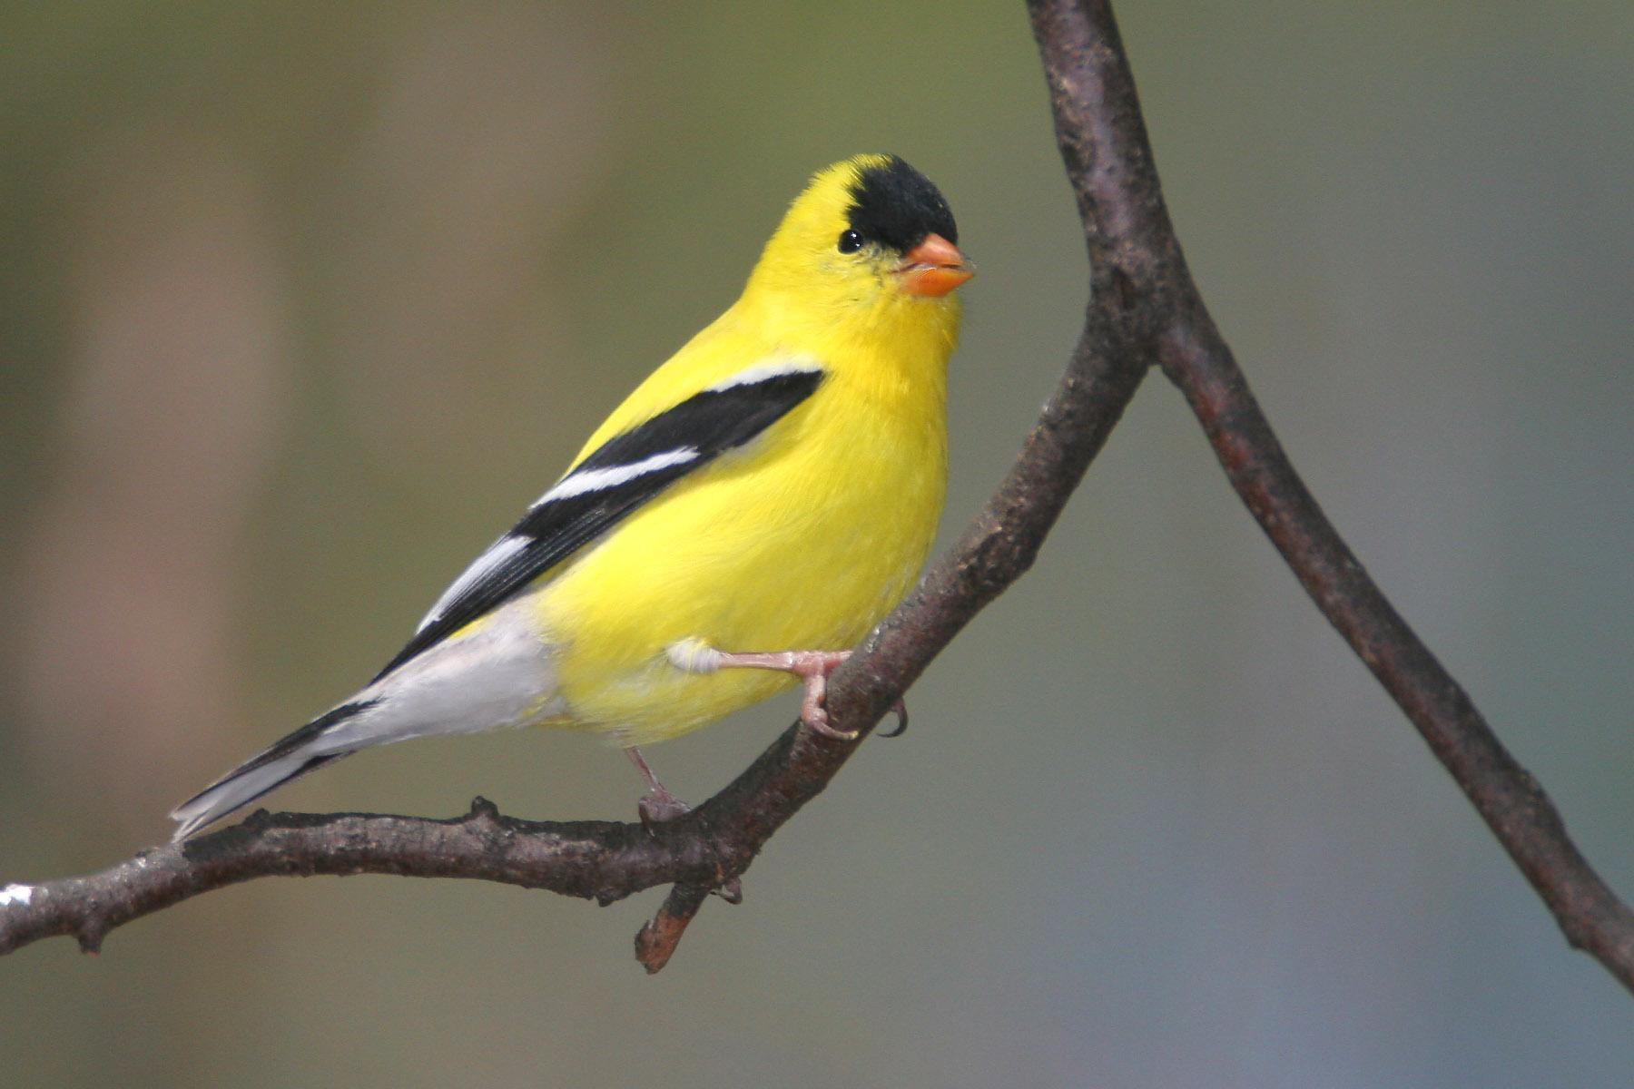
American Goldfinch
Photo Credit: Alan W. Wells

Slide 18
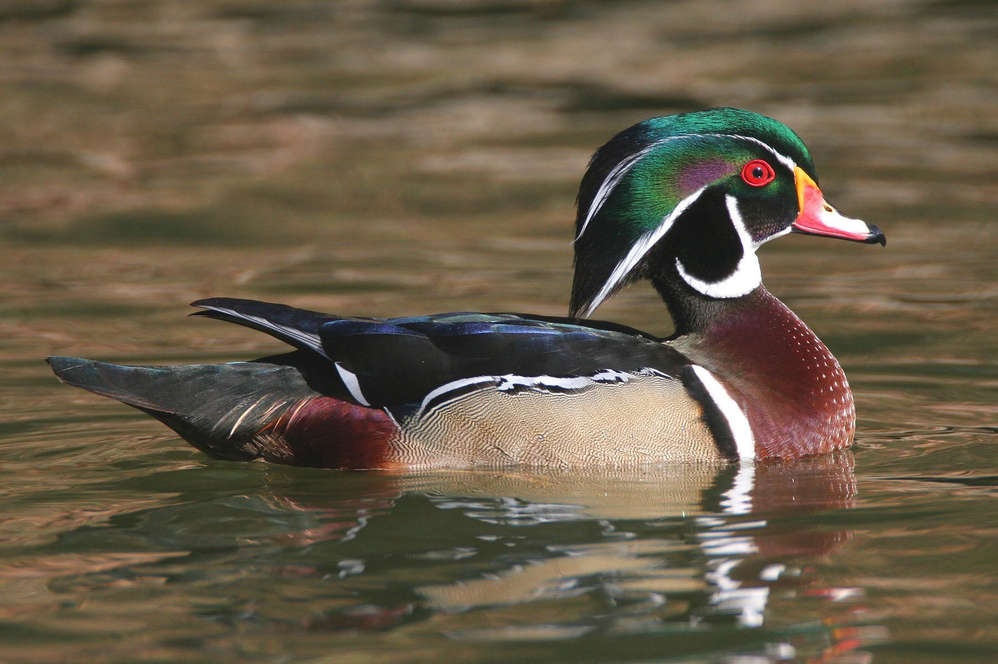
Wood Duck
Photo Credit: Alan W. Wells

Slide 19
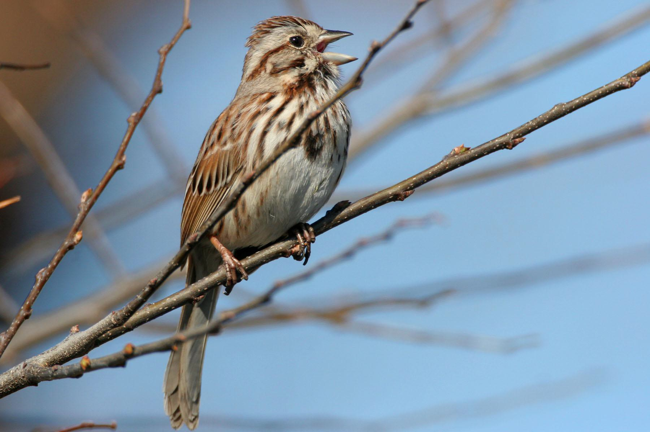
Song Sparrow
Photo Credit: Alan W. Wells

Slide 20
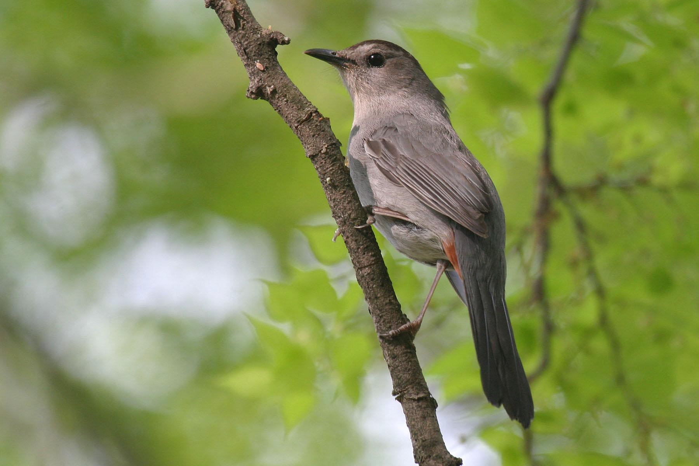
Gray Catbird
Photo Credit: Alan W. Wells

Slide 21
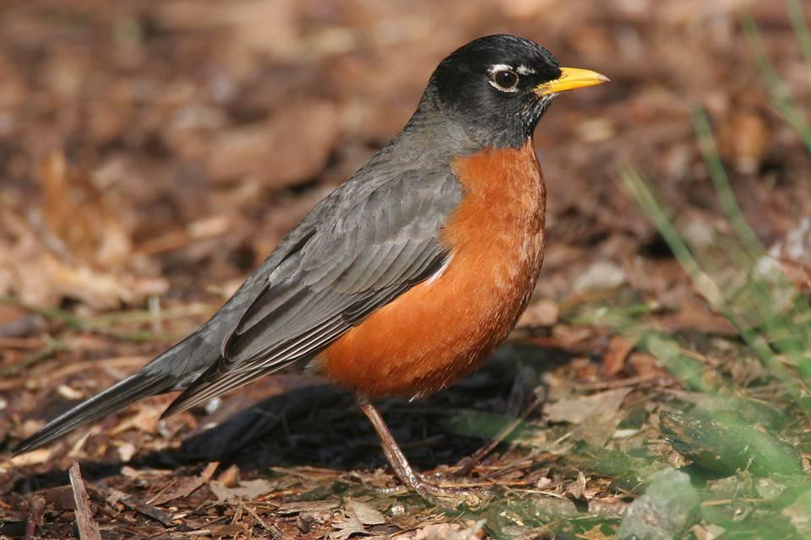
American Robin
Photo Credit: Alan W. Wells

Slide 22
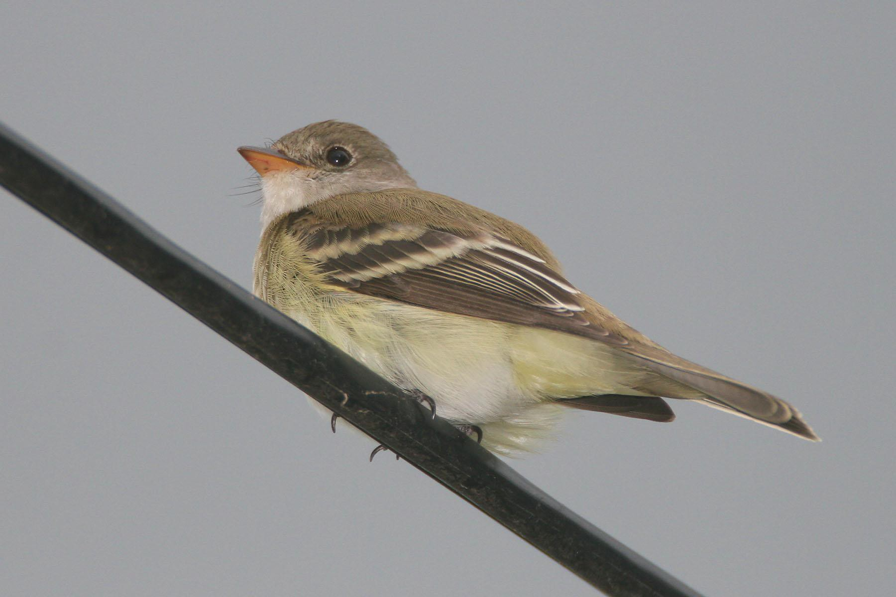
Willow Flycatcher
Photo Credit: Alan W. Wells

Slide 23
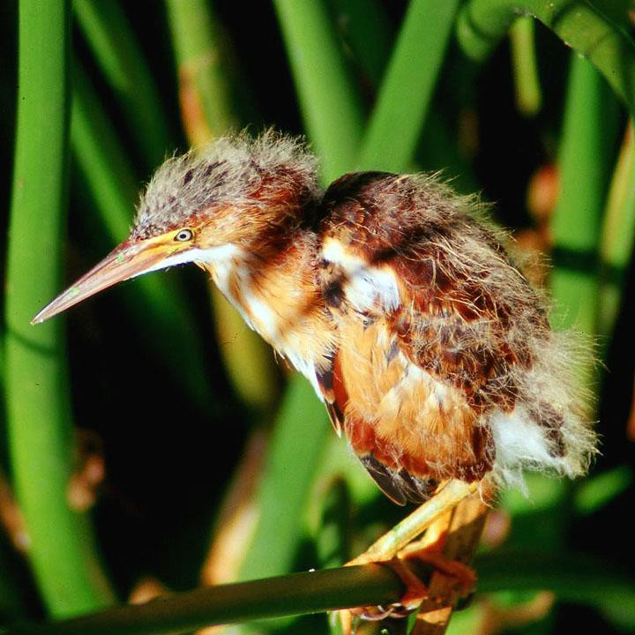
Least Bittern
Photo Credit: Alan W. Wells

Slide 24
Aerial Spread of Phragmites australis at Iona 1974-2005
2
1.5
1
0.5
0
1970 1975 1980 1985 1990 1995 2000 2005 2010
Year
Log10 Area (ha)

