Slide 1
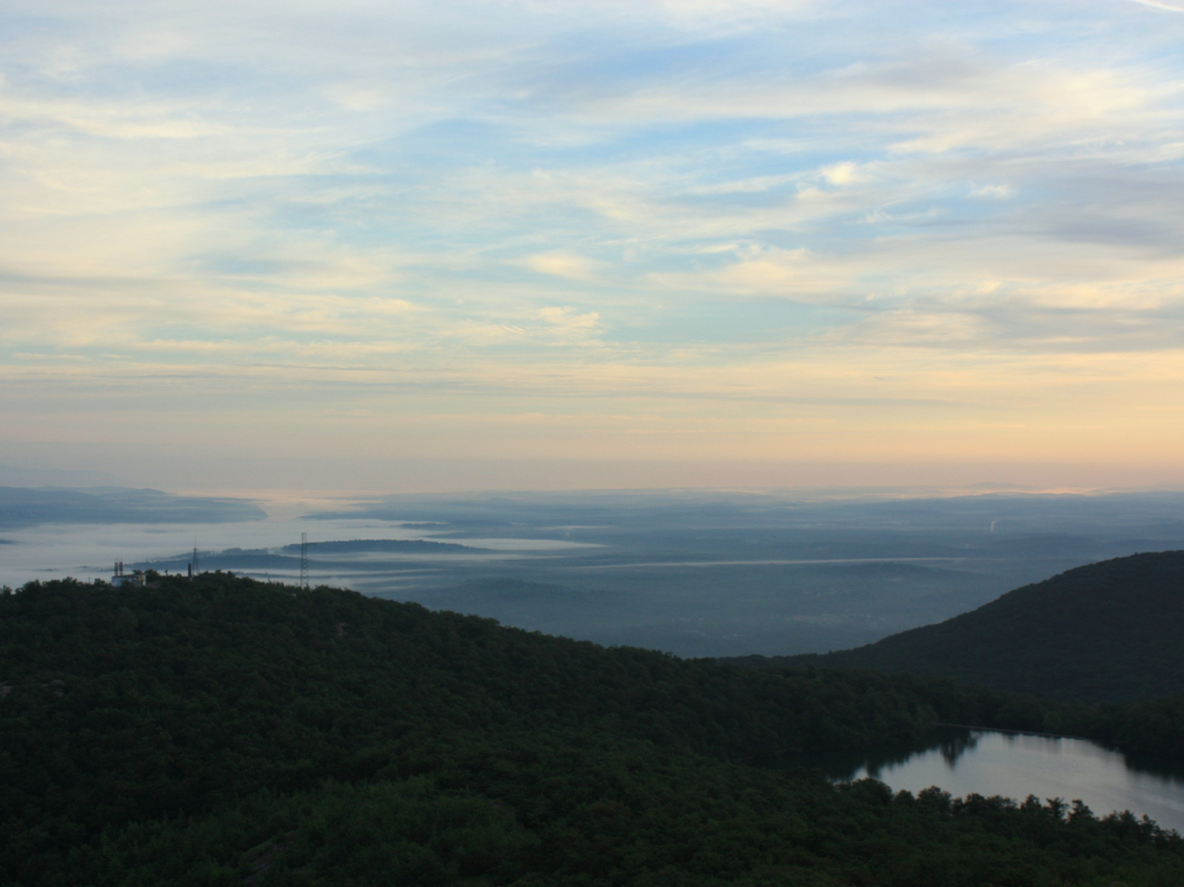
Human-Accelerated Environmental Change

Slide 2
What are some environmental problems caused by human stressors?

Slide 3
What are some environmental problems caused by human stressors?
How do these problems impact each other?

Slide 4
Infectious disease
Global climate change
Land-use changes
Loss of biodiversity
Humans
Loss of ozone layer
Invasive species introductions
Pollution
Human-Accelerated Environmental Change
Modified after
Likens 2004, Water, Air &Soil Pollution

Slide 5
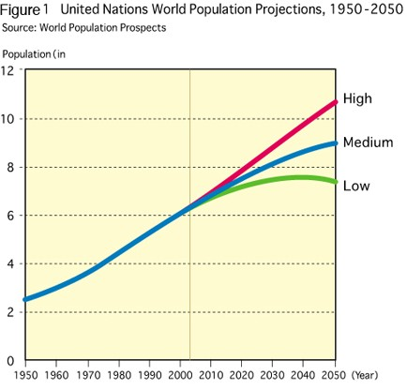
Global Trend #1: More People

Slide 6
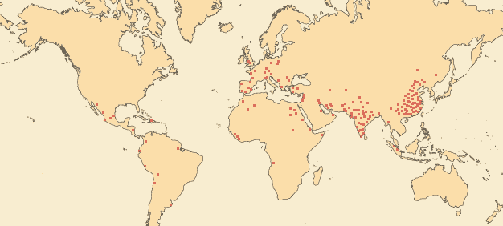
1CE
300 million people

Slide 7
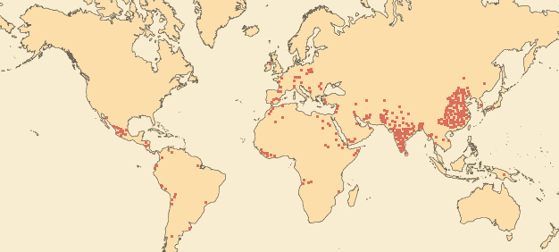
1000 CE
310 million people

Slide 8
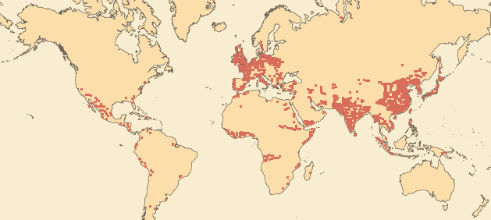
1800 CE
1 billion people

Slide 9
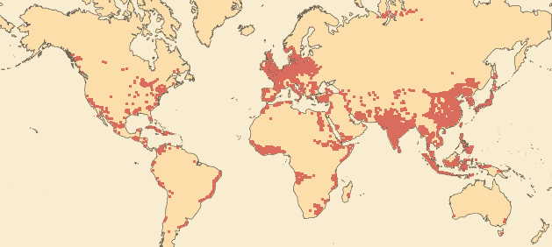
1927
2 billion people

Slide 10
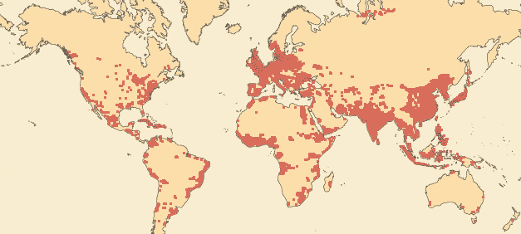
1960
3 billion people

Slide 11
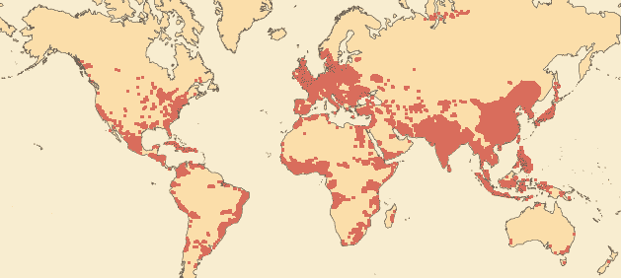
1974
4 billion people

Slide 12
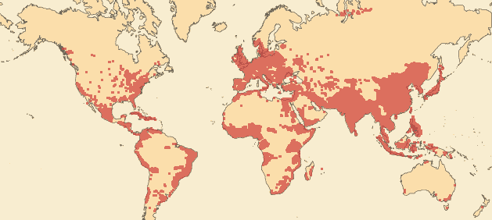
1987
5 billion people

Slide 13
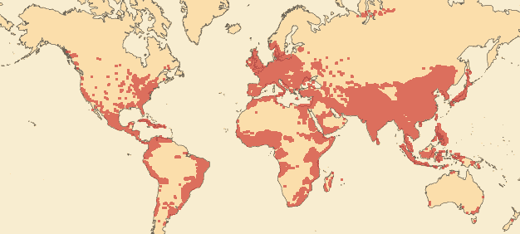
1999
6 billion people

Slide 14
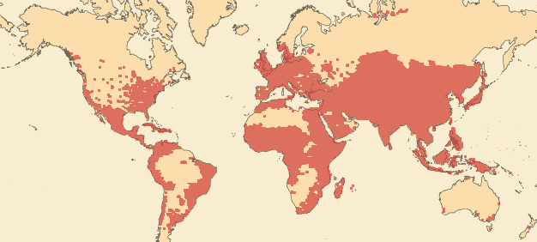
2050
9 billion people

Slide 15
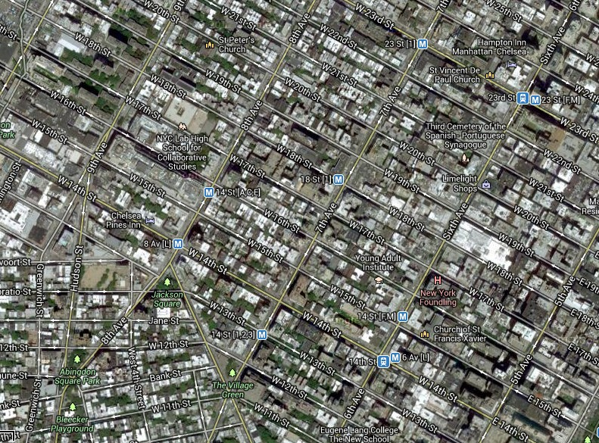
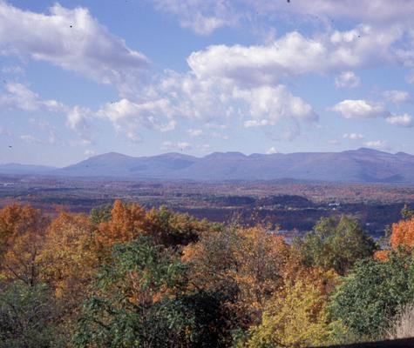
Let’s talk about the U.S.
What percent of the world’s population lives in the United States? (your perception)

Slide 16
Let’s talk about the U.S.
< 5%
US
population

Slide 17
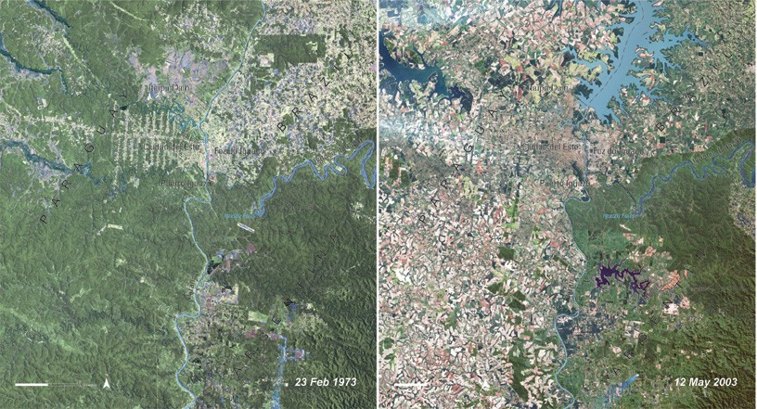
Global Trend #2: More People…More Land Use Change
Google Earth Animations - Land use changes since 1984
(http://bit.ly/18nQTvb)
Paraguay

Slide 18
What about us?
What do you think was here 70 years ago? How do you think it has changed?

Slide 19
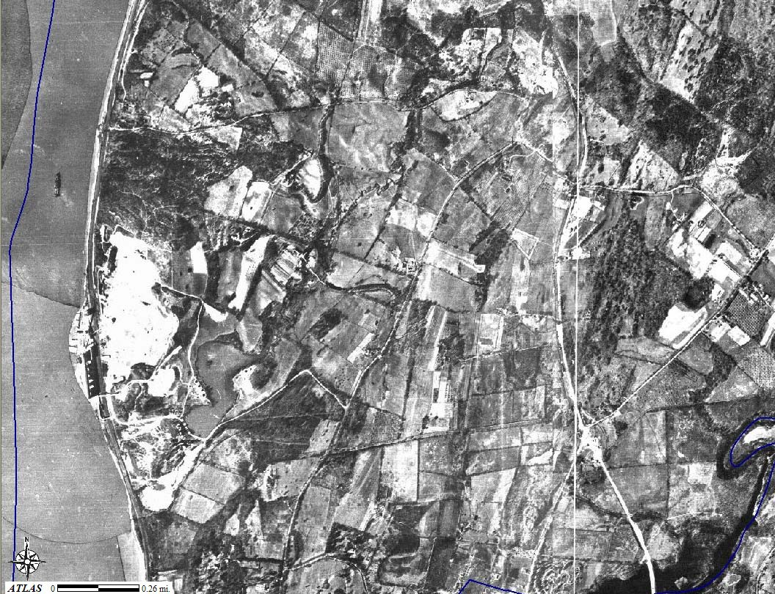
1936: Rt 9, site of current Galleria mall, small quarry visible next to river

Slide 20
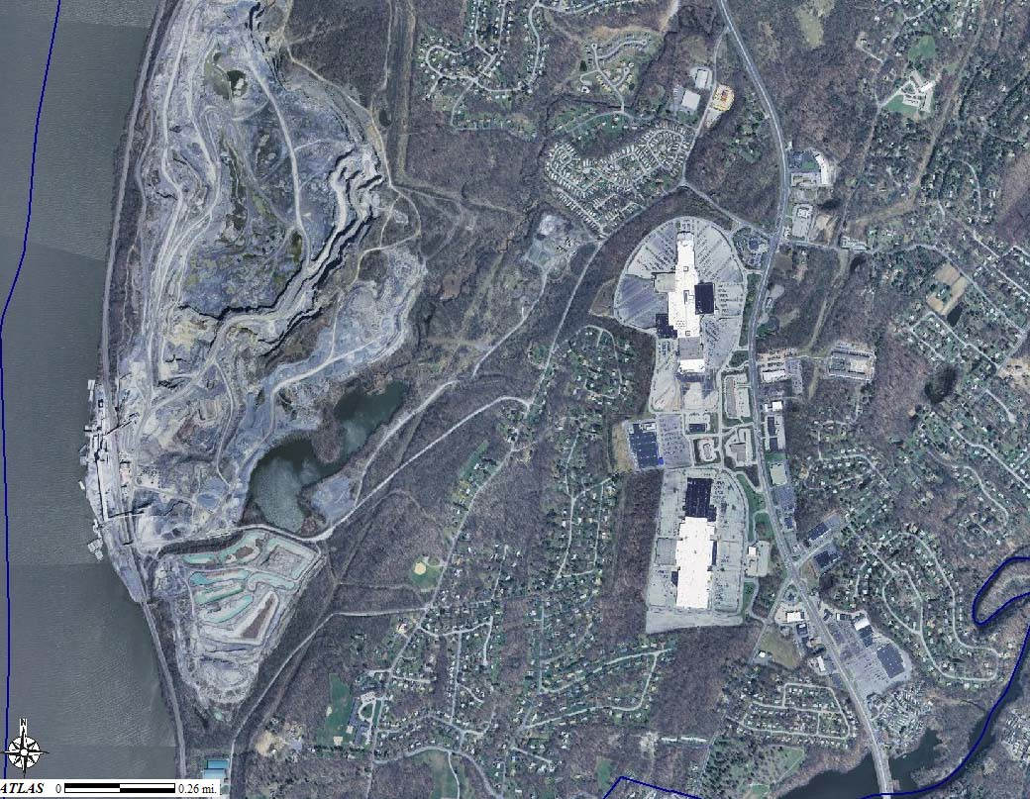
2004: Poughkeepsie Galleria on right hand side, gravel quarry next to river

Slide 21
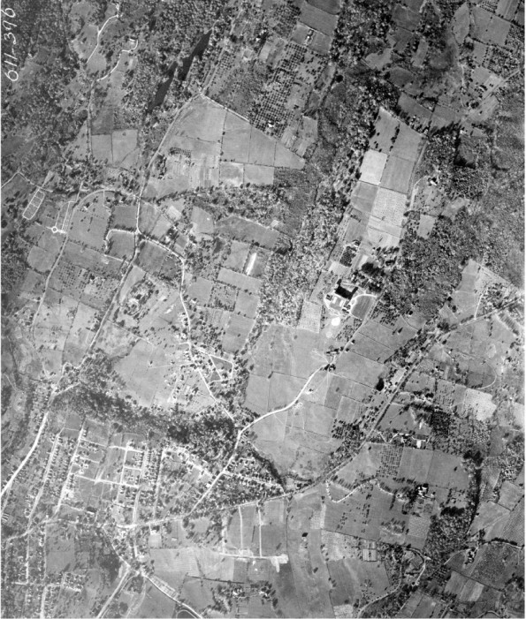
Ossining, 1925
Use the small lakes in the upper left hand corner as reference.

Slide 22
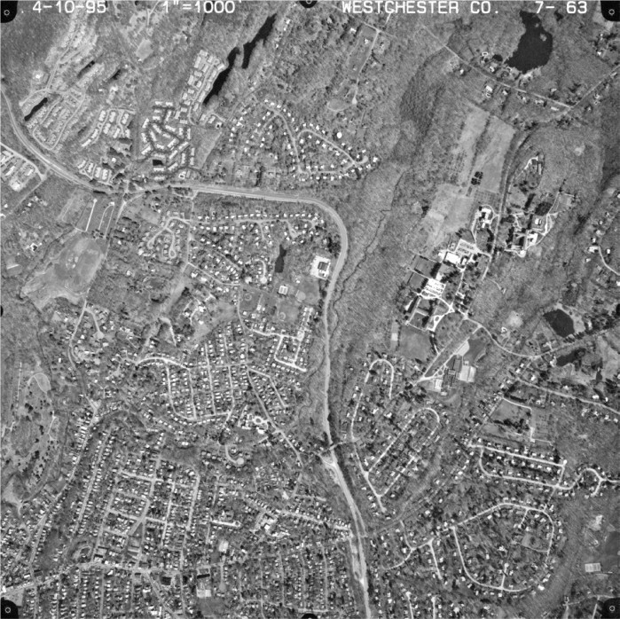
Ossining, 1995

Slide 23
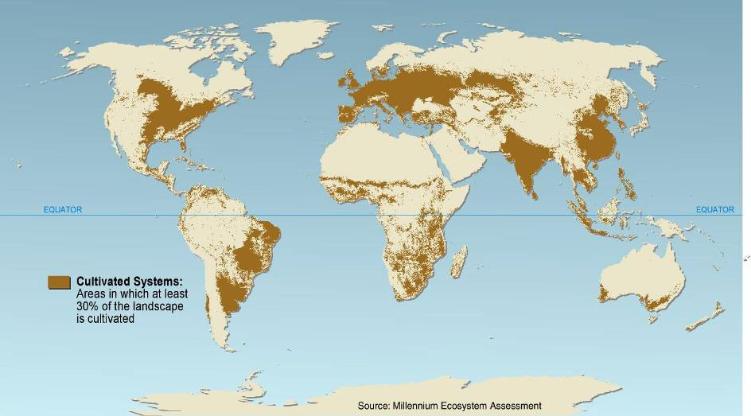
More land was converted to cropland in the 30 years after 1950 than in the 150 years between 1700 and 1850.

Slide 24
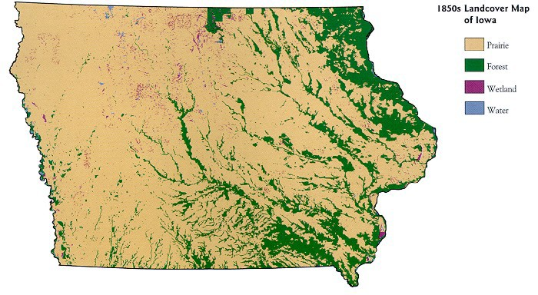
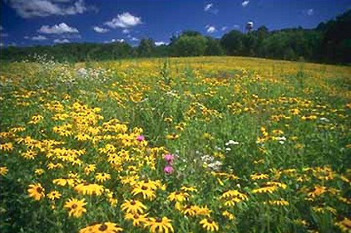
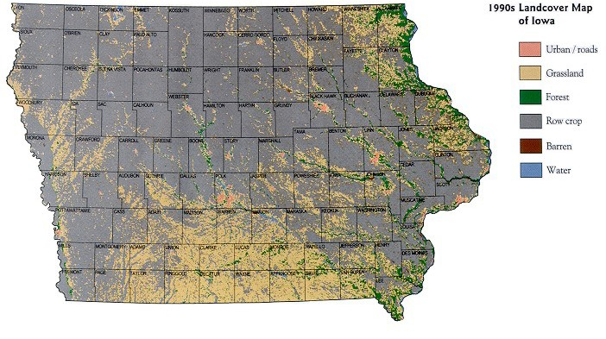
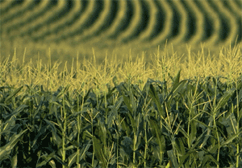
Iowa
Tan: Prairie
1850s
Gray: Row Crops
1990s
Compiled from Landsat Thematic Mapper satellite imagery, Iowa Dept. of Natural Resources.

Slide 25
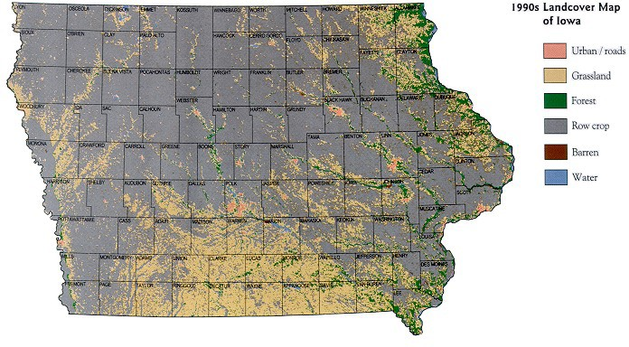
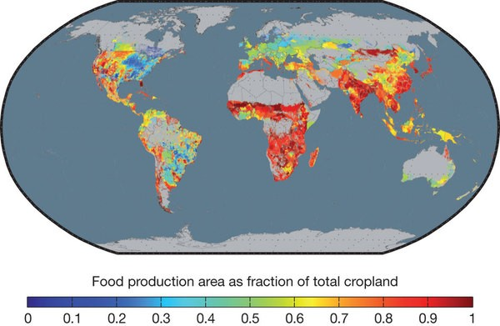
Iowa, 1990’s: Non-food row crops
Nature Publishing Group

Slide 26
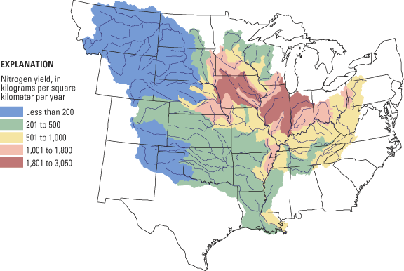
Corn requires a lot of nitrogen!
www.usgs.gov

Slide 27
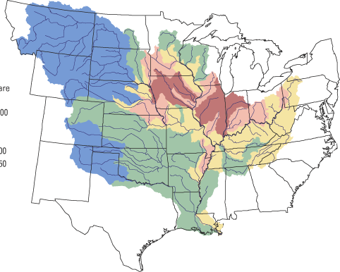
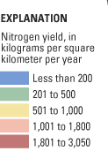
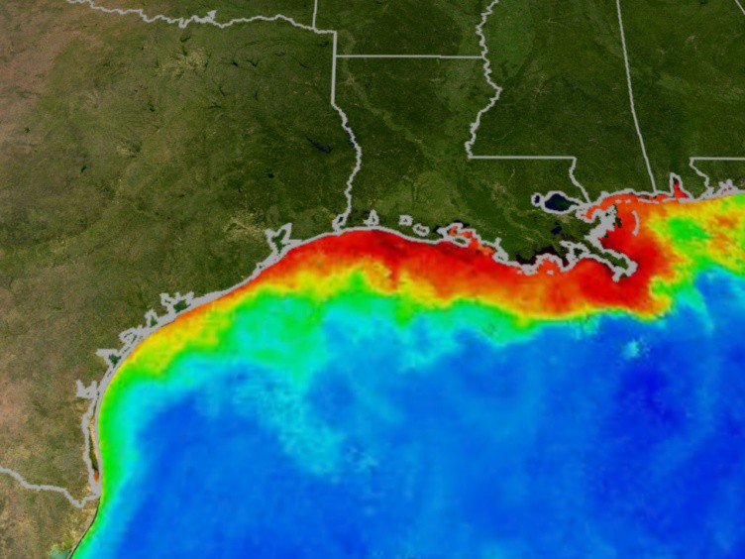
Land Use Change
➔ Pollution
www.usgs.gov

Slide 28
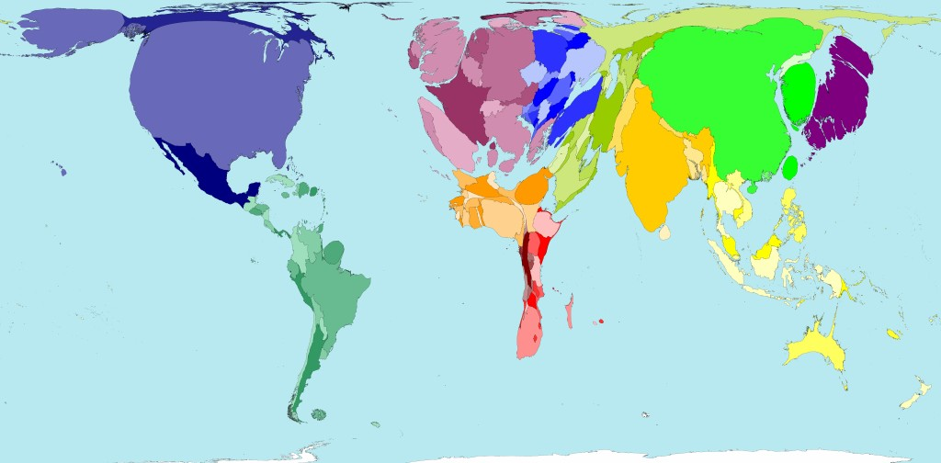
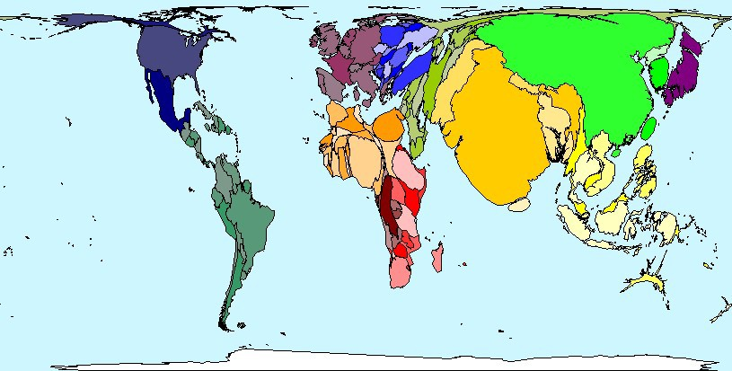
Ecological Footprint
How much do we consume?
~ 22% of the world’s resources
World Population
~ 4.7% of the world’s population

Slide 29
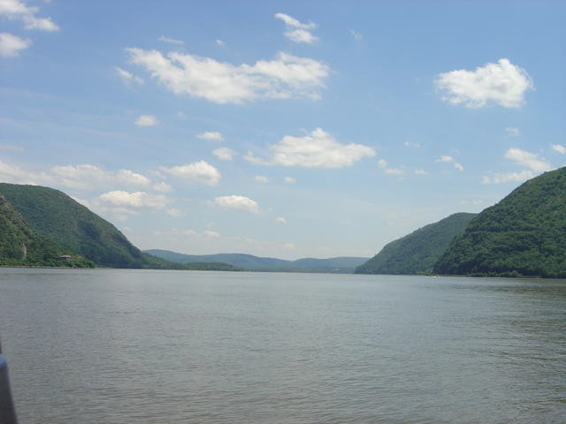
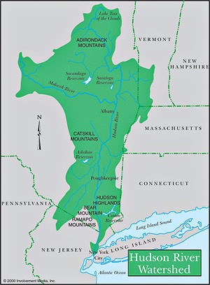
You live in:
The Hudson River Watershed

Slide 30
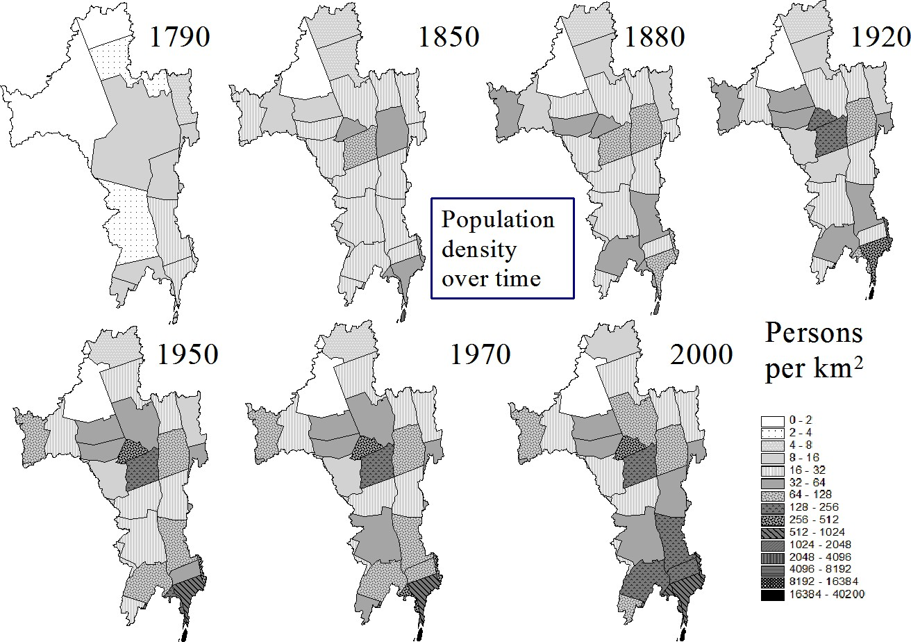
Population
Source: Swaney et.al 2006

Slide 31
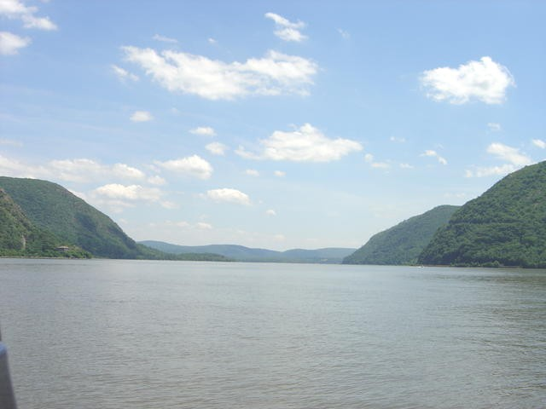
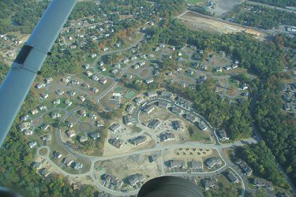
Mid Hudson Valley counties are growing in population, and forest fragmentation is a big problem.
Scenic Hudson

Slide 32
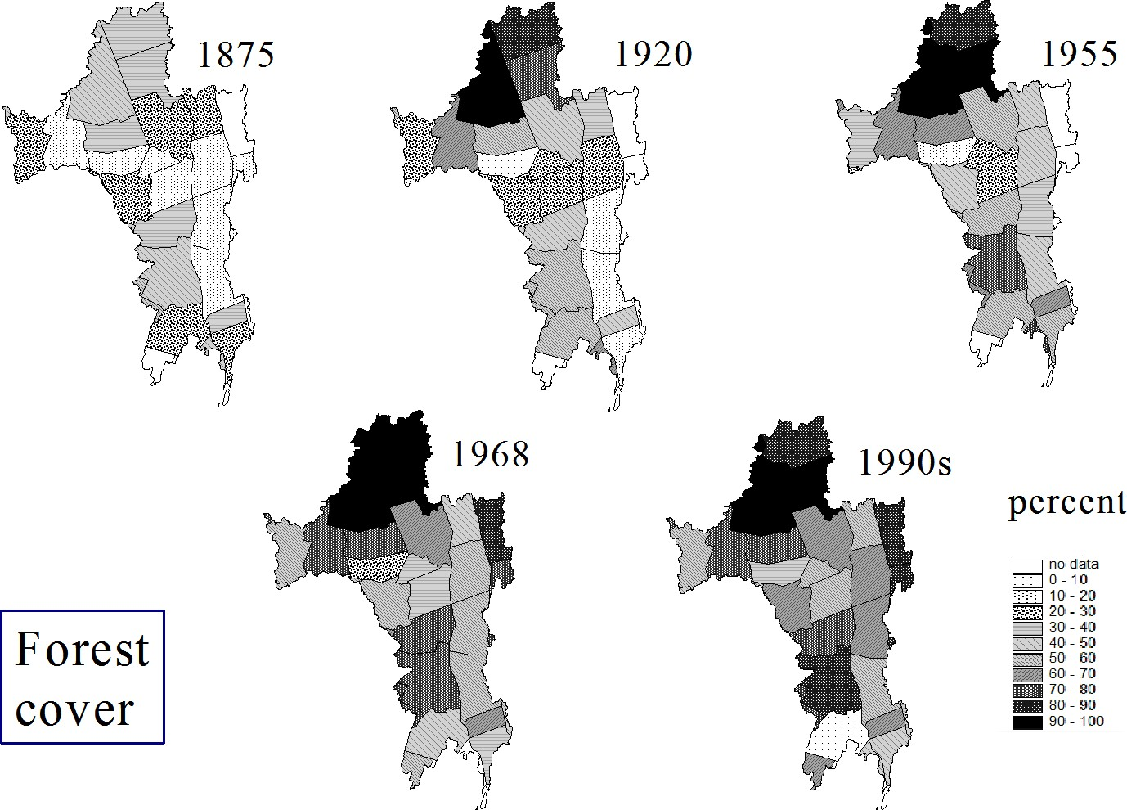
Source: Swaney et.al 2006

Slide 33
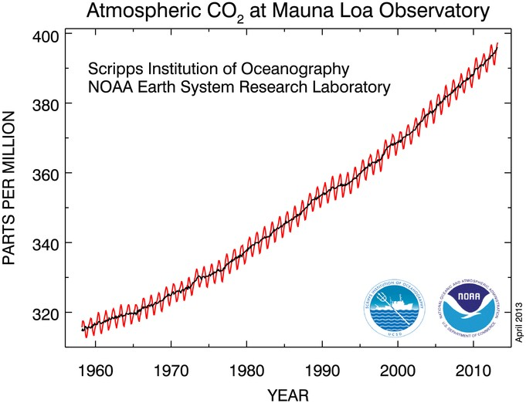
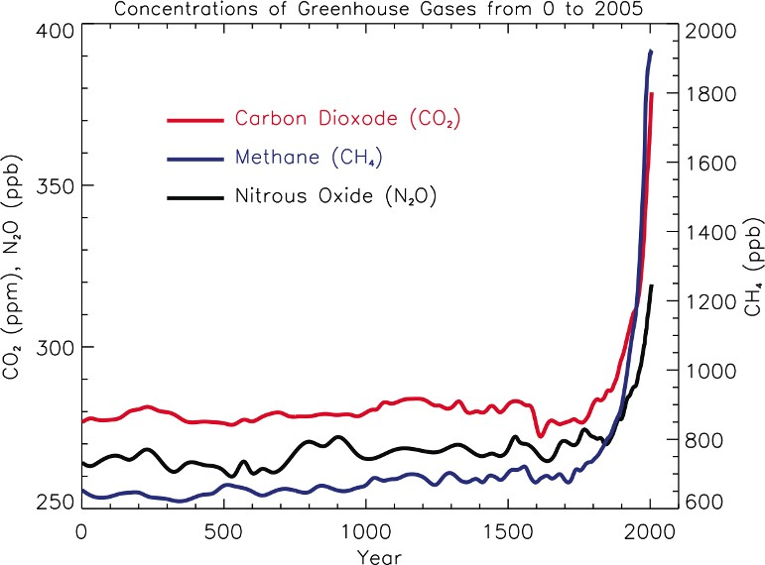
Climate Change

Slide 34
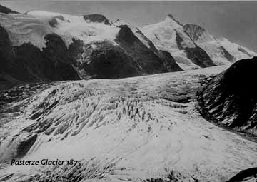
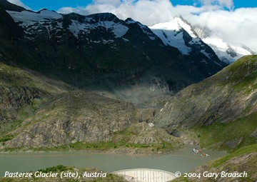
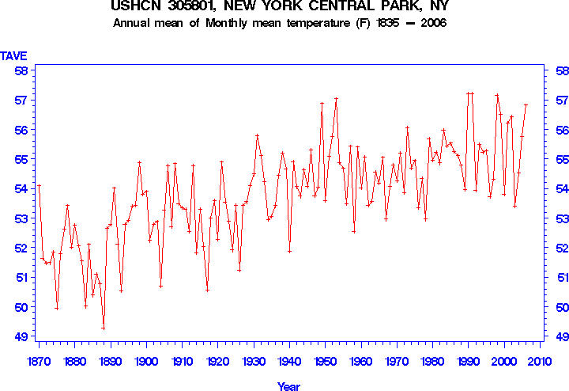
Glacial melting
Air temperatures in Central Park

Slide 35
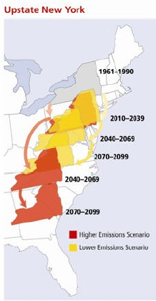
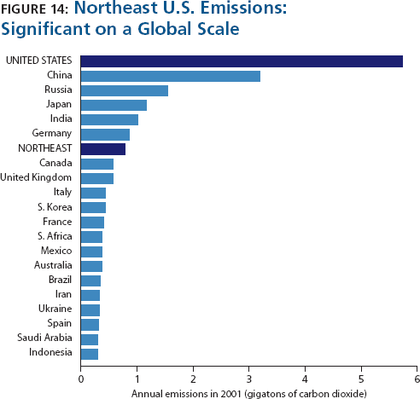
Two Emissions Scenarios

Slide 36
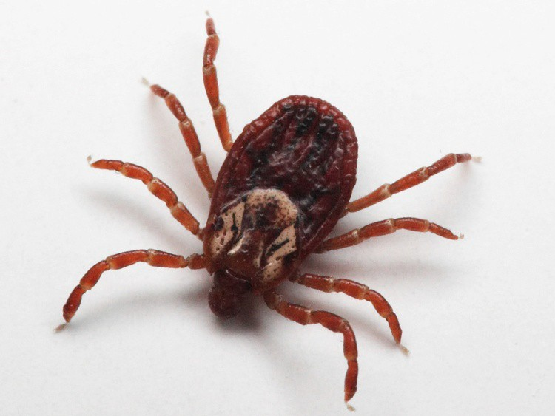
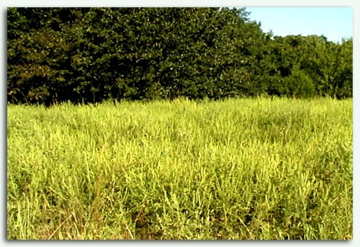
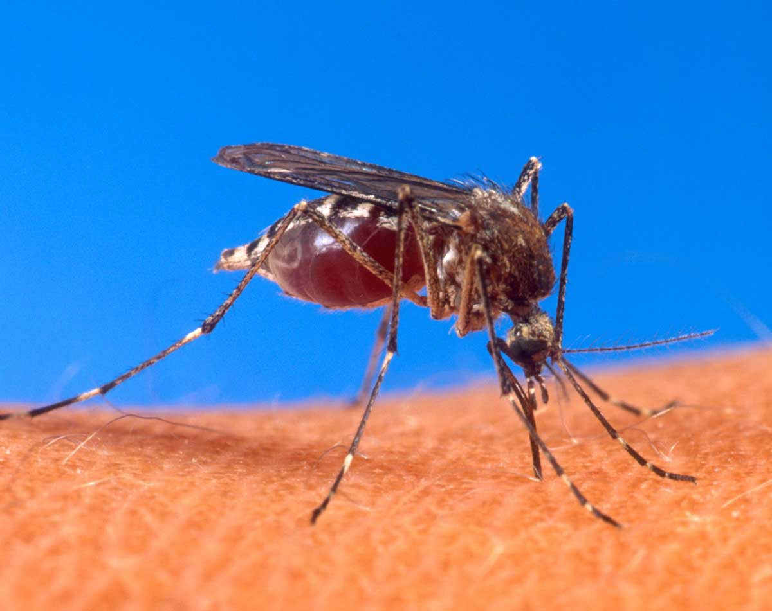
Land Use Change + Climate Change
= Disease Increase
Ragweed Pollen Production g/plant
400
300
200
100
Ziska, 2007
0
280
370
600 ppm
www.usbr.gov

Slide 37
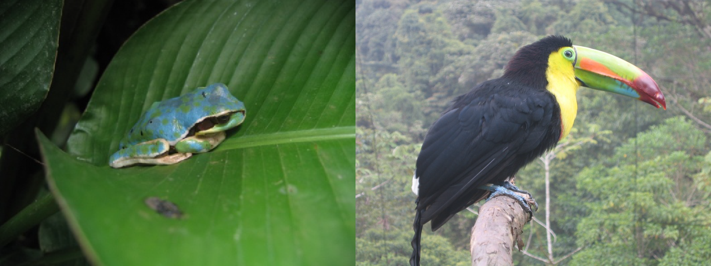
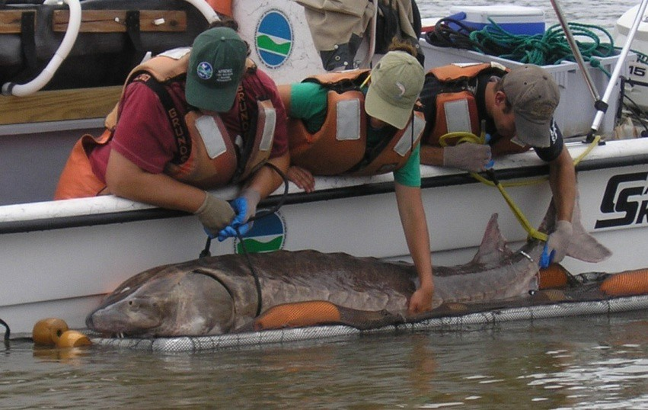
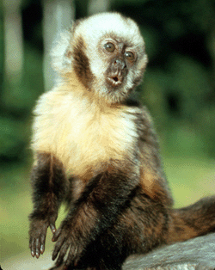
Land Use Change = Biodiversity loss
NOAA
NYSDEC
%
Threatened
22
12
30
Taxa
Mammals Birds Reptiles
Amphibians Fishes Invertebrates
31
39
51
Nature Publishing Group
IUCN Red List

Slide 38
Land Use Change + Invasive Species = more biodiversity loss

Slide 39
Inbocht Bay, south of Catskill on the Hudson River, covered in water chestnut (Trapa natans)
Photos courtesy of IES

Slide 40
Climate Change + Land use + Invasive Species = Yet more biodiversity loss

Slide 41
Amphibians Are Declining Globally
800
600
No. of Species
The species in these 5 categories represent 39% of amphibian species globally!
400
200
0
Extinct
Critical
Vulnerable
Endangered
Threatened

Slide 42
Your Turn
Summarize the major changes in the environment
How does each problem affect the others?
What might be some possible solutions?

