Slide 1
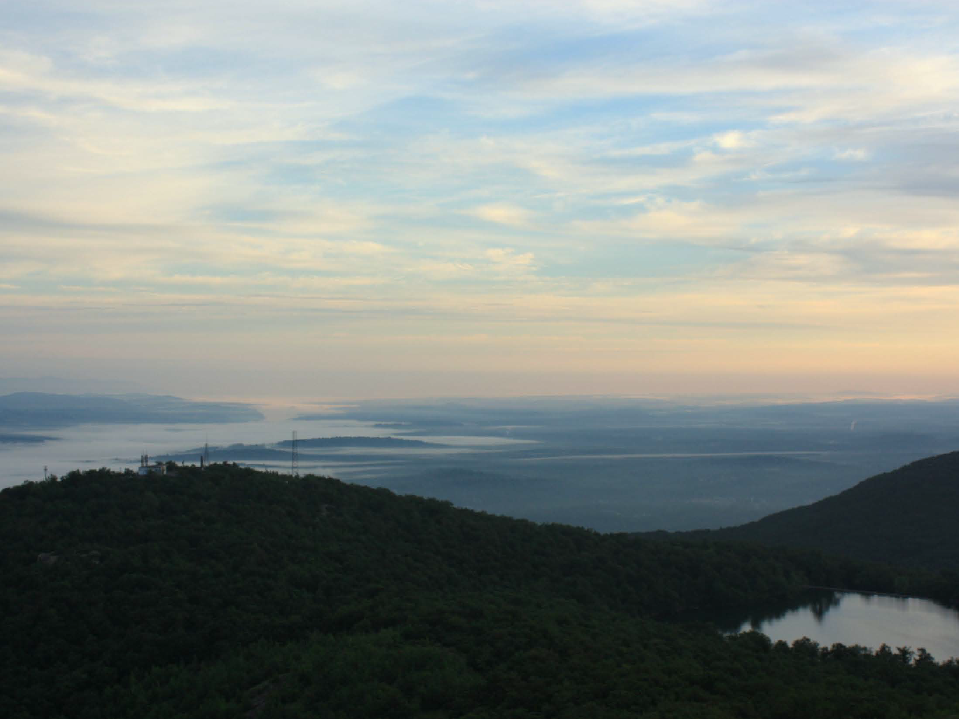
Introduction to Ecosystems
Photo by Kali Bird
Notes:
Presenter
2013-07-27 10:27:52
--------------------------------------------
Photo courtesy of Kali Bird (Cary Institute).

Slide 2
Do you live in an ecosystem?

Slide 3
What is an Ecosystem?
Biological community (biotic)
Physical environment (abiotic)
The ecosystem concept:
– all the organisms (a community of species) & all the abiotic components interacting together as a system, within spatial boundaries
Notes:
Presenter
2013-07-27 10:27:56
--------------------------------------------
Ecosystem: a biological community and its physical environment Biological community is made up of the living things
For example: all the living organisms in a pond—the phytoplankton, cattails, fish, frogs, dragonflies, etc. Physical community is the non-living component
For example: sunlight, which the plants depend on for photosynthesis
Water, minerals, air

Slide 4
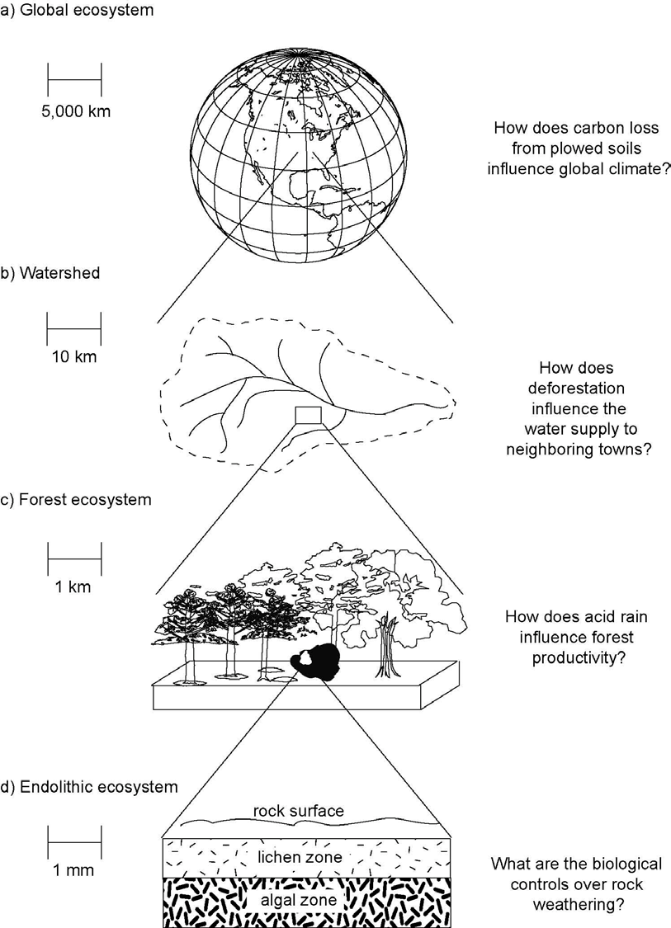
How big is an ecosystem?
Notes:
Presenter
2013-07-27 10:27:58
--------------------------------------------
In the picture, we see several ecosystems within this portion of the Hudson River watershed—forest ecosystems and the river ecosystem (as well as the pond ecosystem now covered by the graphic).

Slide 5
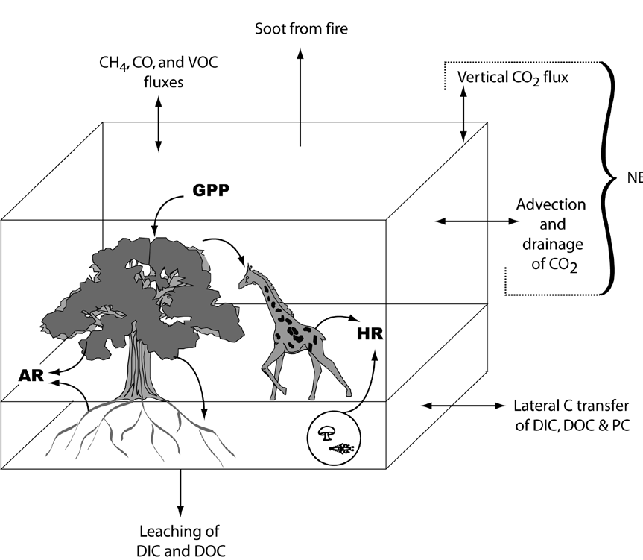

It can get very complicated, very quickly!
Must define the size before you can measure inputs, outputs, rates of cycling, & fluxes
Notes:
Presenter
2013-07-27 10:27:59
--------------------------------------------
Ecosystem ecologists have to define the size of the ecosystem they are working on, as well as measure the inputs and outputs, rate of cycling, pools and fluxes.

Slide 6
How does an ecosystem work (function)?
Things to think about:
Biotic and abiotic components & interactions
Boundaries (scale)
Flux / cycling of nutrients & energy
Change over time & history of a place
Ecosystem inputs /outputs are connections to adjacent ecosystems, and to larger, global cycles

Slide 7
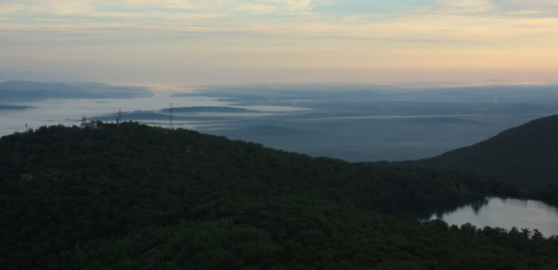
What questions could we ask to understand the Hudson River ecosystem?
Consider:
Biotic and abiotic components & interactions
Boundaries (scale)
Flux / cycling of nutrients & energy
Change over time & history of a place
Ecosystem inputs /outputs are connections to adjacent ecosystems, and to larger, global cycles

Slide 8
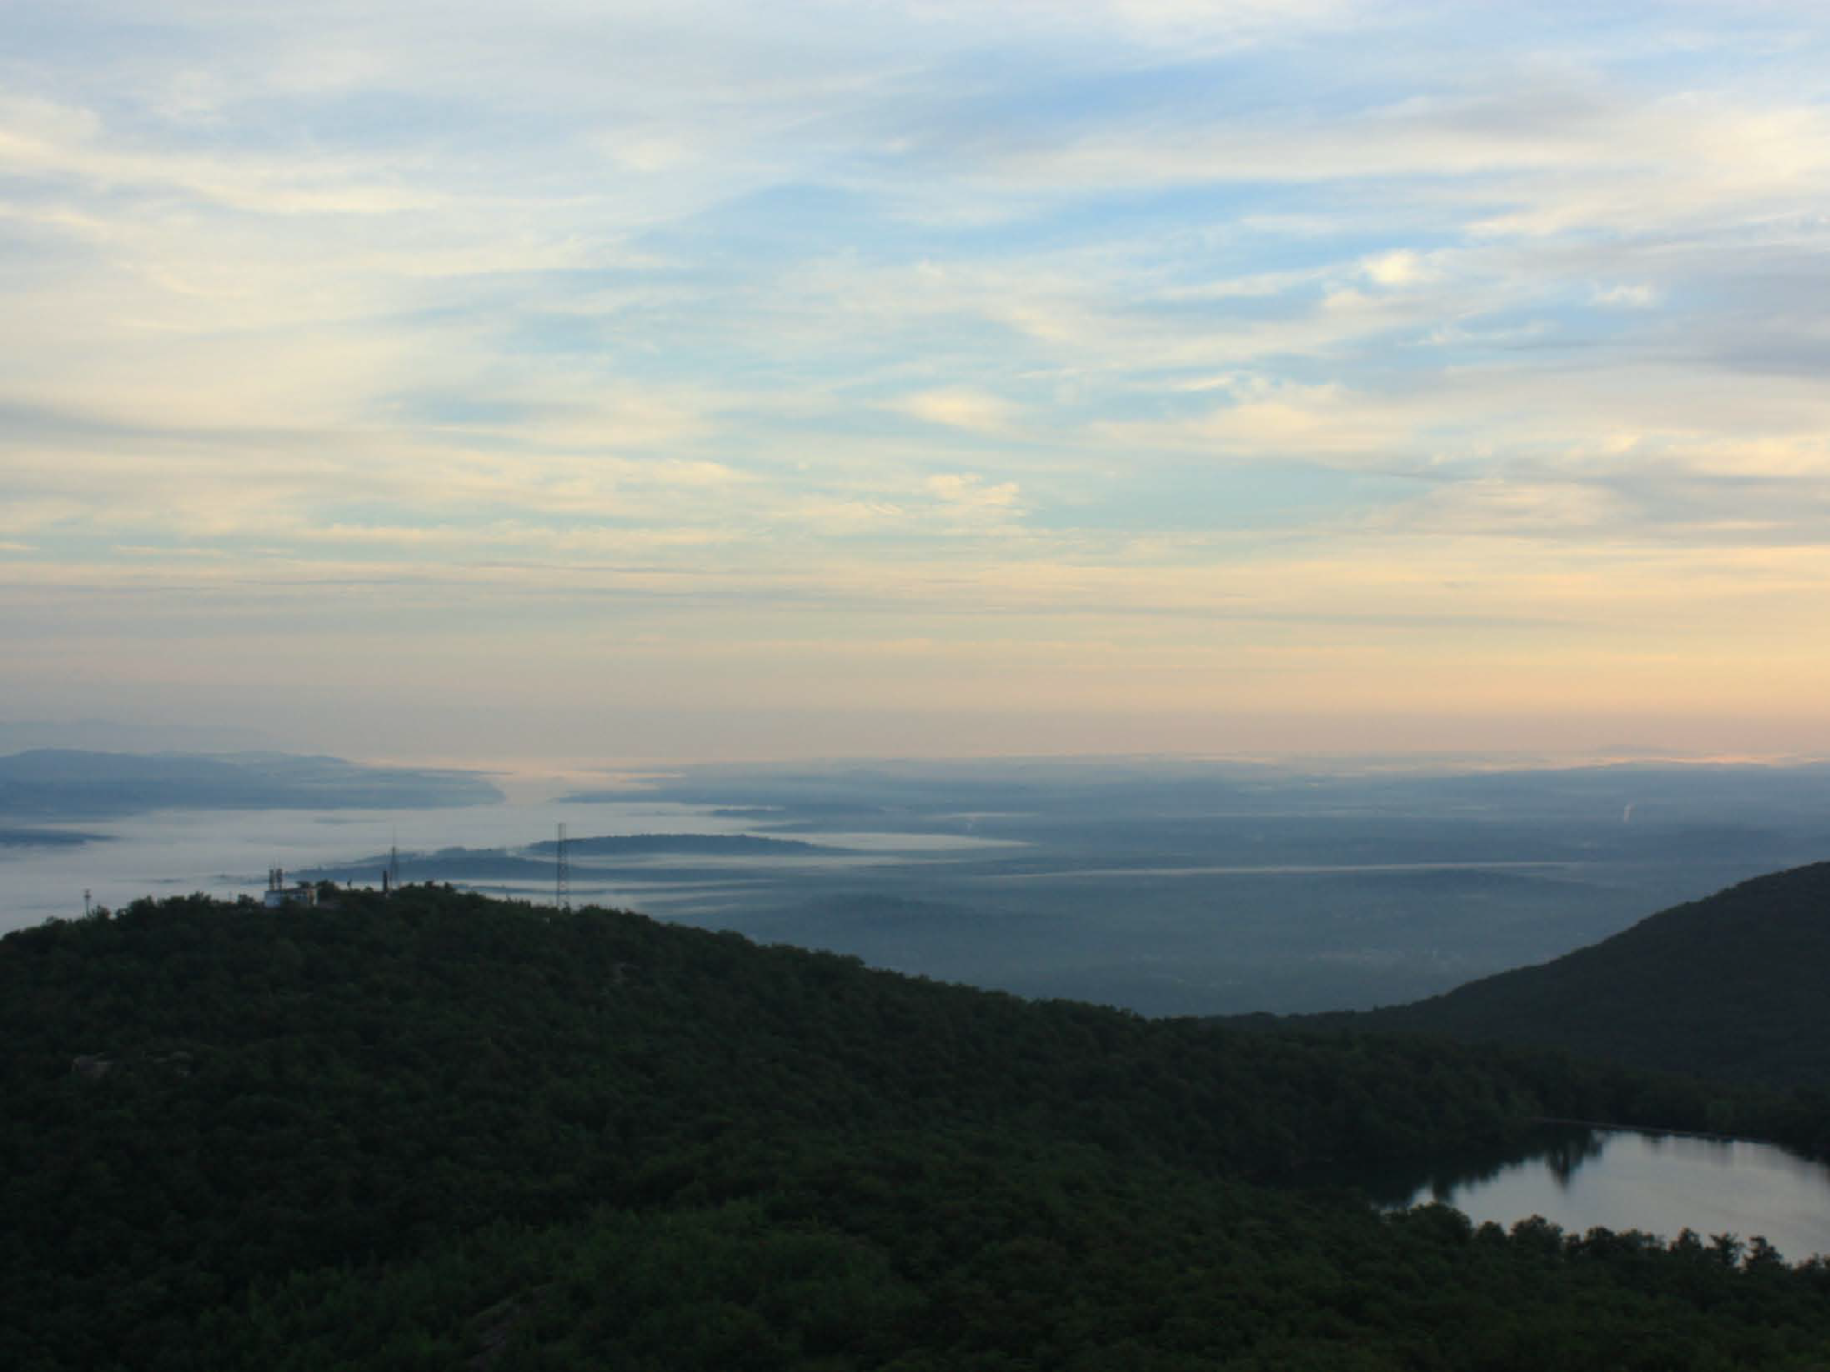
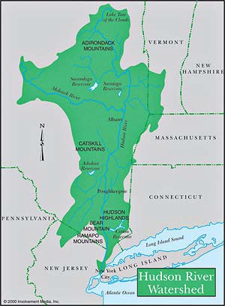
The Hudson as an Ecosystem
What abiotic factors are important?
What lives in the river?
How do nutrients & energy move in the system?
How has the river changed over time?
Notes:
Presenter
2013-07-27 10:28:04
--------------------------------------------
You may want to view the watershed module from http://www.meted.ucar.edu/broadcastmet/watershed/ to help students visualize a watershed. Registration is required, but registration and the resources are free.

Slide 9
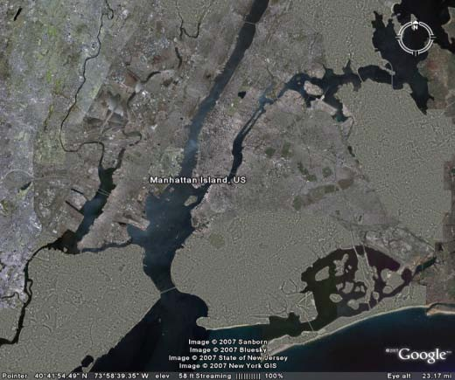
Abiotic: What’s special about it?
Its an estuary
  Tidal
  Fresh & salt water
  Very productive

Slide 10
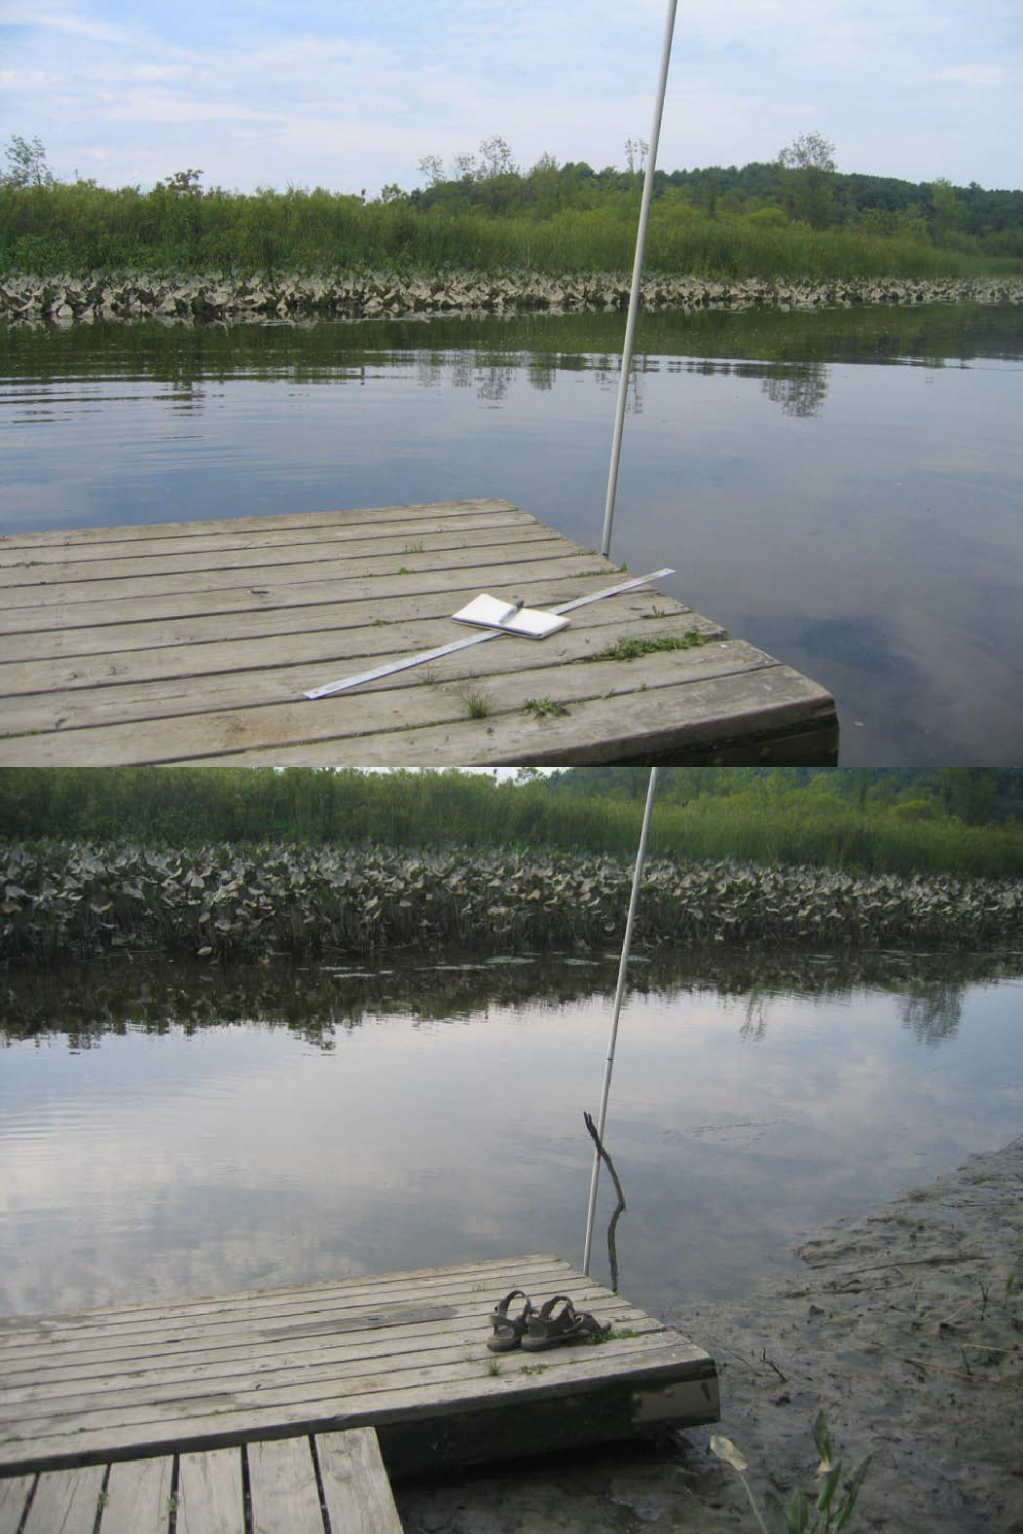
The Hudson River is tidal all the way to the Troy dam.
Some are fresh water tides, like those at Tivoli Bay.

Slide 11
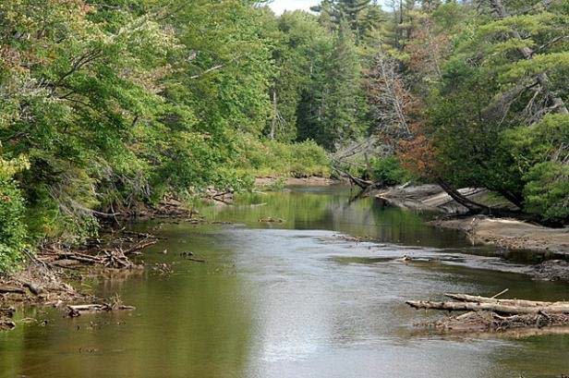
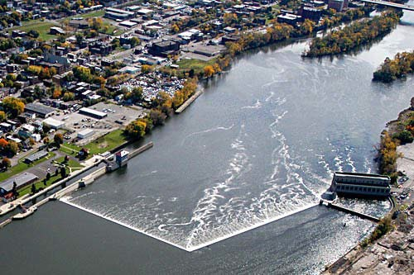
Upper Hudson in the Adirondacks
Federal dam at Troy, NY

Slide 12
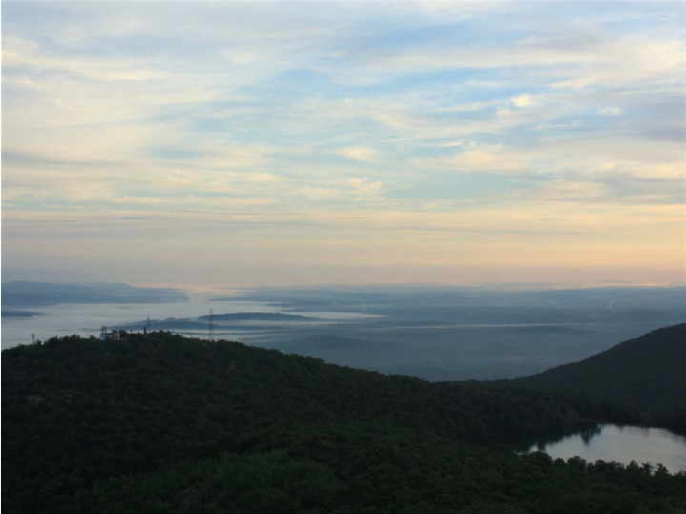
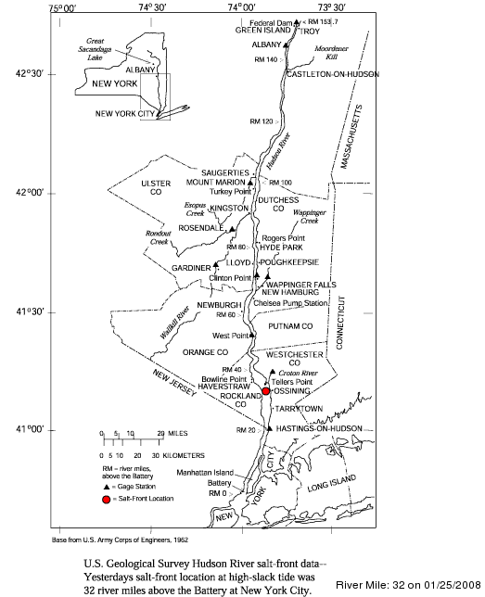
Why does the salt front change?
Notes:
Presenter
2013-07-27 10:28:10
--------------------------------------------
The salt front is where the last measureable amount of salt is found in the river on any given day. It depends on tides, currents, wind, and rainfall.

Slide 13
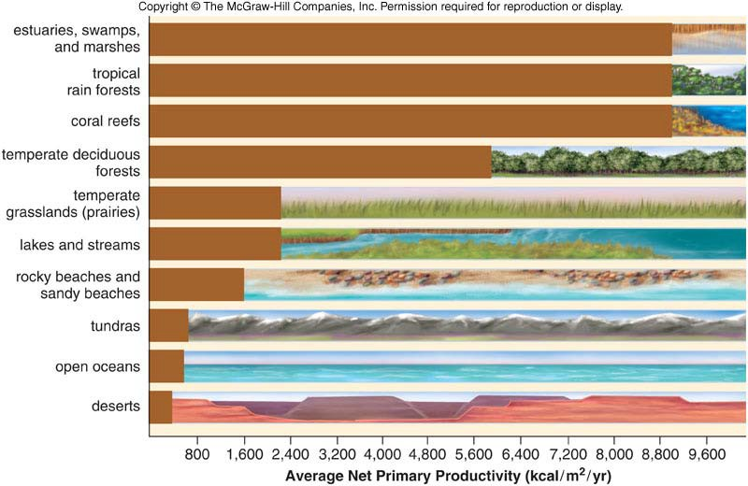
The Hudson, as an estuary, is very productive…what does this mean?
Source: www.globalchange.umich.edu

Slide 14
What is productivity?
Productivity: growth rate of living things
Primary (1°) productivity: growth rate of producers
  Solar energy converted to organic matter (biomass)
  Stored in living organisms
Secondary (2°) productivity: growth rate of consumers
  Organic matter (food) being eaten & used to create new biomass
  Includes most bacteria, archaea, fungi, and animals
Notes:
Presenter
2013-07-27 10:28:12
--------------------------------------------
Ecologists like to talk about the productivity of ecosystems, that is, the amount of solar energy that is stored in living organisms.
Some ecosystems are more efficient at storing energy than others. Because primary producers make oxygen and consume carbon dioxide, we can estimate primary production by measuring the amount of oxygen that is produced (or carbon dioxide that is consumed) in a bottle or in a section of the river. Alternatively, we can add a little carbon-14 (14C), which is radioactive, to a bottle of water, and measure the amount of radioactivity that is picked up by phytoplankton. Secondary production by bacteria is also estimated by measuring the uptake of radioactive nucleic acids or amino acids.

Slide 15
What is productivity?
Important! –All organisms depend on 1° producers for their energy supply.
1° & 2° production is consumed by other organisms, converted to detritus, or accumulated in biomass
What Hudson River organisms are responsible for 1° production? What about 2° production?

Slide 16
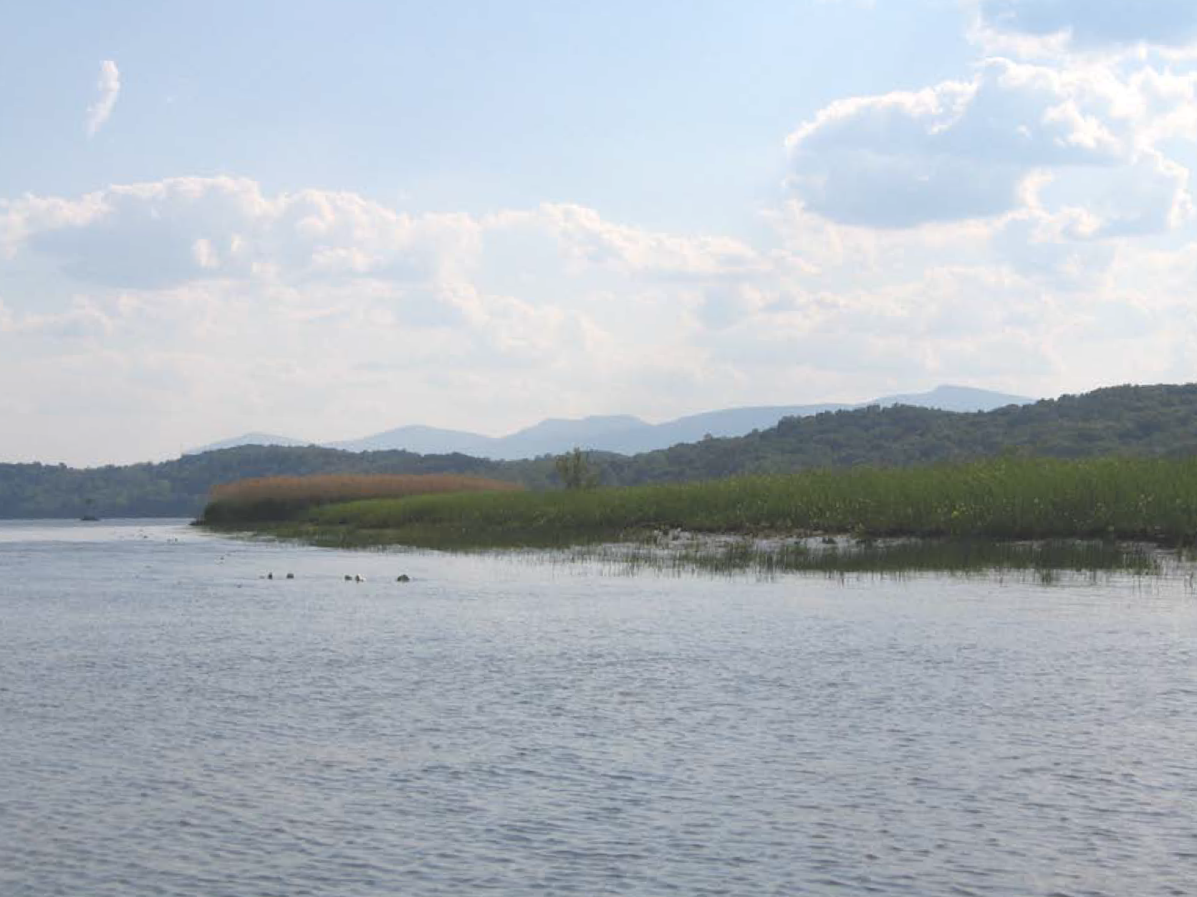
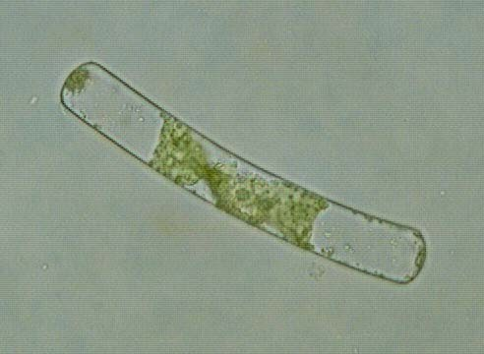
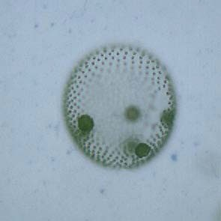
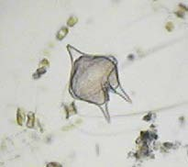
Spirogyra
Volvox
Dinoflagellates
Phytoplankton
Notes:
Presenter
2013-07-27 10:28:16
--------------------------------------------
Primary producers: algae

Slide 17
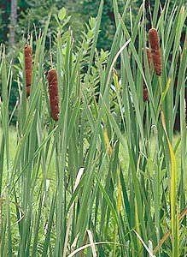
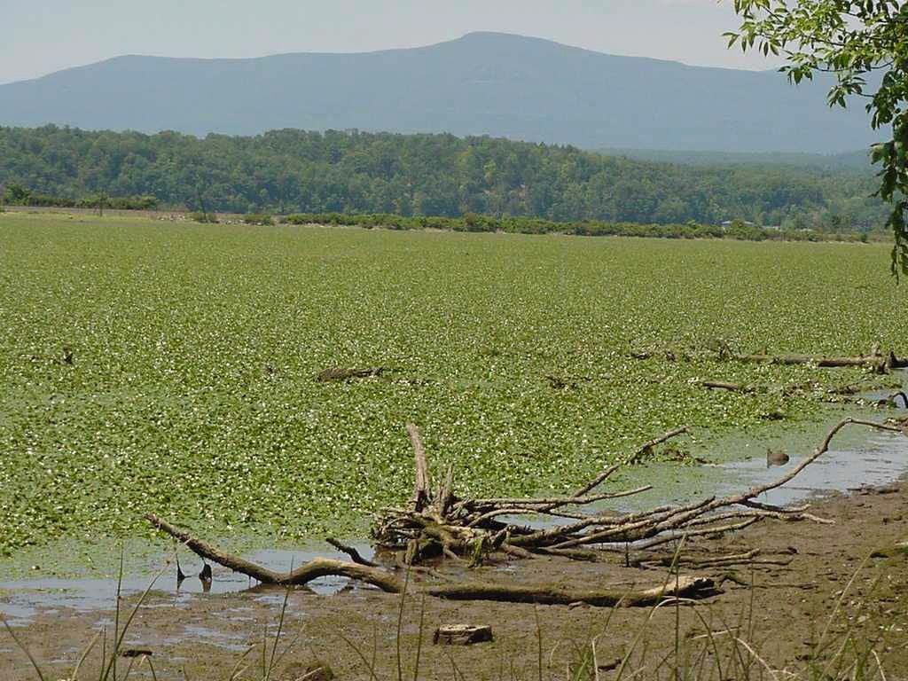
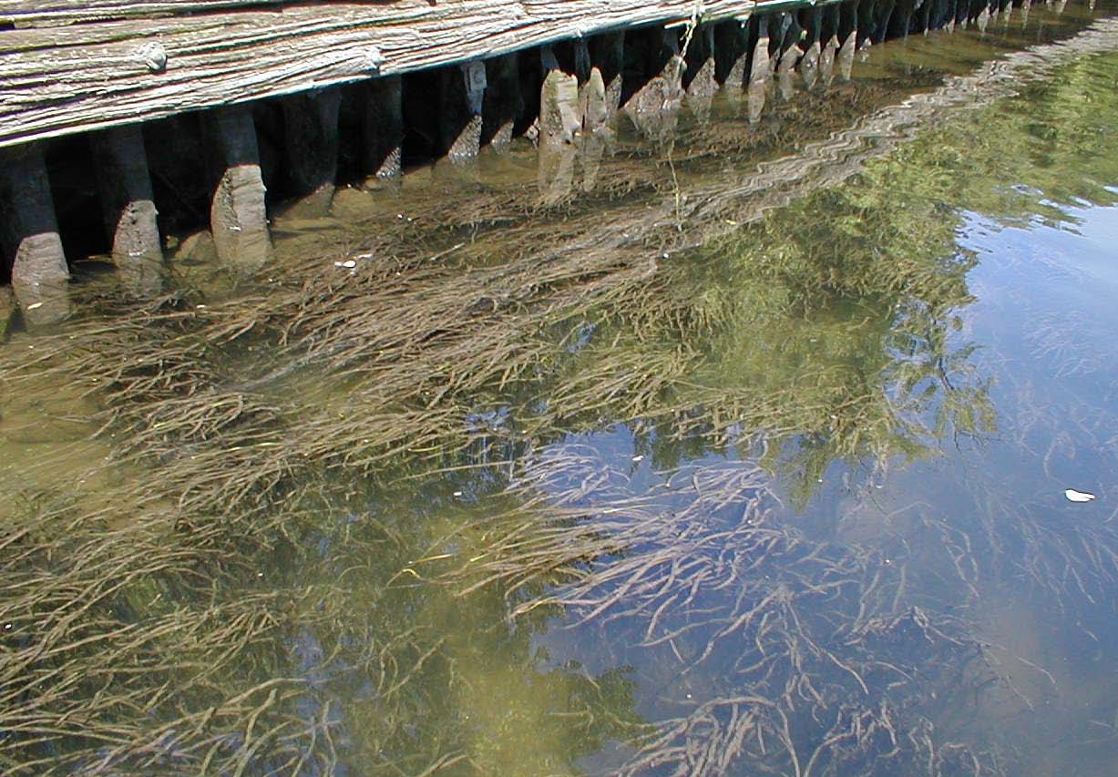
Aquatic macrophytes
Notes:
Presenter
2013-07-27 10:28:18
--------------------------------------------
Primary producers: aquatic macrophytes (i.e. plants that live in the river); Left: cattails; top-right: water chestnut (invasive); lower-left: water celery (native)

Slide 18
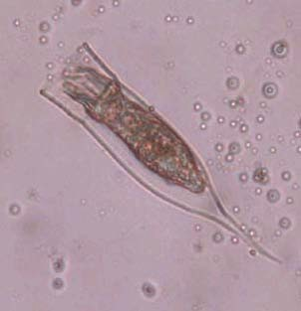
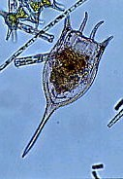
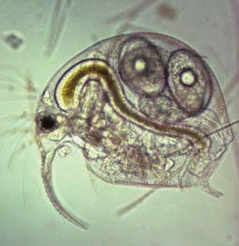
Rotifers
Zooplankton
Rotifers
Cladocerans
Notes:
Presenter
2013-07-27 10:28:20
--------------------------------------------
Consumers: Zooplankton like rotifers and the cladoceran Bosmina, consume primary production, in creating biomass (themselves), they contribute to the ecosystem’s secondary production.

Slide 19
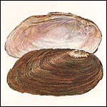
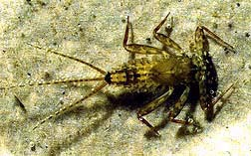
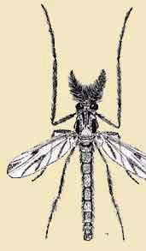
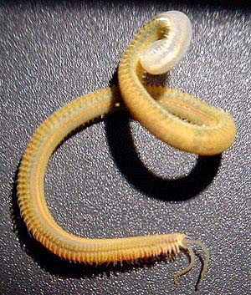
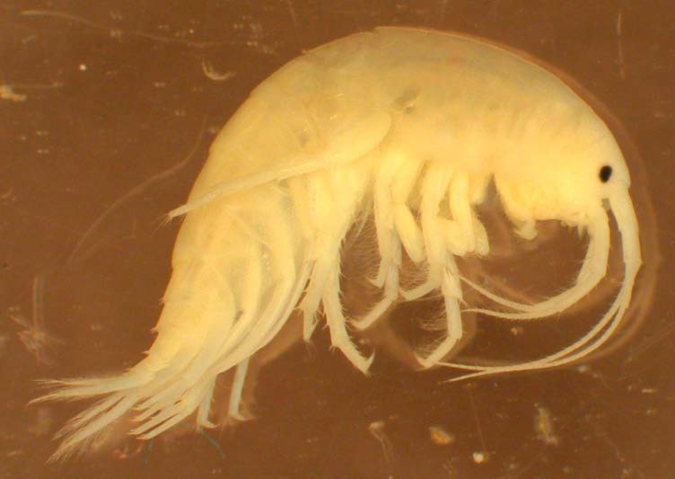
Macroinvertebrates
Notes:
Presenter
2013-07-27 10:28:22
--------------------------------------------
Consumers

Slide 20
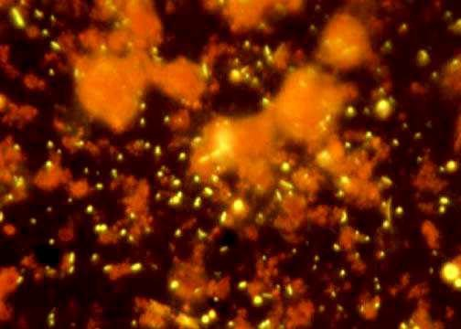
Bacteria
Notes:
Presenter
2013-07-27 10:28:24
--------------------------------------------
Consumers

Slide 21
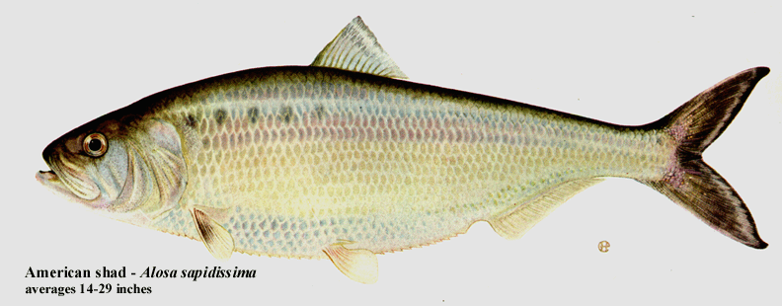
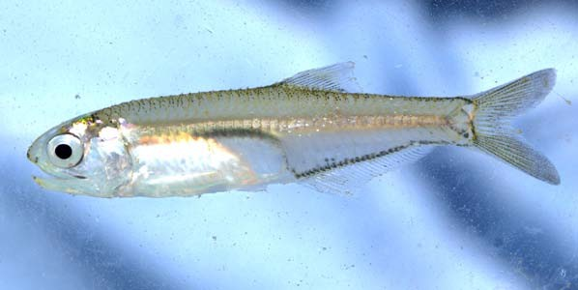
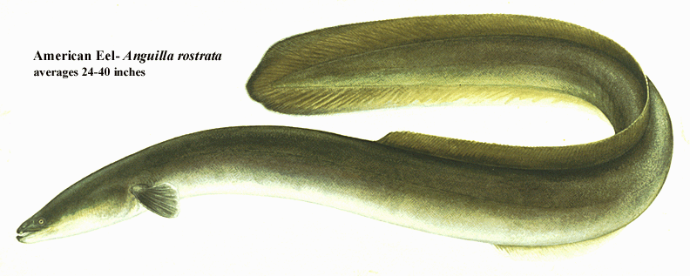
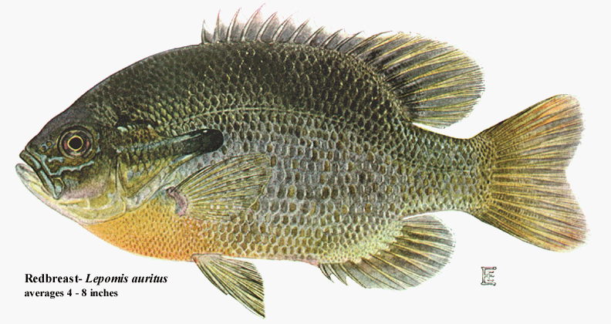
Fishes & other large predators
Notes:
Presenter
2013-07-27 10:28:26
--------------------------------------------
Consumers

Slide 22
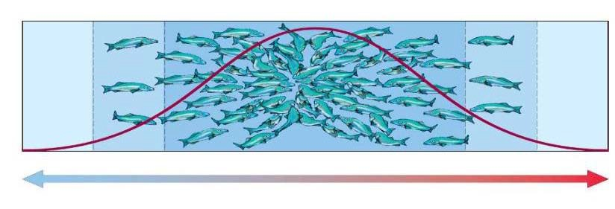
What controls productivity?
“Limiting factors” - Too much or too little of any abiotic factor can limit or prevent growth of a population
What might be a limiting factor in the Hudson?
Notes:
Presenter
2013-07-27 10:28:28
--------------------------------------------
River flow: too much water
Light: not enough, and they can’t grow Predators: grazers
Every part of the food web will have different controls

Slide 23
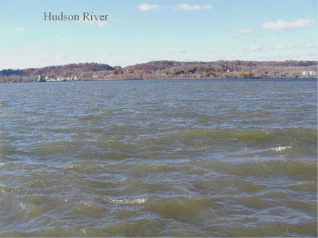
What’s in the water? Mud.
100
80
60
40
20
0
% of surface light
0
5
10
Water depth (m)
15
20
Notes:
Presenter
2013-07-27 10:28:29
--------------------------------------------
The Hudson River is very turbid from all of the sediments that are sloshed around, remaining suspended in it, so light does not penetrate very far into the water. Ask: How might the availability of light in the river affect the plants and animals?

Slide 24












3° consumer
What happens to the useable energy from one level to the next?
2 ° consumer
1 ° consumer

Slide 25
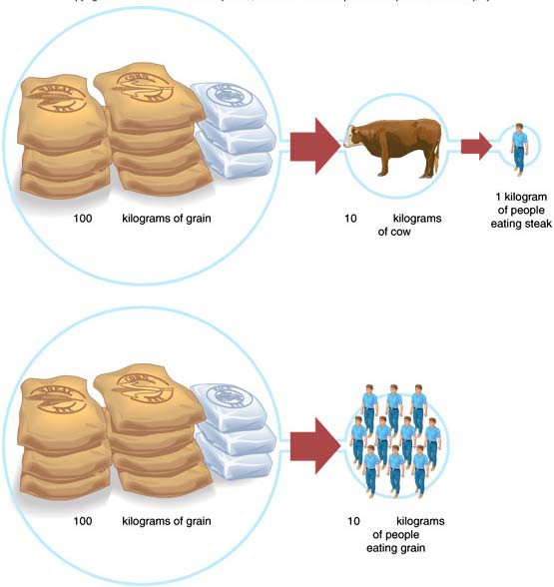
Fig. 8.5

Slide 26
?
Notes:
Presenter
2013-07-27 10:28:35
--------------------------------------------
…which might look something like this in the Hudson River (…though remind the students that really, it’s a food web, not a food chain!)
Ask: Energy is always conserved; so what happens to the energy after the eagle uses it? (Answers: detritivores & scavengers consume/use it, heat is dissipated in the process.)

Slide 27
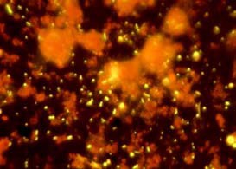
!
Notes:
Presenter
2013-07-27 10:28:38
--------------------------------------------
Ask: Energy is always conserved; so what happens to the energy after the eagle uses it? (Answers: detritivores & scavengers consume/use it; heat is dissipated in the process.)

Slide 28
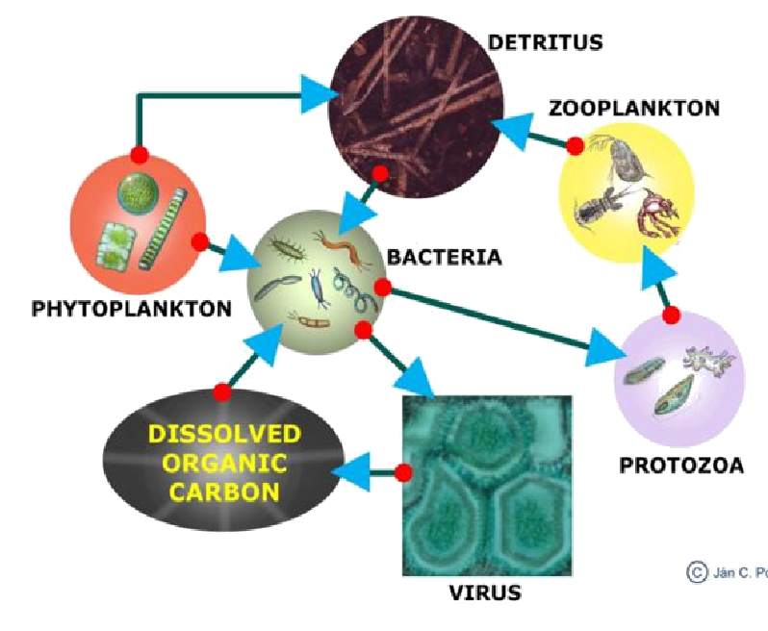
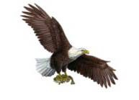
Organisms and Energy
Detritus: dead and decaying organic material
VERY important part of the HR ecosystem (90% of carbon comes from the watershed)
Notes:
Presenter
2013-07-27 10:28:39
--------------------------------------------
Decomposers also need energy
Get it from nonliving organic matter—still energy in bonds Break down organic matter via cellular respiration Release energy, water and carbon dioxide
Trophic levels: an organism’s feeding position in an ecosystems
For example: primary producer, primary consumer, secondary consumer

