Slide 1
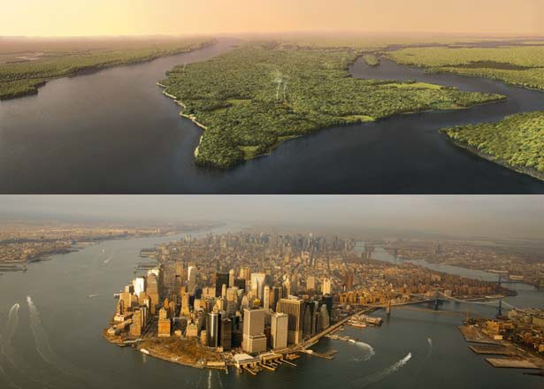
The Hudson Valley: A social-ecological system
Manhattan Island in 1609 and 2009; Mannahatta Project
Notes:
Presenter
2013-07-01 09:41:57
--------------------------------------------
Whether we think about it or not, we all benefit from and use land for a variety of purposes. The next few lessons explore some of those purposes, how land has been used in our area historically, and what types of impacts these uses have had. Computer Generated Image (top) by Markley Boyer, Photograph by Robert Clark. Originally published in National Geographic magazine.

Slide 2
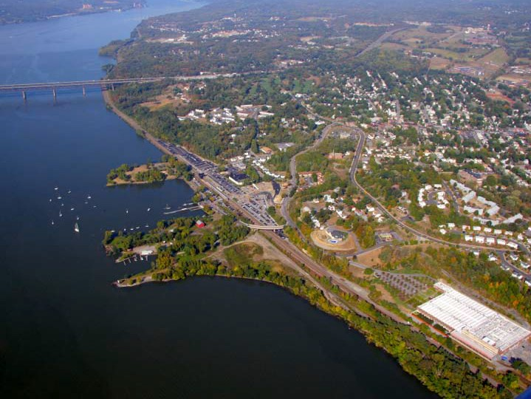
How do you use land?
Photo by Jeff Anzevino
Notes:
Presenter
2013-07-01 09:41:57
--------------------------------------------
Ask students: How do you use land? They’ should come up with things like: food, water, recreation, housing, etc. Photo is of Beacon, NY. Image courtesy of Scenic Hudson, Inc.

Slide 3
How do you use land?
Business
Travel
Home
Recreation
Food
Water
Wildlife habitat
Photo by Jeff Anzevino
Notes:
Presenter
2013-07-01 09:41:57
--------------------------------------------
*Discuss any land uses that they did not come up with and any that they thought of that aren’t here represented. Travel: We build roads, trains, bridges, boat through rivers and across lakes
Recreation: kayaking, swimming, hiking, bicycling, games like hide-and-seek & tag, outdoor bbq’s, etc Food: all of our food comes from land and waters
Water: Clean water for us to drink, healthy waters for our food sources, wildlife, and to swim in
Wildlife habitat: necessary for the insects that pollinate our crops, the birds that eat weed seeds and control mice, rat, and nuisance insect populations, and mammals that we eat and control other populations Business: Necessary for our livelihood, culture, and entertainment
Home: we need a safe, healthy place to live
*Explain that this is a human-centric, yet important question to ask, because the answers affect our health and livelihoods and those of future generations.

Slide 4
How do you think each of these components changed from 1936 -2009?
Topic | Increase? | Decrease?
Forests
Farms
Dams
Wetlands/river shoreline
Housing & roads
Notes:
Presenter
2013-07-01 09:41:57
--------------------------------------------
Predict what you think happened to each of these components between 1936 and 2000.
You can have students write down their predictions or write some up on the board for a before-after comparison.

Slide 5
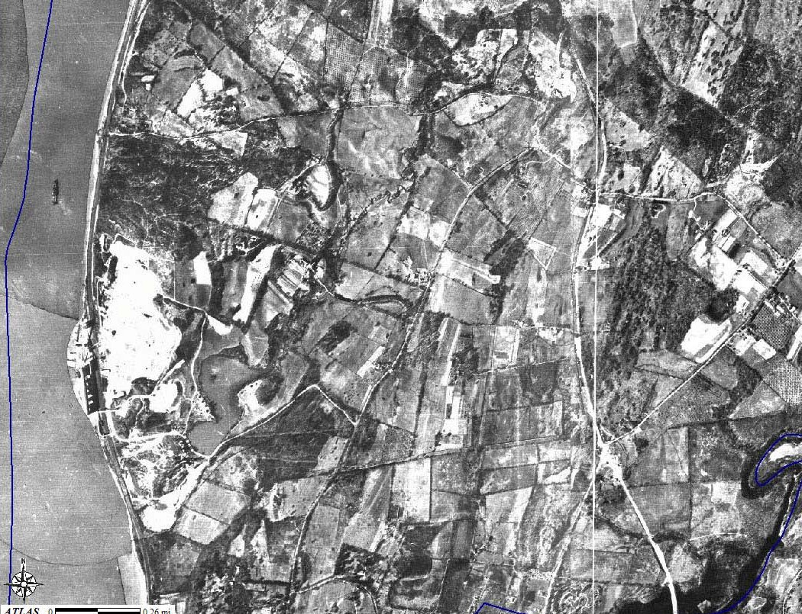
Land Use Activity
Notes:
Presenter
2013-07-01 09:41:57
--------------------------------------------
Use the aerial photos of Dutchess and Westchester counties to determine how accurate your predictions were. 1936 photos:
Aerial Photographic Survey of Dutchess County New York - Made for Dutchess County Planning Board by Fairchild Aerial Surveys In, New York - Flown Spring 1936 - Scale 1 in = 1000 ft. Scanned by Dutchess County Real Property Tax Service Agency, 2004.

Slide 6
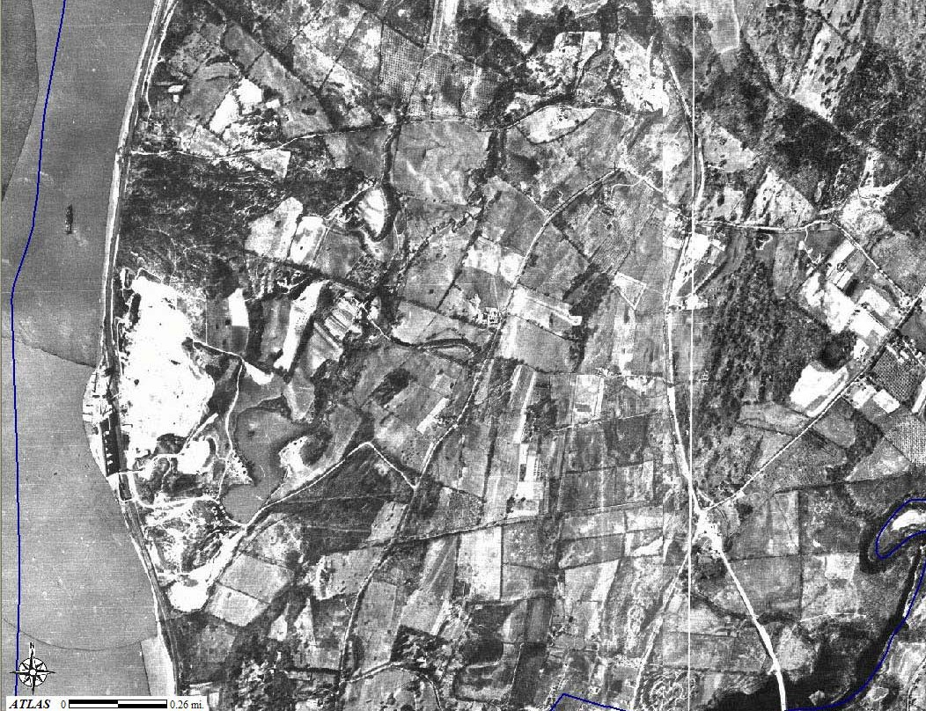
1936: Rt 9, site of current Galleria mall, small quarry visible next to river
Notes:
Presenter
2013-07-01 09:41:57
--------------------------------------------
1936 photos:
Aerial Photographic Survey of Dutchess County New York - Made for Dutchess County Planning Board by Fairchild Aerial Surveys In, New York - Flown Spring 1936 - Scale 1 in = 1000 ft. Scanned by Dutchess County Real Property Tax Service Agency, 2004.

Slide 7
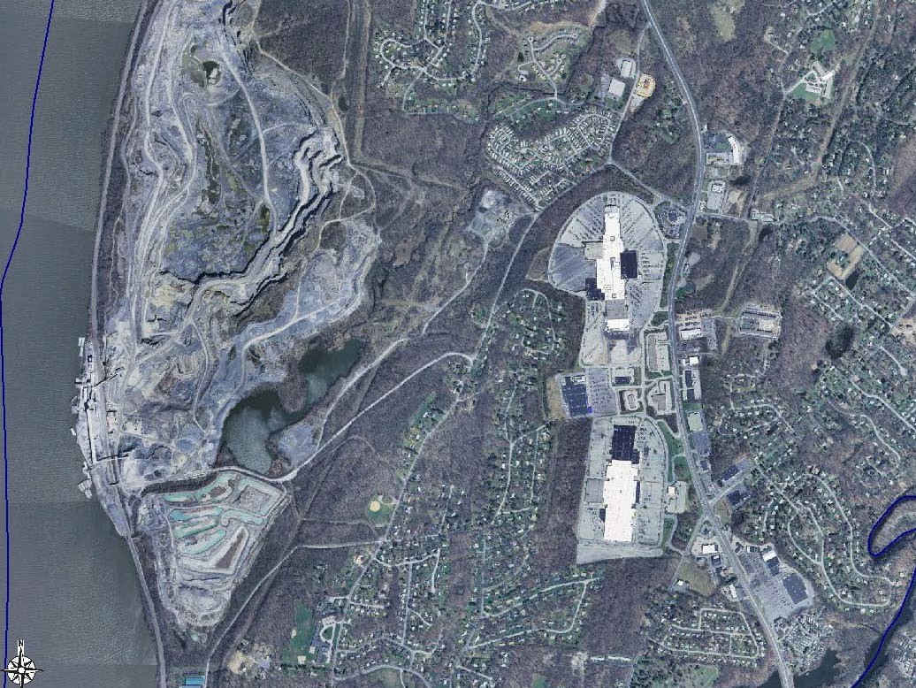
2004: Poughkeepsie Galleria on right hand side, gravel quarry next to river
Notes:
Presenter
2013-07-01 09:41:57
--------------------------------------------
2004 photos:
Dutchess County 12-inch Resolution Natural Color Orthoimagery. NYS Digital Orthoimagery Program (NYSDOP), Spring 2004.

Slide 8
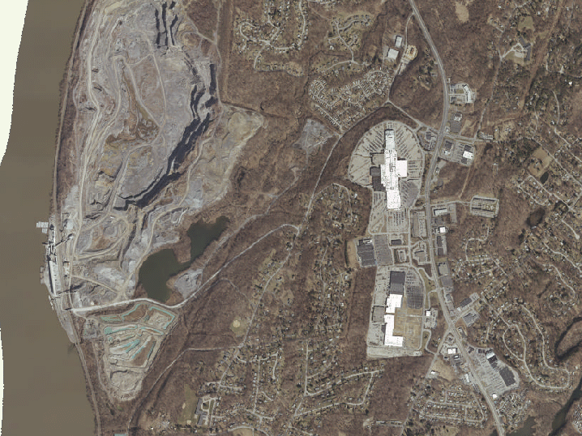
2009: Poughkeepsie Galleria on right hand side, gravel quarry next to river
Notes:
Presenter
2013-07-01 09:41:58
--------------------------------------------
Gravel quarry continues to expand. Continued increase in developed land (quarry, housing, business). 2009 photos:
2009 True Color Aerial Photo at .5 foot pixel size. Contact: Christopher Wren, Dutchess County OCIS. http://geoaccess.co.dutchess.ny.us/geoaccessv2/

Slide 9
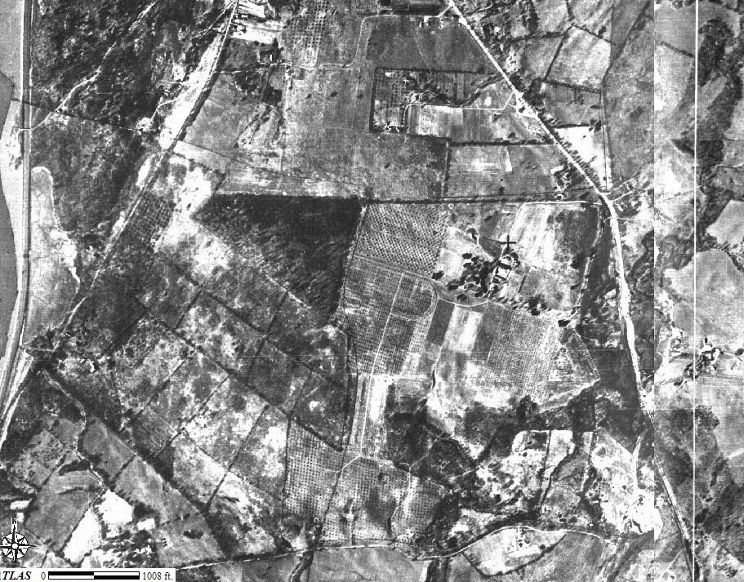
1936: Rt 9 south of Poughkeepsie
Notes:
Presenter
2013-07-01 09:41:58
--------------------------------------------
~75 years ago: Primarily farmland. 1936 photos:
Aerial Photographic Survey of Dutchess County New York - Made for Dutchess County Planning Board by Fairchild Aerial Surveys In, New York - Flown Spring 1936 - Scale 1 in = 1000 ft. Scanned by Dutchess County Real Property Tax Service Agency, 2004.

Slide 10
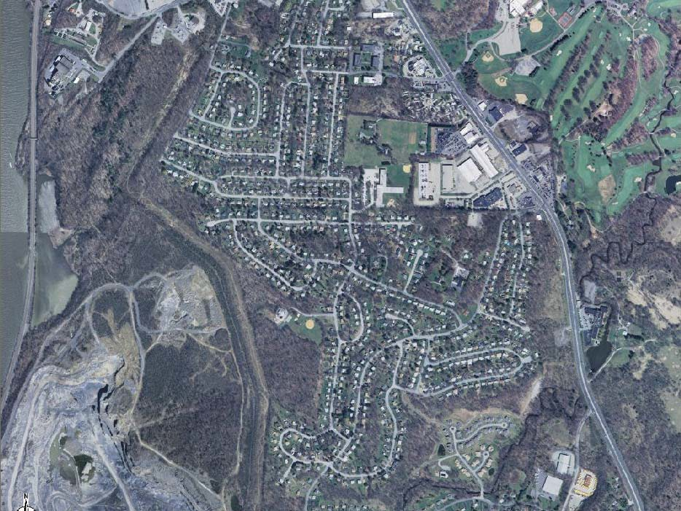
2004: Rt 9 south of Poughkeepsie (top of quarry is visible)
Notes:
Presenter
2013-07-01 09:41:58
--------------------------------------------
--Top of the quarry is not visible in 1936 photo. The quarry exists but was much smaller. The quarry is even larger now than it was in the 2004 photo (next).
--Golf course built on old farms and further fragments already fragmented forest.
–Neighborhoods built on old farms. The small, triangular-shaped forest in the center of the 1936 photo was clearly sold as a lot and developed for housing.
**Compare the location of forests in the prior photo to this one: Note that most present-day forested land is new growth on old agricultural land.** 2004 photos:
Dutchess County 12-inch Resolution Natural Color Orthoimagery. NYS Digital Orthoimagery Program (NYSDOP), Spring 2004.

Slide 11
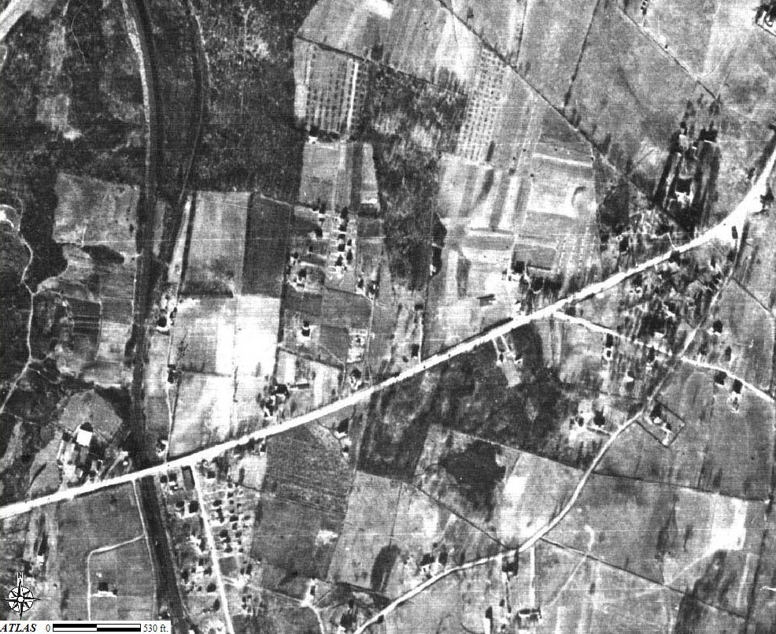
1936: Rt 44 leaving Poughkeepsie
Notes:
Presenter
2013-07-01 09:41:58
--------------------------------------------
1936 photos:
Aerial Photographic Survey of Dutchess County New York - Made for Dutchess County Planning Board by Fairchild Aerial Surveys In, New York - Flown Spring 1936 - Scale 1 in = 1000 ft. Scanned by Dutchess County Real Property Tax Service Agency, 2004.

Slide 12
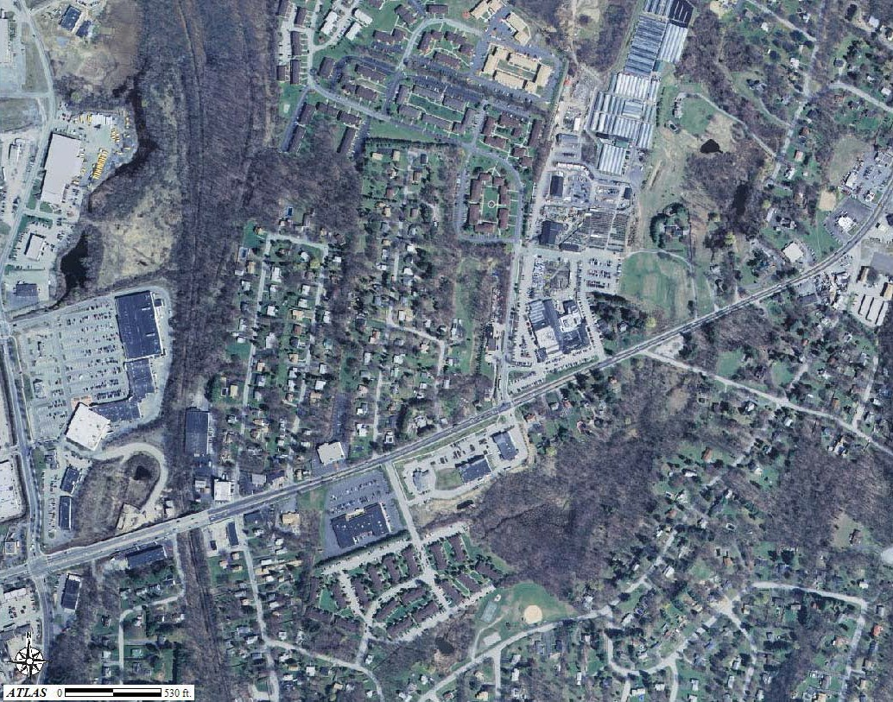
2004: Rt 44 leaving Poughkeepsie; Stop and Shop plaza is on the left hand side, Adams Fairacre Farms is in the middle of the photo
Notes:
Presenter
2013-07-01 09:41:58
--------------------------------------------
2004 photos:
Dutchess County 12-inch Resolution Natural Color Orthoimagery. NYS Digital Orthoimagery Program (NYSDOP), Spring 2004.

Slide 13
←North
1798
Notes:
Presenter
2013-07-01 09:42:07
--------------------------------------------
1798 map from:
Platt, Edmund. The Eagle’s History of Poughkeepsie: From the Earliest Settlements 1683-1905. Poughkeepsie, NY: Platt & Platt, 1905.

Slide 14
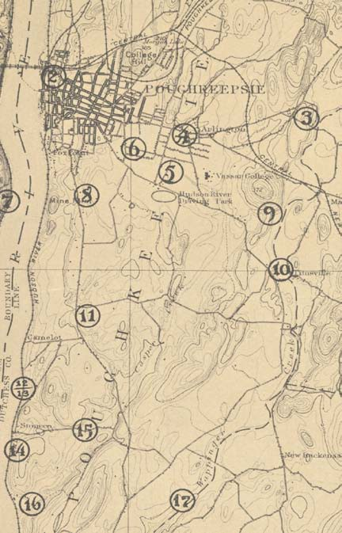
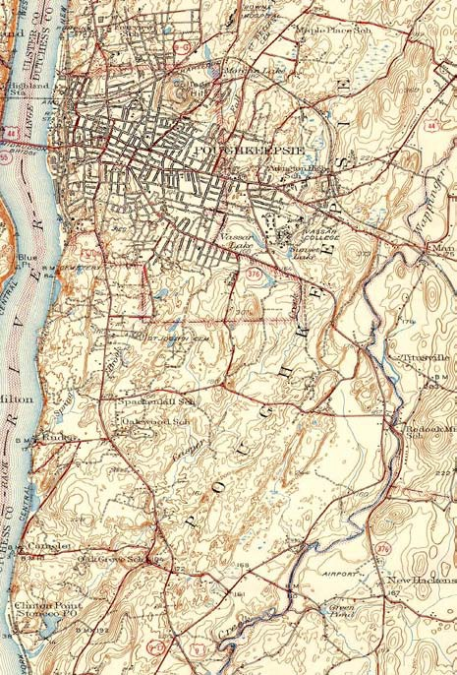
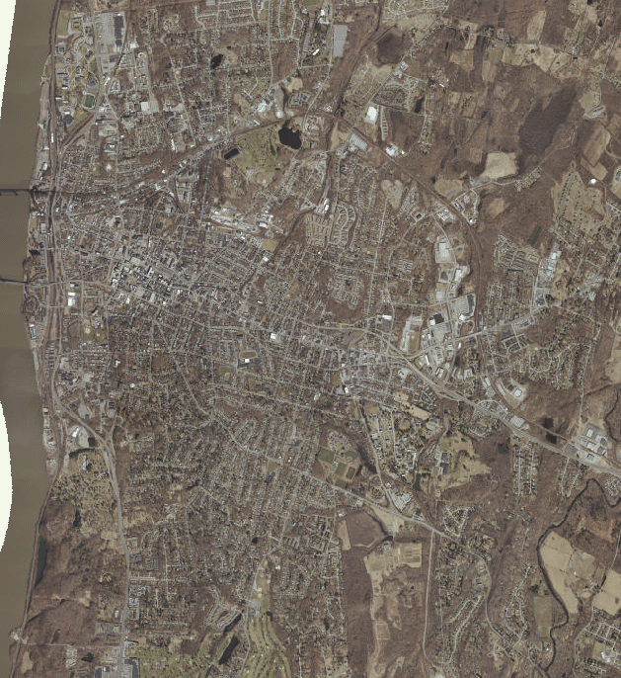
1891
1943
2009
Notes:
Presenter
2013-07-01 09:42:08
--------------------------------------------
A map-visual version of the population growth from 1891 to present day. (Numbers in 1891 map refer to streams)
1891 map created by the USGS, from:
Reynolds, Helen Wilkinson. Poughkeepsie: The Origin and Meaning of the Word, Volume 1. Poughkeepsie, NY: Collections of the Dutchess County Historical Society, 1924.

Slide 15
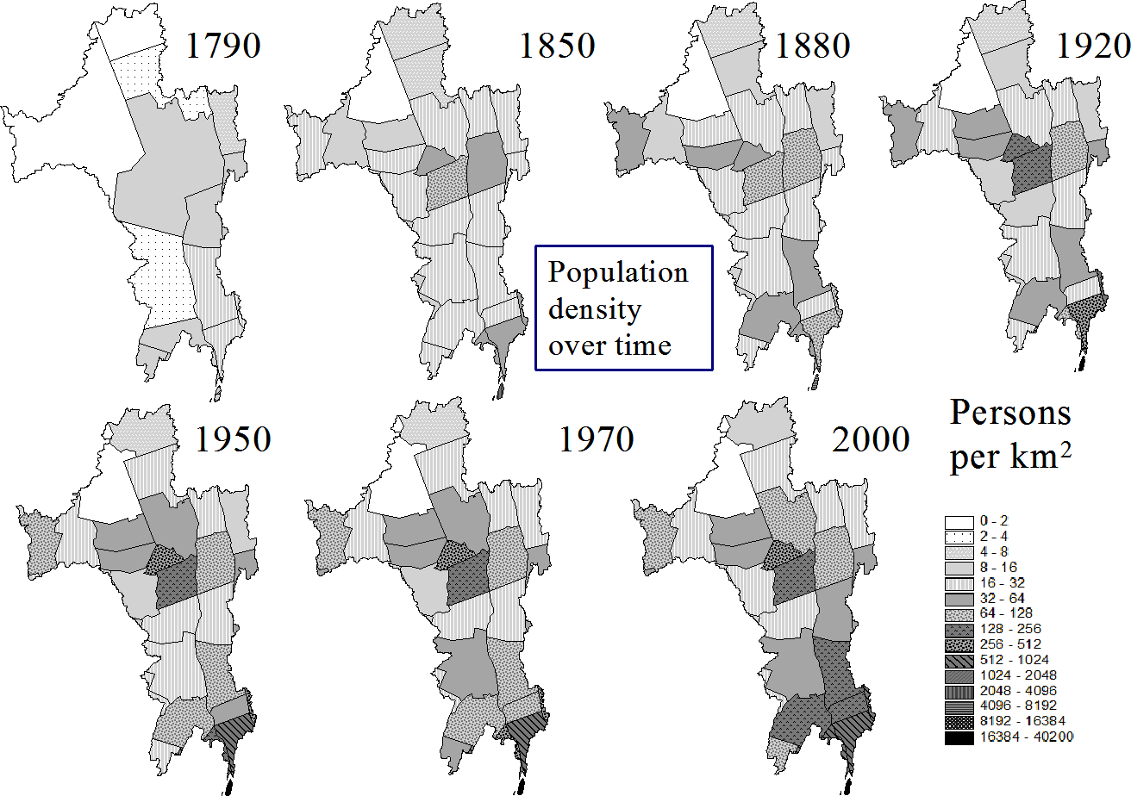
Population
Source: Swaney et.al 2006
Notes:
Presenter
2013-07-01 09:42:08
--------------------------------------------
Dutchess County is circled, where population density increased ~10-fold over the last 200 years. This means that where there used to be 20 people living within one km2 area, there are now 200 people living in that same area.

Slide 16
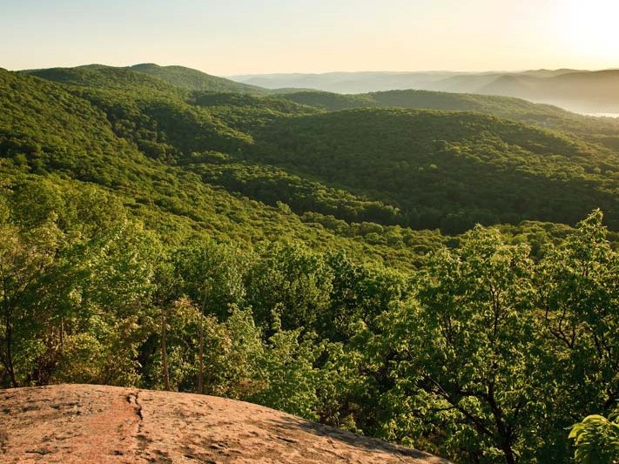
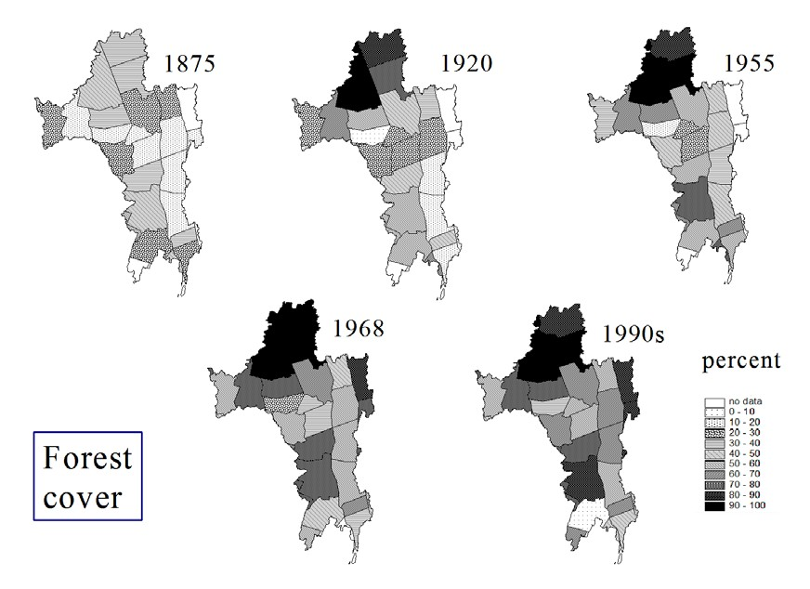
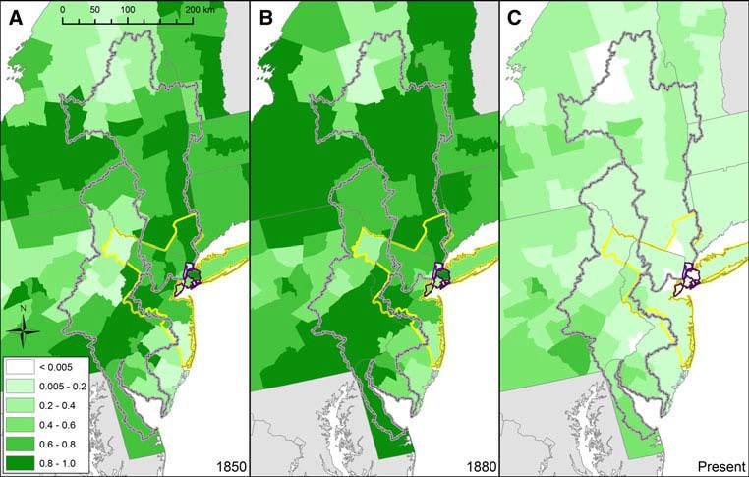
Proportion of land in
farms and forest
Swaney et al. 2006
Swaney et al. 2012
Photo by Robert Rodriguez, Jr.
Notes:
Presenter
2013-07-01 09:42:09
--------------------------------------------
Here we see the spatial distribution of farmland in our watershed (lower left image, upper right grey outline; lower left grey outline denotes Delaware watershed) & forest cover (upper right) through time. Between 1850 (1st panel) and 1880 (2nd panel) farmland was still increasing. But today (3rd panel), very little land is used for farming. Much of it has been replaced by young forests.
Image is reproduction of Figure 3 from:
Historical changes in the food and water supply systems of the New York City Metropolitan Area. Swaney, Dennis P.; Santoro, Renee L.; Howarth, Robert W.; et al. REGIONAL ENVIRONMENTAL CHANGE Volume: 12 Issue: 2 Special Issue: SI Pages: 363-380 DOI: 10.1007/s10113-011-0266-1 Published: JUN 2012

Slide 17
We all have land use goals
-shelter …..home sites
-food production ….farms
-economy, services …businesses, roads
-clean water ….wetlands, forests
-aesthetic beauty ….gardens, green space
-recreation ….rivers, lawn, hiking trails
-flood prevention ….dams, wetlands
-protect wildlife ….healthy natural areas
-climate mitigation ….forests
Photo by Jeff Anzevino
Notes:
Presenter
2013-07-01 09:42:10
--------------------------------------------
We all use our land in lots of ways for many different purposes. Our land provides our shelter, food, water, business needs and recreation.
**Encourage students to remember that we ‘use’ even undeveloped land, such as forested areas: Forests cool our communities, sequester CO2 and therefore affect the global climate, filter & clean our water supplies, provide wildlife habitat, and mitigate floods by taking up a lot of water through transpiration.

Slide 18
What did you observe?
Why might we want to increase or decrease each of these components on our land?
Topic | Increase? | Decrease?
Forests
Farms
Dams
Wetlands/river shoreline
Housing & roads
Notes:
Presenter
2013-07-01 09:42:10
--------------------------------------------
--Discuss which land use components you saw increase or decrease in the aerial photos.
--Brainstorm reasons they might have seen increases or decreases in these components when observing the aerial photos.
***This can be used as a homework/research jigsaw activity
Point out that we still have many of the same needs (food, clean water, healthy wildlife, etc). How do the changes they saw affect our ability to meet these needs?

Slide 19
Why might we want to increase or decrease each of these components on our land?
Topic | Increase? | Decrease?
Forests | Improve air & water quality Climate & flood mitigation Preserve habitat & biodiversity Recreation, scenic views | Logging for paper, wood Clearing for homes, industrial buildings, parking lots
Farms | Food production Animal feed Biofuels | Economically not worth it Poor soil
Dams | Flood control, water supply Hydroeletric power | Preserve habitat & biodiversity Preserve fishery health
Wetlands/river shoreline | Flood prevention/mitigation Improve water quality Preserve habitat & biodiversity | Cheap land for homes, industrial development, and farming
Housing & roads | Local population increase Sprawling development | Population decrease Land reclamation / Re- purposing
Notes:
Presenter
2013-07-01 09:42:10
--------------------------------------------
Discuss some of the reasons they might have seen increases or decreases in these components when observing the aerial photos. (This is not an exhaustive list.)
Point out that we still have many of the same needs (food, clean water, healthy wildlife, etc). How do the changes they saw affect our ability to meet these needs?

