Slide 1
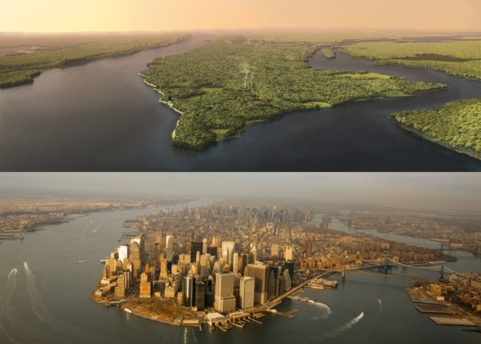
The Hudson Valley: A social-ecological system
Manhattan Island in 1609 and 2009; Mannahatta Project
Notes:
Whether we think about it or not, we all benefit from and use land for a variety of purposes. The next few lessons explore some of those purposes, how land has been used in our area historically, and what types of impacts these uses have had.
Computer Generated Image (top) by Markley Boyer, Photograph by Robert Clark. Originally published in National Geographic magazine.

Slide 2
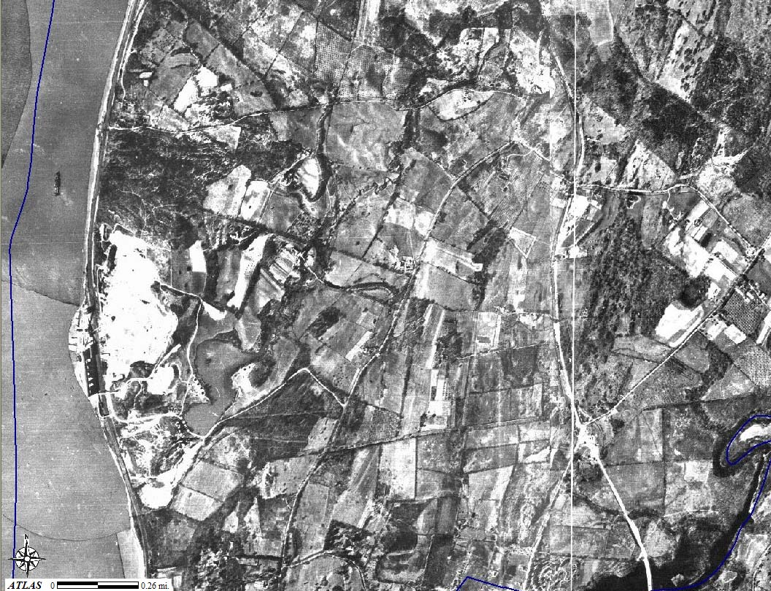
1936: Rt 9, site of current Galleria mall, small quarry visible next to river
Notes:
1936 photos:
Aerial Photographic Survey of Dutchess County New York - Made for Dutchess County Planning Board by Fairchild Aerial Surveys In, New York - Flown Spring 1936 - Scale 1 in = 1000 ft. Scanned by Dutchess County Real Property Tax Service Agency, 2004.

Slide 3
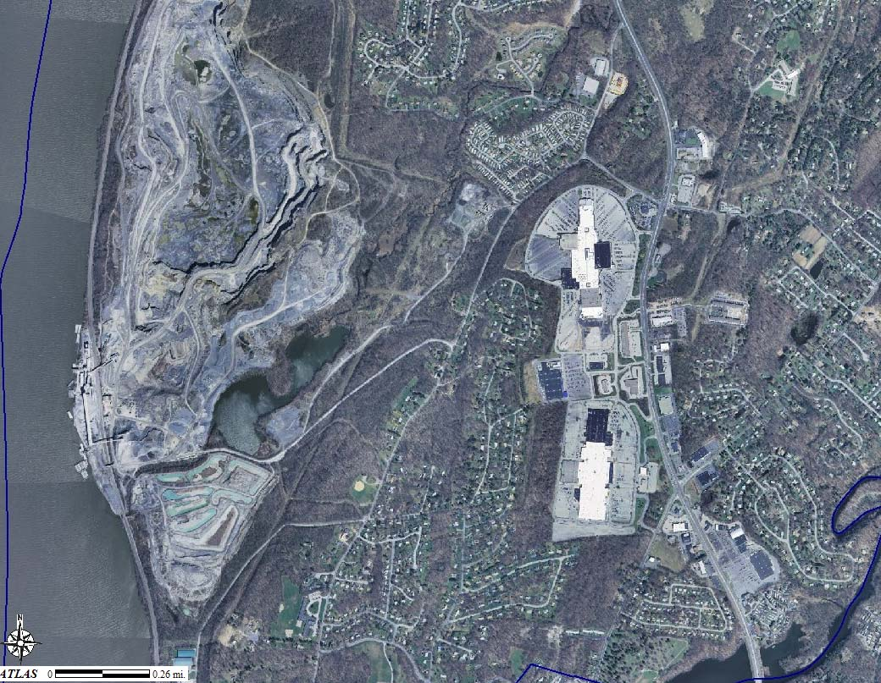
2004: Poughkeepsie Galleria on right hand side, gravel quarry next to river
Notes:
2004 photos:
Dutchess County 12-inch Resolution Natural Color Orthoimagery. NYS Digital Orthoimagery Program (NYSDOP), Spring 2004.

Slide 4
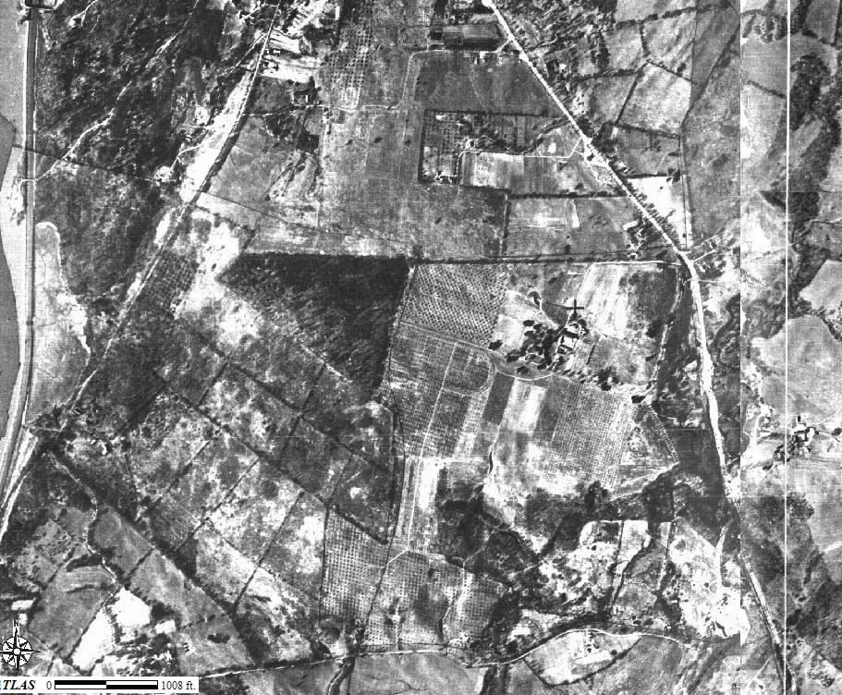
1936: Rt 9 south of Poughkeepsie
Notes:
~75 years ago: Primarily farmland.
1936 photos:
Aerial Photographic Survey of Dutchess County New York - Made for Dutchess County Planning Board by Fairchild Aerial Surveys In, New York - Flown Spring 1936 - Scale 1 in = 1000 ft. Scanned by Dutchess County Real Property Tax Service Agency, 2004.

Slide 5
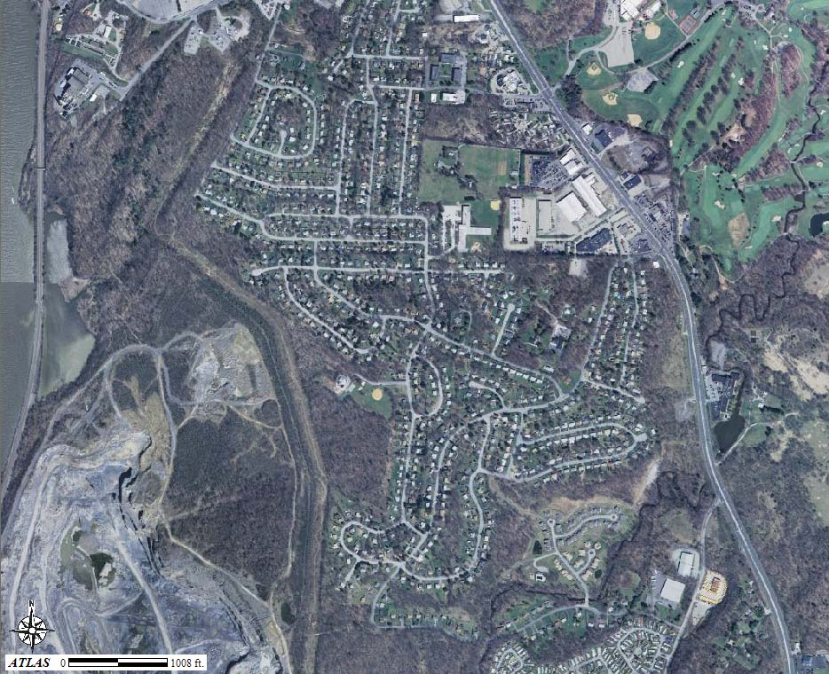
2004: Rt 9 south of Poughkeepsie (top of quarry is visible)
Notes:
--Top of the quarry is not visible in 1936 photo. The quarry exists but was much smaller. The quarry is even larger now than it was in the 2004 photo (next).
--Golf course built on old farms and further fragments already fragmented forest.
–Neighborhoods built on old farms. The small, triangular-shaped forest in the center of the 1936 photo was clearly sold as a lot and developed for housing.
**Compare the location of forests in the prior photo to this one: Note that most present-day forested land is new growth on old agricultural land.**
2004 photos:
Dutchess County 12-inch Resolution Natural Color Orthoimagery. NYS Digital Orthoimagery Program (NYSDOP), Spring 2004.

Slide 6
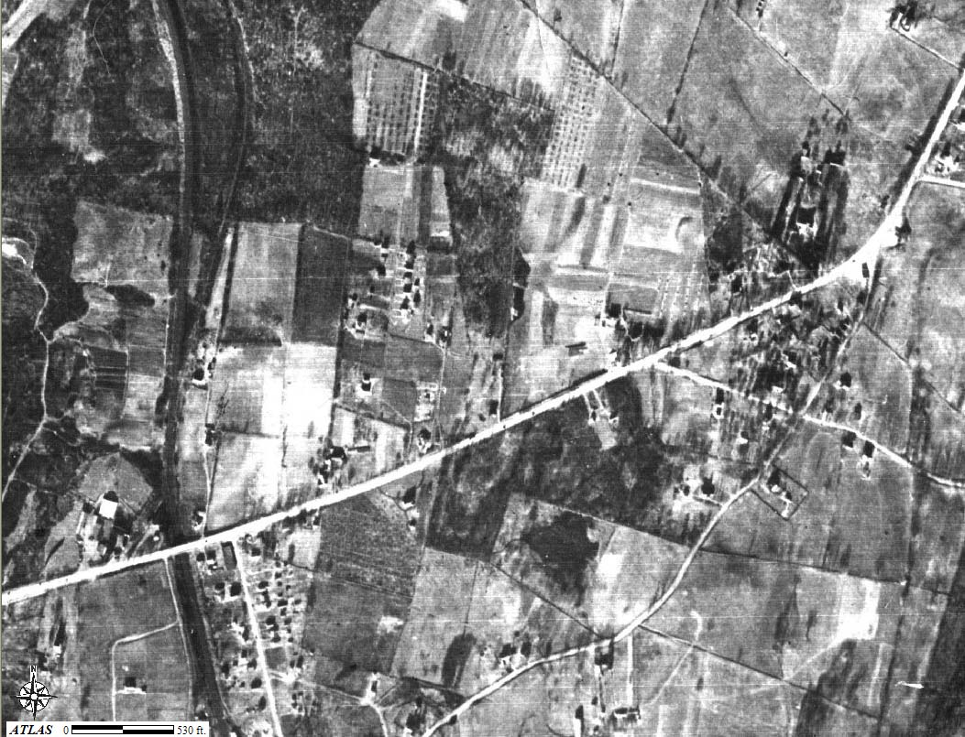
1936: Rt 44 leaving Poughkeepsie
Notes:
1936 photos:
Aerial Photographic Survey of Dutchess County New York - Made for Dutchess County Planning Board by Fairchild Aerial Surveys In, New York - Flown Spring 1936 - Scale 1 in = 1000 ft. Scanned by Dutchess County Real Property Tax Service Agency, 2004.

Slide 7
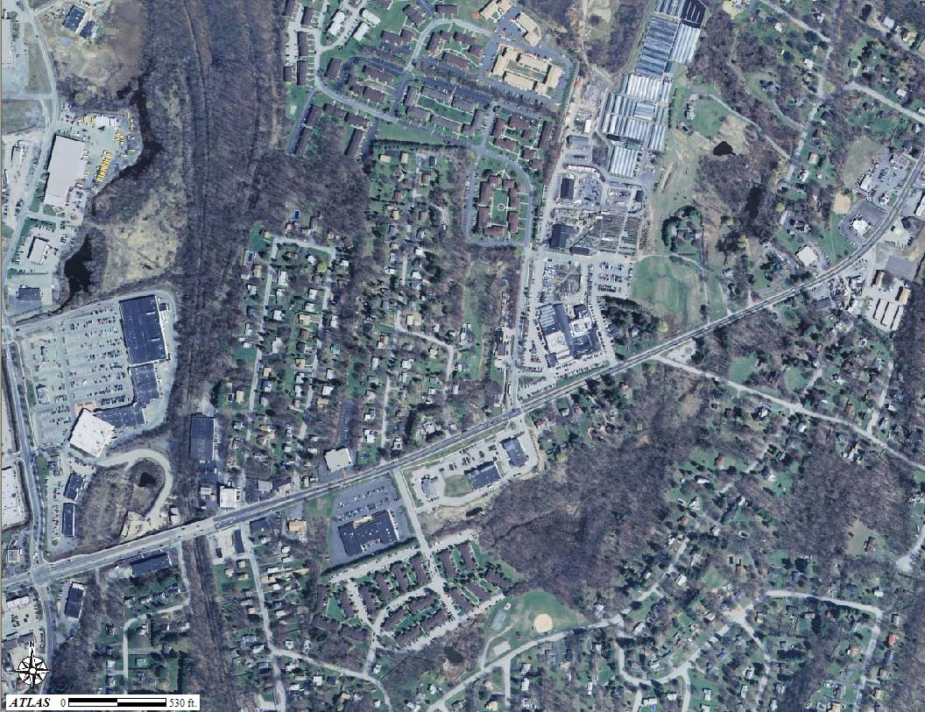
2004: Rt 44 leaving Poughkeepsie; Stop and Shop plaza is on the left hand side, Adams Fairacre Farms is in the middle of the photo
Notes:
2004 photos:
Dutchess County 12-inch Resolution Natural Color Orthoimagery. NYS Digital Orthoimagery Program (NYSDOP), Spring 2004.

Slide 8
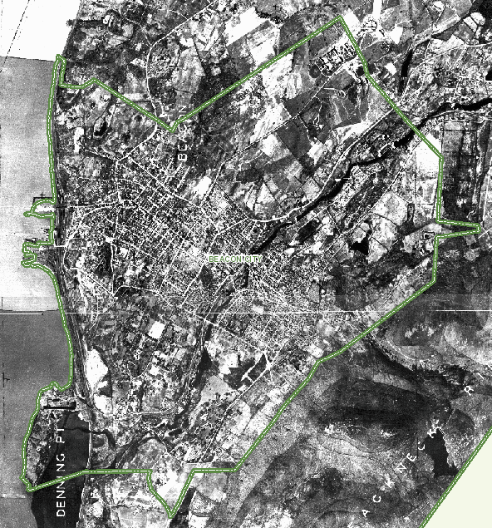

Slide 9
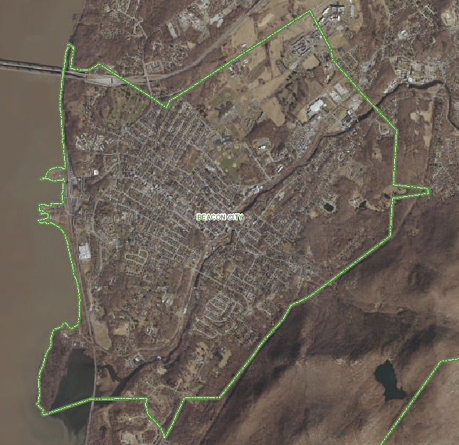

Slide 10
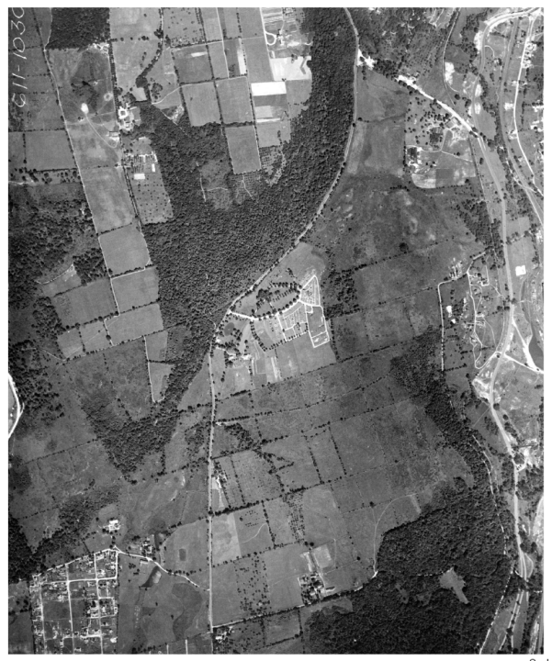
White Plains, 1925
(although the images do not match up exactly, you can see the contour outline of the trees in the second image, along with the development that is circled)

Slide 11
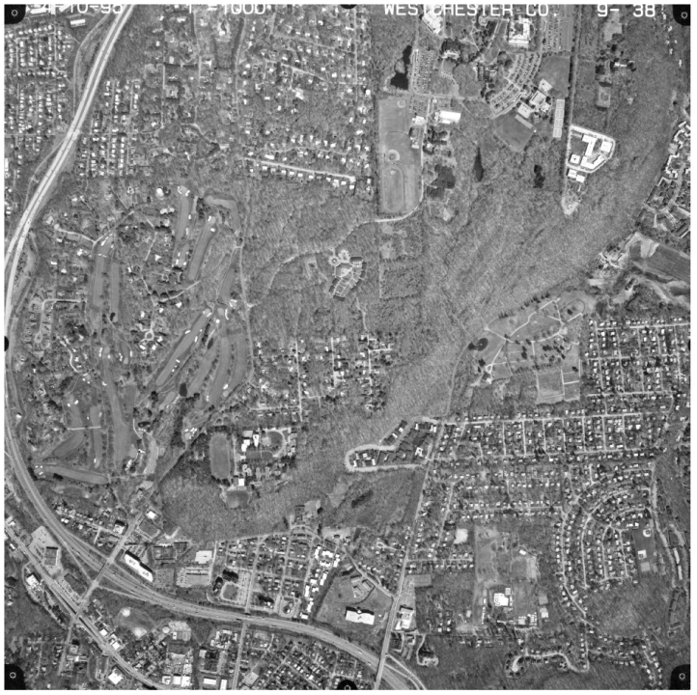
White Plains, 1995
Interstate 287/87

Slide 12
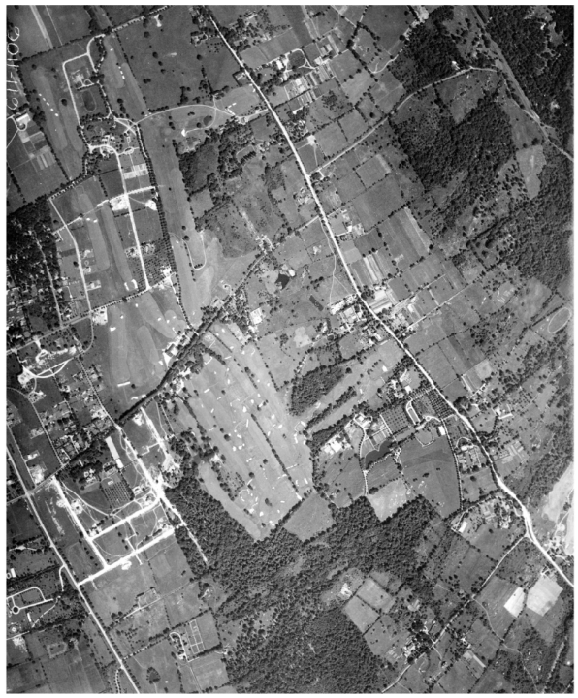
White Plains, 1925

Slide 13
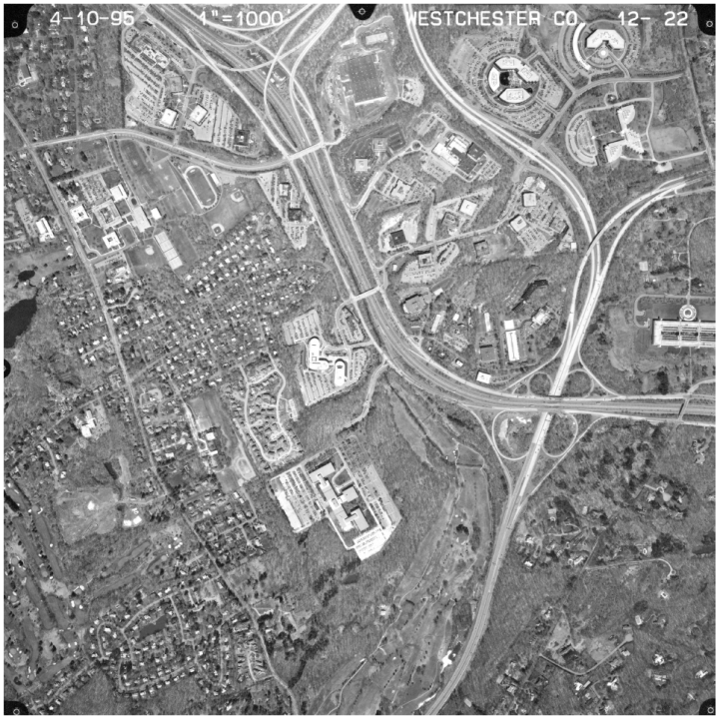
White Plains, 1995

Slide 14
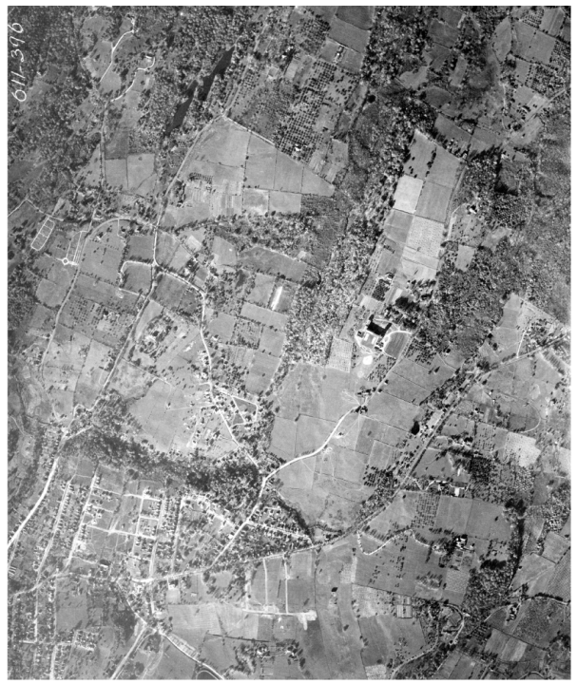
Ossining, 1925
Use the small lakes in the upper left hand corner as reference.

Slide 15
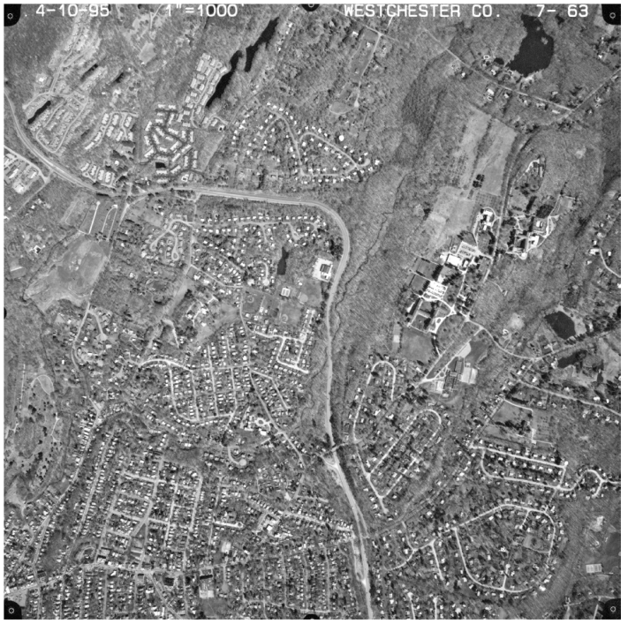
Ossining, 1995

Slide 16
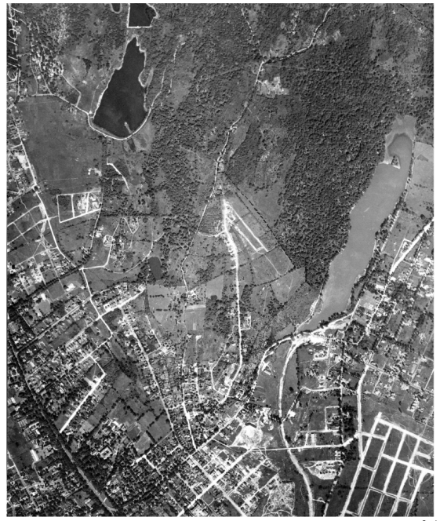
White Plains, 1925
Roads for future subdivisions are visible in lower right hand side of photo. You can also use the lakes to match up the two images.

Slide 17
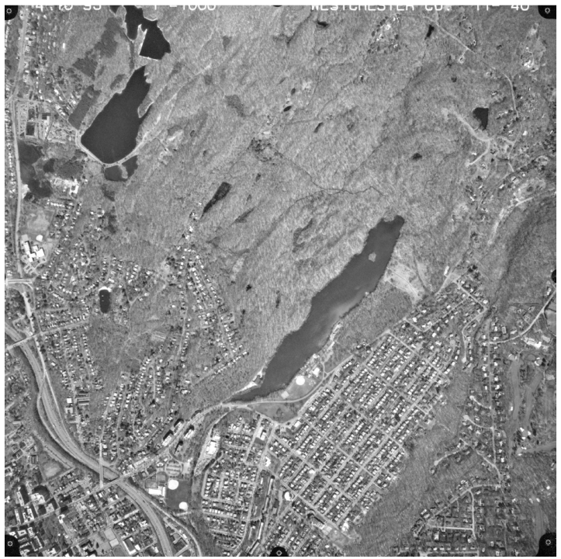
White Plains, 1995

Slide 18
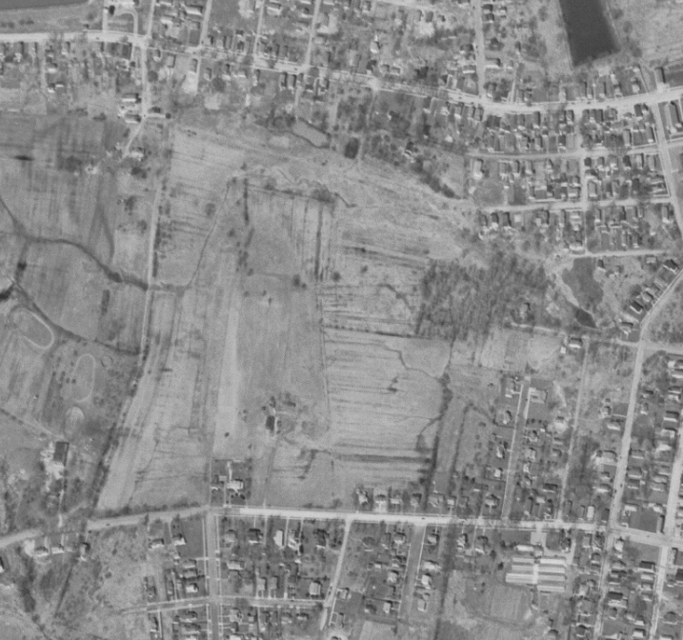
Cohoes High School, NY, 1952

Slide 19
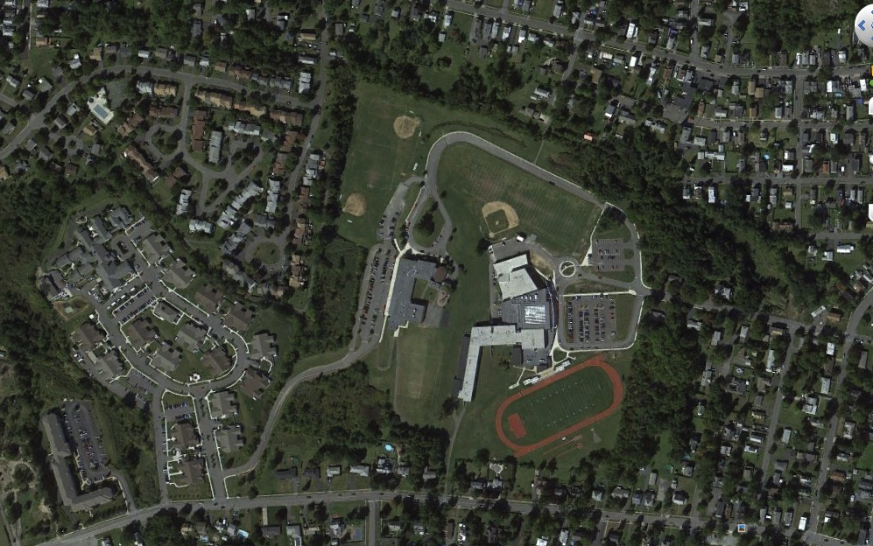
Cohoes High School, 2015

Slide 20
What did you observe?
Why might we want to increase or decrease each of these components on our land?
Topic | Increase? | Decrease?
Forests
Farms
Natural shoreline
Housing & roads
Notes:
--Discuss which land use components you saw increase or decrease in the aerial photos.
--Have students discuss in groups reasons they might have seen increases or decreases in these components when observing the aerial photos.

Slide 21
Population
Source: Swaney et.al 2006
Notes:
Dutchess County is circled, where population density increased ~10-fold over the last 200 years. This means that where there used to be 20 people living within one km² area, there are now 200 people living in that same area.

Slide 22
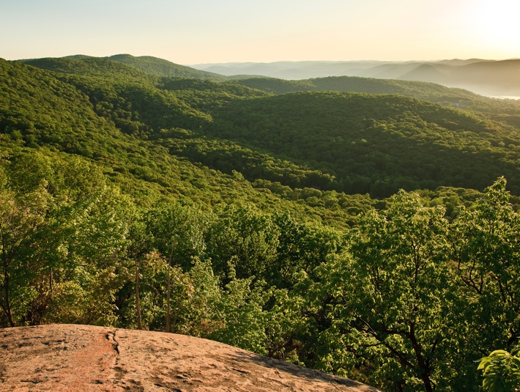
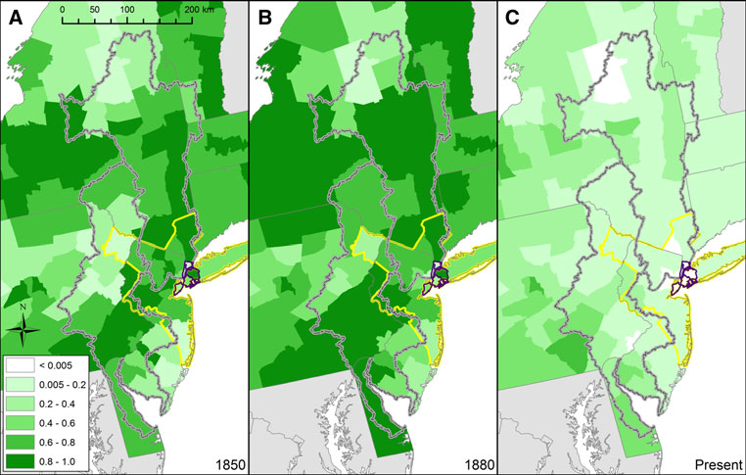
Proportion of land in farms and forest
Swaney et al. 2006
Swaney et al. 2012
Photo by Robert Rodriguez, Jr.
Notes:
Here we see the spatial distribution of farmland in our watershed (lower left image, upper right grey outline; lower left grey outline denotes Delaware watershed) & forest cover (upper right) through time.
Between 1850 (1st panel) and 1880 (2^{nd panel}) farmland was still increasing. But today (3rd panel), very little land is used for farming. Much of it has been replaced by young forests.
Image is reproduction of Figure 3 from:
Historical changes in the food and water supply systems of the New York City Metropolitan Area. Swaney, Dennis P.; Santoro, Renee L.; Howarth, Robert W.; et al. REGIONAL ENVIRONMENTAL CHANGE Volume: 12 Issue: 2 Special Issue: SI Pages: 363-380 DOI: 10.1007/s10113-011-0266-1 Published: JUN 2012

Slide 23
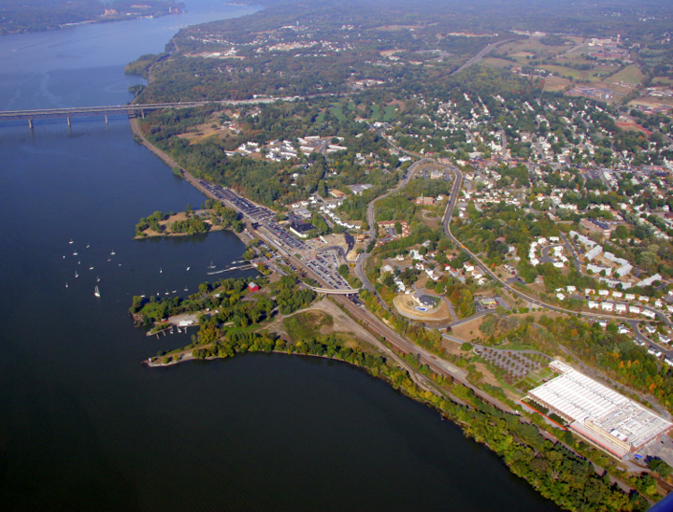
We all have land use goals
-shelter …..home sites
-food production ….farms
-economy, services …businesses, roads
-clean water ….wetlands, forests
-aesthetic beauty ….gardens, green space
-recreation ….rivers, lawn, hiking trails
-flood prevention ….dams, wetlands
-protect wildlife ….healthy natural areas
-climate mitigation ….forests
Photo by Jeff Anzevino
Notes:
We all use our land in lots of ways for many different purposes. Our land provides our shelter, food, water, business needs and recreation.
**Encourage students to remember that we ‘use’ even undeveloped land, such as forested areas: Forests cool our communities, sequester CO2 and therefore affect the global climate, filter & clean our water supplies, provide wildlife habitat, and mitigate floods by taking up a lot of water through transpiration.

